Slide 1
Going into business as a freelance journalist
David Mascord
davidmascord@gmail.com 07842 207337 Twitter: @DavidMascord
www.absolutewriting.co.uk

Slide 2

Is going freelance the right move for you?
Questions to consider:
Why am I freelancing?
Can I work without company structure?
Can I manage myself?
Am I customer-focused & reliable?
How am I at working on my own?
How do I cope with working for multiple commissioners?
Can I live with possibly irregular income?
Am I too much of a perfectionist?

Slide 3
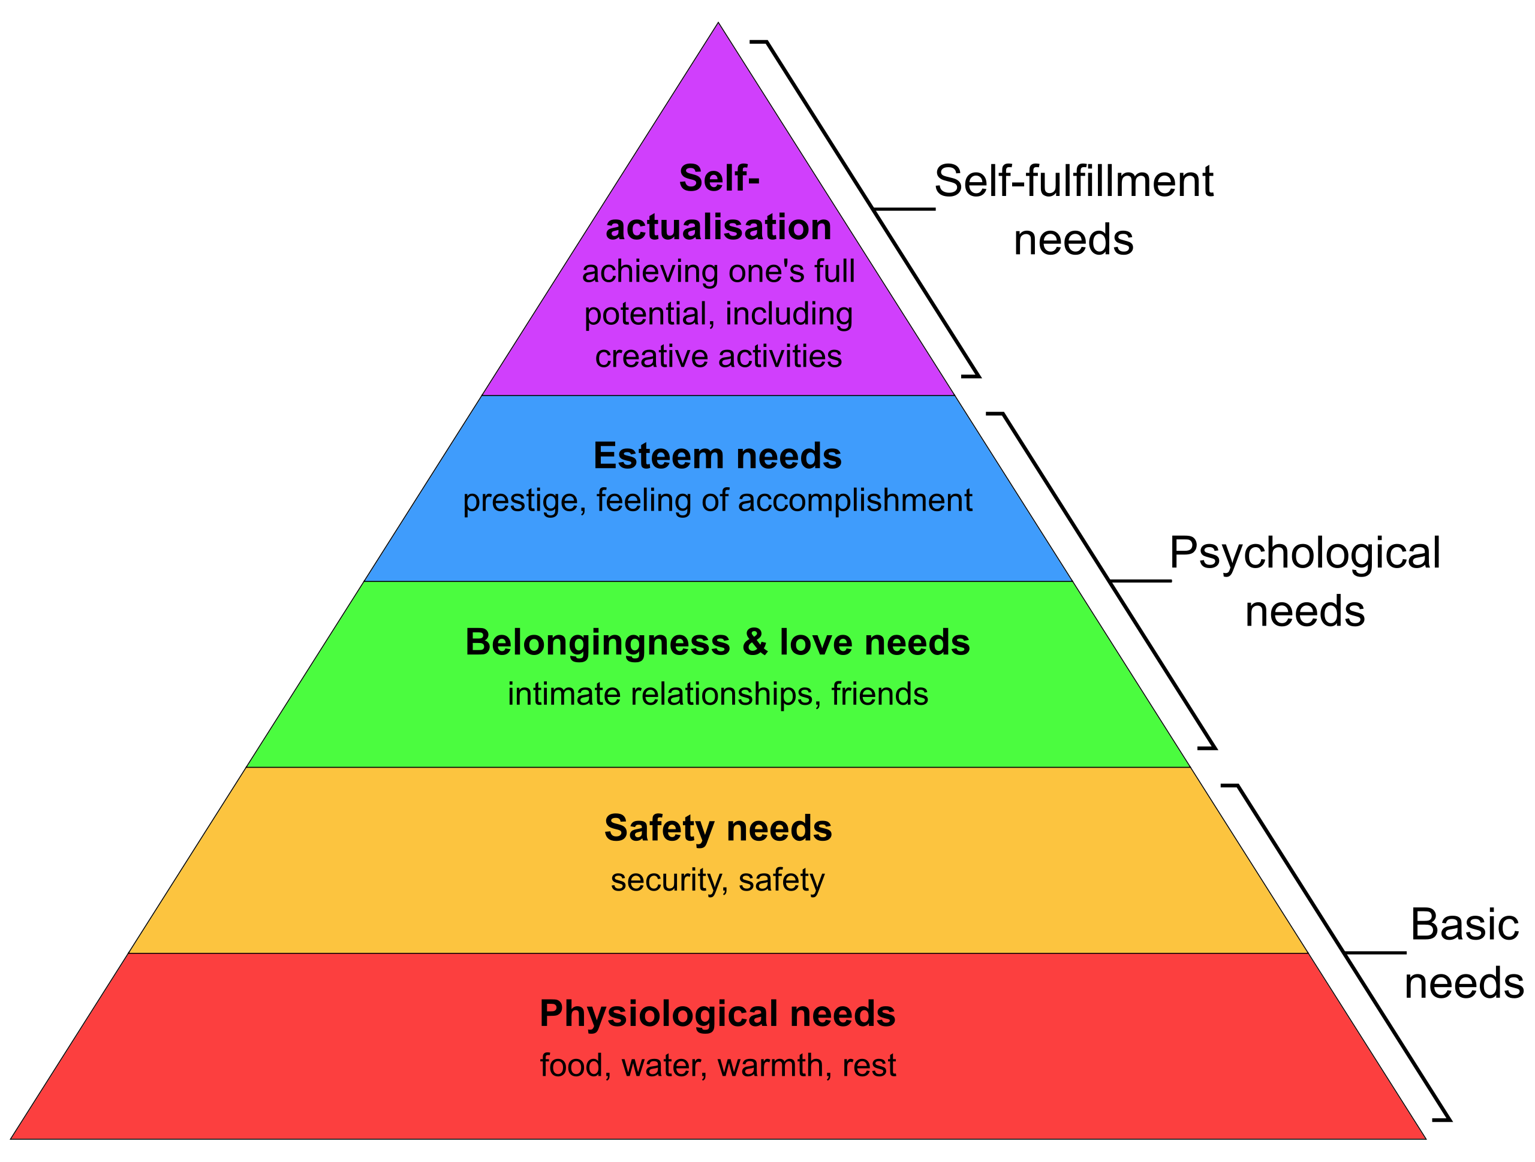
Maslow’s hierarchy of needs
You’re not selling articles you’re selling solutions to editors’ needs

Slide 4

Setting up your business
Sole trader
Simple book-keeping
Annual tax return
Keep simple expenses records
Ringfence potential tax money
Accountant = very useful
Limited company
More complex book-keeping
Annual tax return
Quarterly VAT return (if relevant)
Set up a business bank account for revenue & tax
Accountant = essential

Slide 5
Claiming business expenses
What can I claim?
Use of home as office
Phone, computer costs, etc
Travel/fuel and subsistence
Professional updating/development
Professional memberships & subscriptions
What can’t I claim?
Rent/mortgage
Clothing
All car costs
(unless company car – take advice)

Slide 6

Filling in tax forms
Declare all income and relevant costs
Submit on time (late penalty costs apply)
Get advice on what to include
Keep good records/files in case of tax investigation

Slide 7
Do I need to be VAT-registered?
If VAT-registered can claim back VAT on goods purchased for business
Must add VAT to all invoices issued; pay quarterly return
No need to be VAT-registered if main claims are for office, subsistence and travel
Can choose to be VAT-registered
MUST be VAT-registered if taxable turnover is over £85,000 https://www.gov.uk/vat-registration/when-to-register

Slide 8

What kinds of donations can I include in my tax return?
Sole trader:
Donations by individuals to a registered charity are tax free
Charity claims via Gift Aid
Limited company:
Can claim tax relief
Deduct value of donations to registered charity from your total business profits before you pay tax
https://www.gov.uk/donating-to-charity

Slide 9

Negotiating fees
Ask: What’s your usual rate?
Try negotiating a higher rate: you’re selling time, skills, expertise
Ask more for a rush job
Aim for annual fee increases
Independent guides:
NUJ freelance fees guide
Journo Resources
  https://www.journoresources.org.uk/freelance-rates/

Slide 10

Chasing up slow payers
Be very polite
Call commissioning editor to explain payment is late
Get to know the admin people - and the finance team, if there is one. Approach them if lengthy delay.
Further strategies:
Send an updated invoice with interest added
Last resort: Letter from solicitor

Slide 11

Deciding what to charge if no set fee
How much do you need to earn?
What are your outgoings?
Build in admin time & personal development time to fee
How big and important is the title you’re pitching to?
Other factors:
What fee do you feel comfortable with?
How much competition is there?

Slide 12
Getting more work
Networking
Expand target titles
‘Warm’ and ‘cold’ pitching
Write about what you’re doing
Media appearances
Low-fee work eg guest blogpost
Write for a media agency
Freelance journalism:
Diversifying:
Other types of content eg sciencepod/content-creators/
Speaking/chairing seminars
Books (& other passive income)
PR
Media training
Sub-contracting

Slide 13
How do you protect yourself from burnout?
Book time for yourself – and stick to it
If you have a quiet period, use some of it as downtime
Actively aim to improve your writing
Set some personal aims eg is there a ‘prestige’ title you would like to write for?

Slide 14
Summary
Be customer focused: Help editors meet their needs
Be perfect 95% of the time. Be on time 100% of the time
Ask ‘what’s your usual rate’, and prepare to negotiate
Always be networking and looking for opportunities
Keep an eye on financial issues
Think about how to diversify

