Slide 1
Perinatal Optimisation Pathway Passport
This passport must be completed for all women at risk of birth before 34 weeks’ gestation and should accompany the baby on admission to neonatal care.
Time of birth: _ _ : _ _
Type of birth:
Time of admission to NNU: _ _ : _ _
Gestation: /40
Birth weight: g
Apgars: @1 @5 @10
Booking Hospital:
Name:
DOB:
Hosp No:
NHS No:
Or patient sticker here
1. Place of Birth:
Aim: babies <27/40, EFW <800g or multiple pregnancy <28/40 should be born in maternity centre with a NICU
Born in a maternity centre with the appropriate designation of neonatal unit?
Y N N/A
If not, why was intrauterine transfer not achieved?
2. Antenatal Steroids:
Aim: women giving birth before 34 weeks should receive a full course of steroids no longer than 7 days prior to birth
Full course of antenatal steroids (2 doses 12-24hrs apart)?
Y N
Last dose: Date: / / Time: :
If a full course of optimally timed steroids was not achieved, why?
3. Antenatal Magnesium
Aim: women giving birth before 30 weeks should receive a loading dose and ideally a 4-hour infusion in the 24 hours prior to birth
Loading dose given? Y N N/A
Was a 4-hour infusion given within 24 hours prior to birth?
Y N
If optimally-timed Magnesium was not achieved, why?

Slide 2
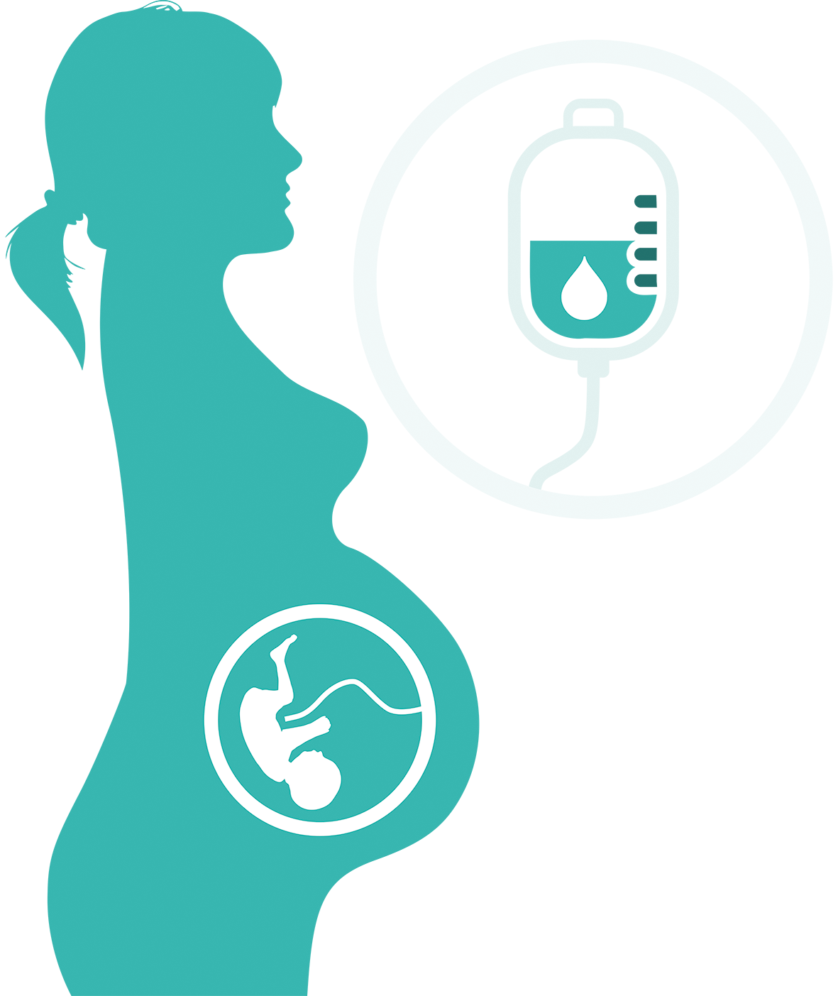
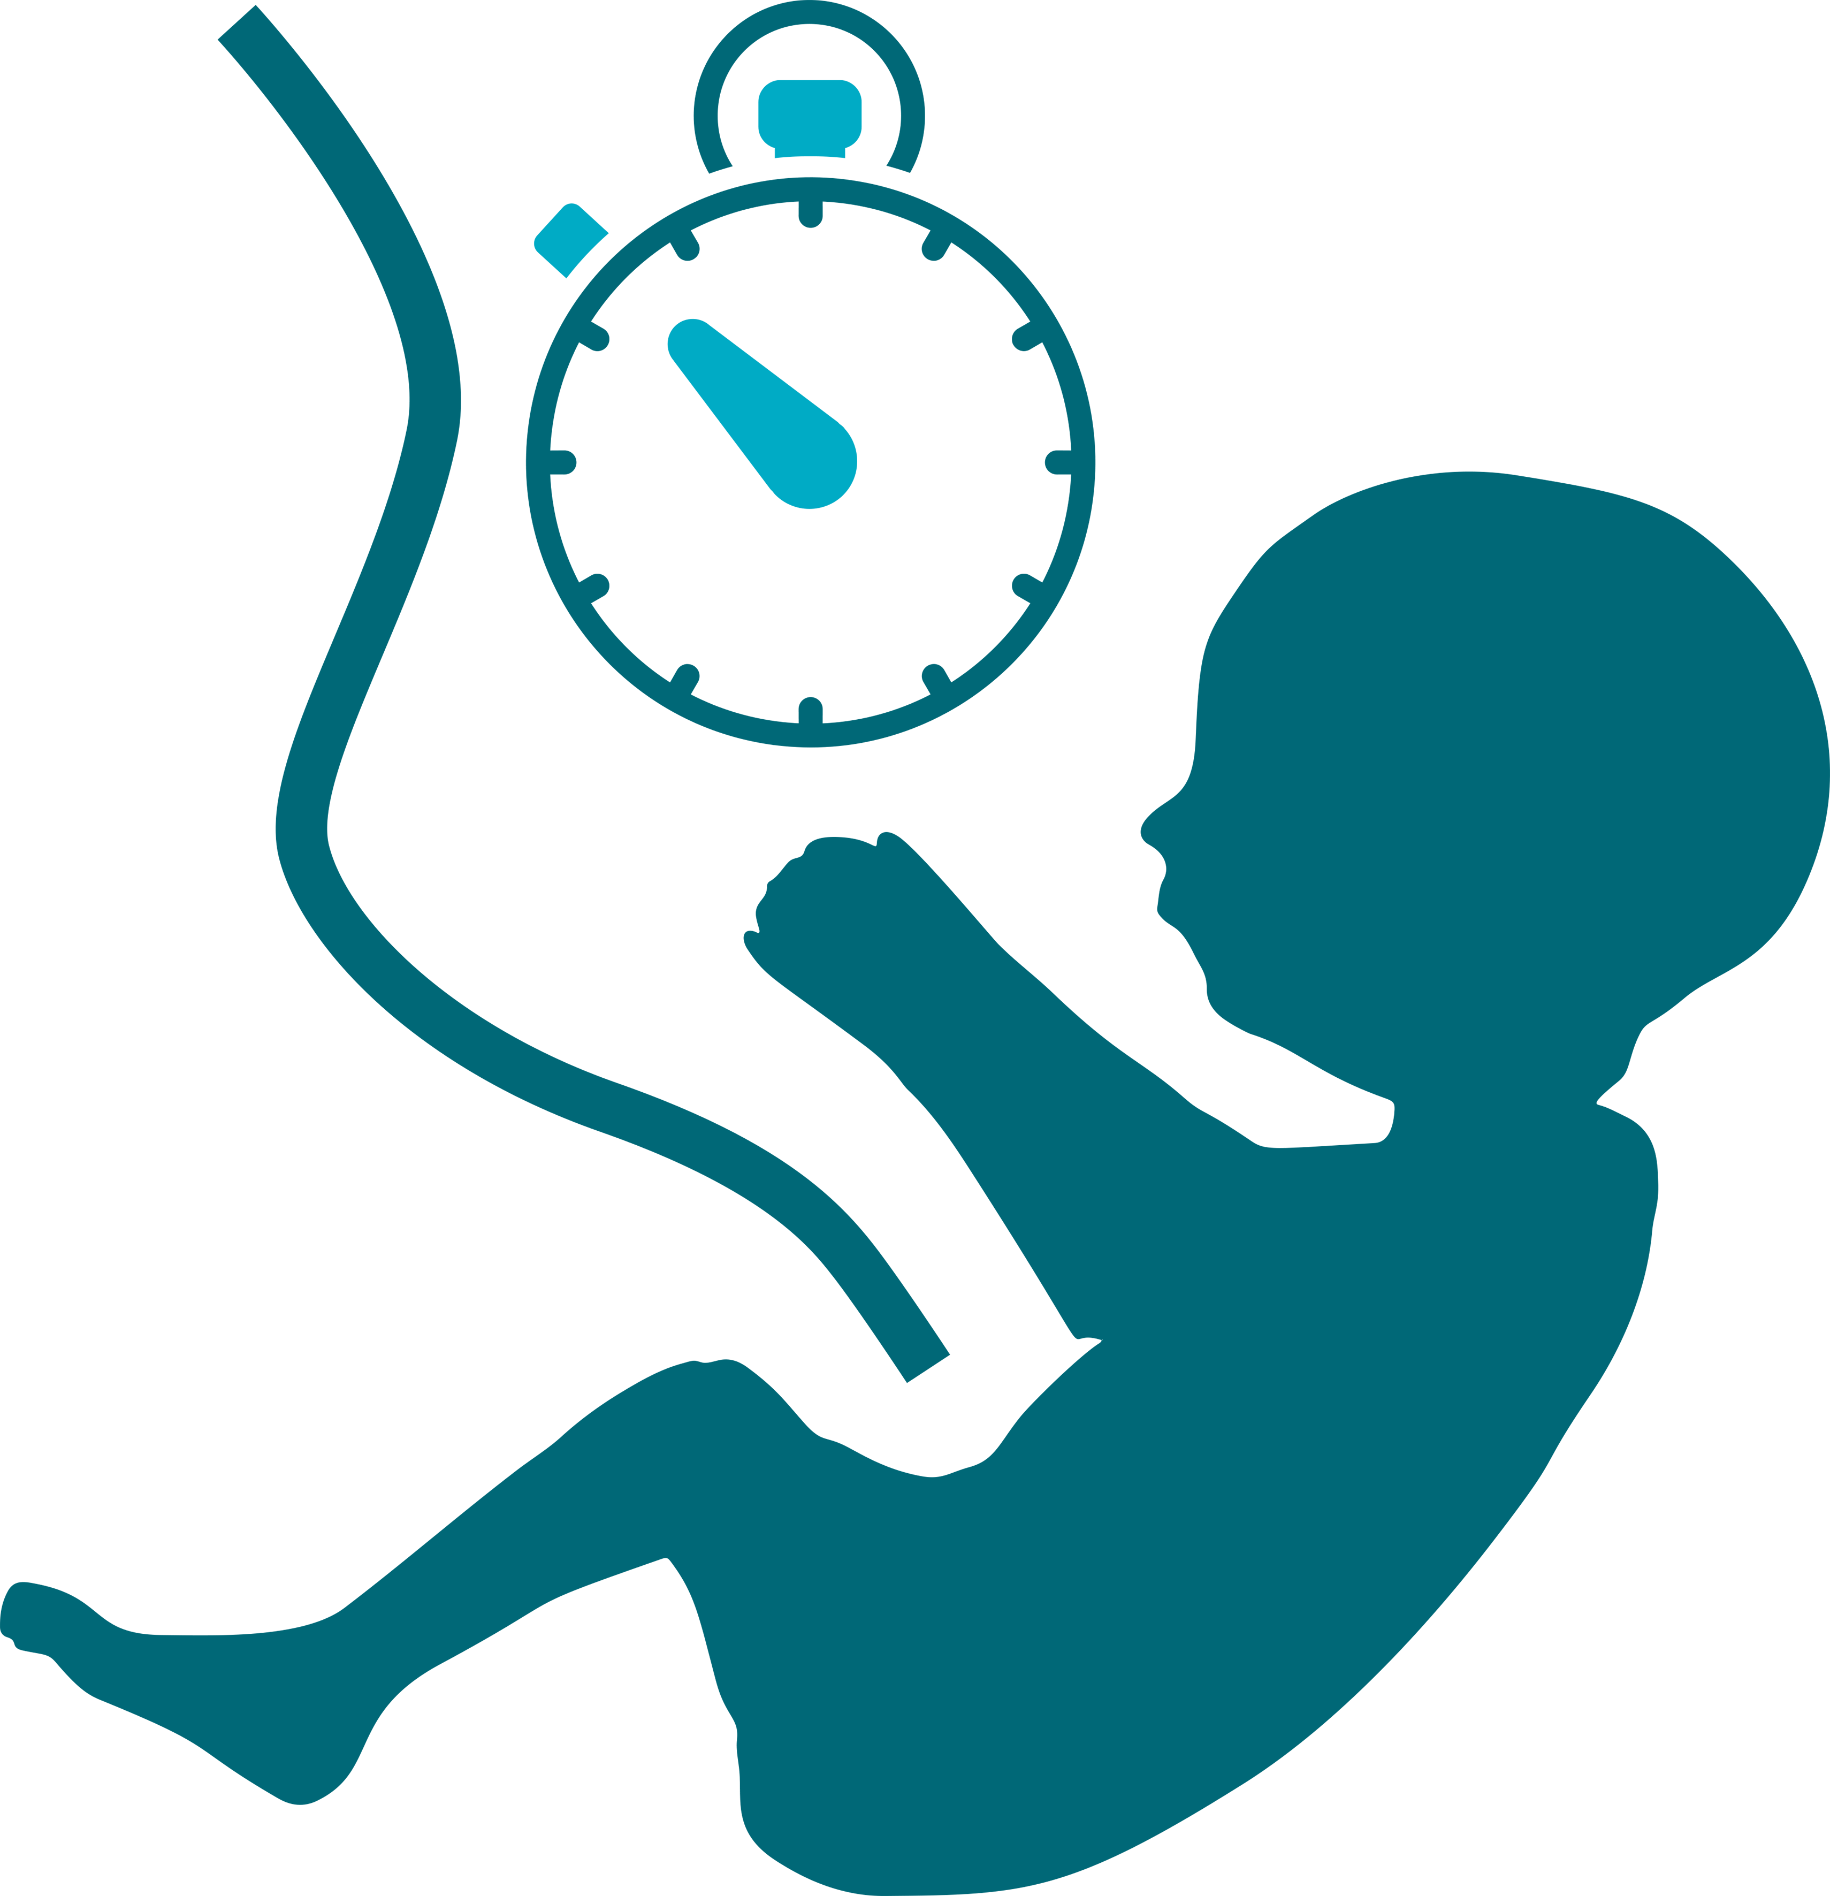
4. Antibiotic Prophylaxis
Aim: women in established preterm labour should receive intrapartum antibiotic prophylaxis to prevent early onset GBS infection
Required? Y N
Given more than 4hrs before birth? Y N N/A
If no antibiotic prophylaxis given or antibiotic given within 4h, why?
Antenatal counselling and advice for mother re benefits of MBM and early & frequent expressing?
Y N
Supplemental information given eg. Written / digital
Y N
If not given, why?
5a. Early Breast Milk (antenatal info)
Aim: women at risk of preterm birth should receive information about the importance of breast milk
6. Optimal Cord Management (OCM)
Aim: the umbilical cord should be clamped at or after one minute following birth
Was the umbilical cord clamped at or after one minute?
Y N
Time of OCM: _ _ minutes _ _ seconds
If no OCM, why?
7. Thermal Care
Aim: babies should have an admission temperature taken within one hour and this should be between 36.5-37.5C
Admission Temp between 36.5°C to 37.5°C ?
Y N
Admission Temp: °C
If normothermia was not achieved, why?

Slide 3
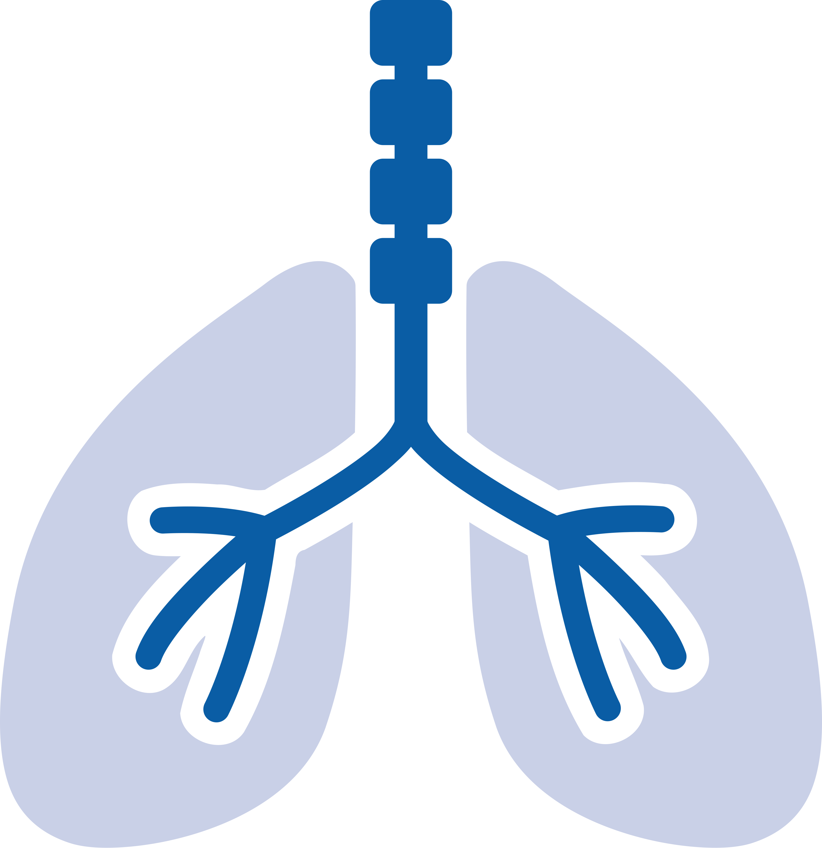
5b. Early Breast Milk
Aim: all mothers should be supported to express within 2 hours of birth
All babies should receive their own mother’s milk within 24 hours of birth and ideally within 6 hours
Mother helped to express within 2h of birth?
Y N
Date: / / Time: :
Colostrum first available: Date: / / Time: :
Colostrum given to baby: Date: / / Time: :
If not achieved within first 24h, why?
8. Respiratory
Management:
Aim: Where ventilation is required, Volume targeted ventilation (VTV) should be used as the initial mode of ventilation to reduce lung injury
Respiratory support required prior to neonatal unit admission (tick all that apply) CPAP HFT Ventilation Other
Was VTV/VG ventilation used as initial mode of ventilation if ventilated in first 72 hours? Y N N/A
If VTV/VG not used as initial mode of ventilation, why?
9. Caffeine:
Aim: To reduce brain injury and chronic lung disease and improve neurodevelopmental outcome. Give to babies <30 weeks/<1.5kg (consider up to 32-34 weeks) within 24 hours of birth
Given within first 24 hours of life
Y N N/A
Loading dose given at: Date: / / Time: :
If Caffeine is not given within 24 hours, why?
www.bapm.org/pop www.weahsn.net/periprem
This passport has been modified with kind permission from PERIPrem.

