Slide 1
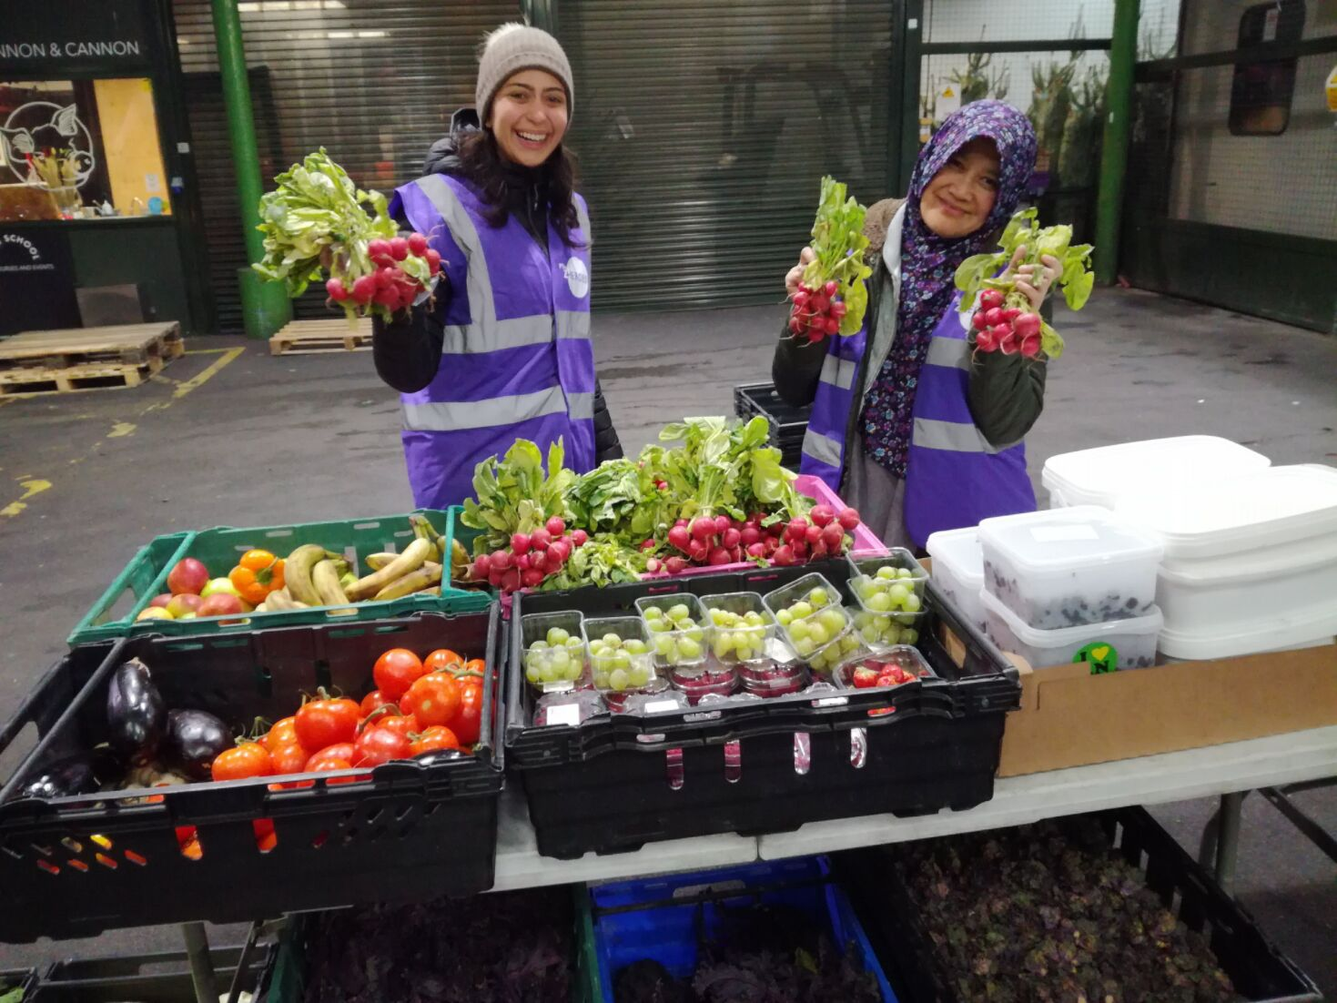
Business planning Moving forward on the right foot
Stephen Cahill
Regional Manager for Scotland
25 January 2024

Slide 2
Cranfield Trust
We’re an independent charity that works alongside other charities to offer management advice, training and professional support
Our purpose
To empower charities with the confidence and capabilities to thrive
Our values
We care and connect
We learn and lead
We focus on impact
We meet the moment
We raise the bar
Notes:
AMANDA
Introductions from CT
Our values
We care and connect
We lead with compassion. We nurture positive relationships by listening & building trust, & collaborate with empathy, understanding & support.
We learn and lead
We value & develop knowledge, skills, & experience to help build successful charities & we aim to be at the forefront of issues & trends facing the charity sector.
We focus on impact
We strive for excellence, focus on results & achieve success for our clients, volunteers & organisation, shaping a world that offers opportunities for everyone.
We meet the moment
We face the challenges of our times head on, being creative & agile to anticipate & adapt to the changing needs of our society.
We raise the bar
We take pride in the quality of our work, always striving to exceed expectations & raise standards, while engaging a diverse range of talent, skills & perspectives from the communities we serve.

Slide 3
Why do business planning?
Question – Do you really need a business plan?

Slide 4
Why do business planning?
It is a reference point for your mission
Important stakeholder/funder communication - @70% of charities struggle to make effective use of their business plan
Yardstick to assess performance against – make sense of the world

Slide 5
The world we live in – complicated!
What do you think has changed? ( at least as affects business planning)?
My answers
Volatility & Risk–uncertainty/ ‘the lack of answers’ – e.g. pandemic!
Structural changes – economic and social shifts – demand for services
People – How they view the world and interact with it
Balance between the ‘long view’ and being responsive

Slide 6
5 Pitfalls in business planning
How does business planning fail?

Slide 7
Pitfall No 1 in business planning
Planning by the ‘rear view mirror’ method
Unpack this
Is a recital of the past – ‘historical narrative’
Has little to say about the future – assumptions rooted in past
‘Fossilises ‘ activity in the charity – crushes innovation
Risk – creates divergence between board( drivers) and frontline (passengers)

Slide 8
Pitfall No 2 in business planning
The ‘rootless’ business plan
Unpack this
Not ‘anchored’ – ignores important stakeholder input
Only meaningful to the author/s
Peter’s out when everyone realises it is unachievable
Risk – It alienates stakeholders – nobody can buy into it

Slide 9
Pitfall No 3 in business planning
The ‘Tolstoy’ business plan - The biggest most detailed plan in the universe…EVER!
Unpack this
Stifling detail
Is redundant by the time it is written
Is a grind to write and maintain
Risk - It is brittle…and people soon cotton on to this…

Slide 10
Pitfall No 4 in business planning
The ‘doughnut’ plan
Unpack this
Ephemeral/ a wish list couched in superlatives
Confuses end points/outcomes/mission statement with goals
Impossible to evaluate – How would you know you have achieved it?
Risk – Nobody can get traction on it - It attracts little real effort ..and payoff

Slide 11
Pitfall No 5 in business planning
The ‘absent plan’.There isn’t one!
Unpack this
Progress determined by ‘the fates’ - Success( or failure) is a gamble
Lack of awareness as to why a business plan matters
No reference points to assess ‘enablers’ or ‘disablers’
Risk – Shortcut to ‘disaster faster’

Slide 12
The pillars of new business planning
A business plan should be….
A statement of ‘Investability’ – attracts investment (£’s and hearts)
Future oriented – Is about a future state
Founded on a diverse constituency – built in ‘reality check’
Brief – focus is on hard goals (The ‘vital few’ not ‘trivial many’)
Resonant – staff and stakeholders can relate to it
Comprehensive – tells a story – has key elements
Quick to prepare and change – ‘enabler’ rather than ‘lock in’

Slide 13
Doing business planning – deep dive
Strategic analysis - A brief diagnosis of the ‘outside world’
‘Grounded reality - Risks, opportunities, demand’
Your strategic response to this world reality
No more than 3 or 4 BIG goals – ‘moving the world on’– with targets and measures
Attainability exercise /An educated likelihood of success
Finance plan
The money/resources required to deliver the big goals & business as usual
Stakeholder management plan
Who you need to engage with to deliver the big goals
People plan
What people and skills you need – ‘make or buy’ decisions
What about an operations plan? Save this until later…..

Slide 14
Title here
Bullet points here
And more
More here
And here
Here too
Last one

Slide 15
Four good questions - Insider secret No1
Who do you REALLY create value for?
Obvious Vs unobvious stakeholders
What will the world bring us in the next 12 months?
demand/opportunities/risks
How will we service it/mitigate it?
What goals to achieve
What shape do we need to be in to service it?
your configuration/ resources/ organisational health

Slide 16
Planning in practice - strategic analysis
Grounded reality – why diversity matters
Cross section of your organisation/key stakeholders/Give voice to your beneficiaries
Make sure EVERYONE involved sees the same data
Marshal data and responses around these key questions:
What demand is likely in the next 12 months ( where from, how is it likely to come)
What opportunities are likely to present themselves in the next 12 months
What risks may present themselves over the next 12 months
Group and rank responses – you will see priority areas emerging

Slide 17
Strategic analysis - example
Our biggest funder is pulling the plug - £85,000
Another pandemic/outbreak could be around the corner
Our project in X is killing us financially!
20% more clients will need our services
40% of our clients have more complex needs – require more time
Emergent goals
Risks
Demand
Opportunities
Three competing charities in area are struggling
Our lease is up in three months
New contracts mean being asked to extend range of services
We have a whole raft of stakeholders we aren’t engaging with!

Slide 18
Planning in practice - strategic response
Focus on moving the world on
No more than 3 or 4 BIG goals linked clearly to strategic analysis
Goals have targets and measures
You can
Do more of something
Do less/exit doing something
Do something different
Use the same cross section of stakeholders to formulate goals
Have an initial validation of your goals – are they attainable? Anything hiding in the shadows? ( risks, money, assumptions)
Revisit and refine until you are happy

Slide 19
Strategic response – example
Increase our beneficiary base in three more cities in Scotland by 2025
Partner with two similar charities in our field by 2026
Exit our partnerships with A N Other Ltd by 2024
Bid for three known contracts by 2025
Increase our donations base by £25,000 by 2024
Relocate our centre to better, smaller premises by 2026
Deploy 50% of staff and volunteers remotely by 2027
Develop three new services for the family of beneficiaries by 2026

Slide 20
Attainability of goals - Insider secret No2
Goals need to generate activity
Leading not lagging
Assess the attainability of goals
Most plans never do!
Your front line/cross section of staff
Your best validation
ALWAYS ‘de-risk’ your goals
‘Do-ability’ check assumptions and rate their likelihood of success

Slide 21
Planning in practice - Finance plan
Three areas of focus:
Keeping the lights on – Business as usual
The standstill cost – “ If we do nothing different – what is the cost of standing still”?
Your backstop numbers – “If it all goes pear shaped”
Costing the goals ( forecasting)
Projected savings, outgoings/investments, projected income
SHOW your risk- make it explicit ( internally)
Under capitalisation, exposure to default, income risks, legal risk

Slide 22
Finance plan – example
1 Standstill costs
Our current payroll/fees are £125,000 pa
Our premises cost £15,000 pa
Our current contractual commitments cost us £65,000 pa to service
2 Costing the goals
Recruiting three more staff for our service expansion will cost £90,000
Winning the bid for services with XYZ will generate £75,000 net profit
Relocating our premises will cost us £12,000 but save us £4,000 pa recurring
3 Risks
Another lockdown means our social enterprise will close – Risk is £10,000 pa
Loss of funding for our project in Aytoun will cost us £65,000 pa
If 2 members of staff leave it will cost us £45,000 pa replacement else, we cannot service existing contracts
Always ‘follow the pounds’ – what you are committed to Vs what you bring in

Slide 23
Planning in practice- stakeholder management
Know your stakeholders– Who do you deliver value to? ( Inc. staff!)
Tailor messages to particular stakeholder – “ Investability”
The emotive message – the heartstrings
The rational message – the purse strings
Tie up your stakeholder management with finances
Avoid a ‘scatter gun’ approach
Ubiquitous messages/‘Bread on the water’
Obscure messages - ‘in group’ only
Hollow messages – “ no meat in the sandwich’
Messages must be USEFUL to the recipient – must answer a need

Slide 24
Stakeholder management – example
Messages make money – focus on value
Fit the tool to the stakeholder – and learn how to use it
The emotive message – ‘Emotional investment’
Social media/Websites/direct approaches ( mail, email, press, letters, face to face)
“ What we have done, how you have helped and your part in the future”
The logical message – Practical investment/ The ‘value’ message
Bid material/collateral/lobbying/campaigning
“ This issue is costing X – for Y we can reduce the cost of this issue”
A little and often – regularity is crucial

Slide 25
Planning in practice - people plan
Cover off business as usual and the big goals
Can you service your current operations?
Risks/dependencies
Can you service future demand, opportunities, risks?
Skills, amount of people, deployment of people
Walk-out costs and replacement costs
Right people – right place – right time – fit for purpose
Operational staff
Your board
Make or buy decision
Get the finished product or
Develop your own people - training

Slide 26
Planning in practice - operations plan
Execution of the goals and ‘business as usual’
Is a decomposition of goals
Goals become targets become means become targets and so on
It needs an owner
One person
Report on it – regularly
Board and ‘Town hall’ meetings
Act on feedback
Tune your plan
Give everyone an action in support of goals
Get the goals right and the plan writes itself – Don’t let the tail wag the dog!

Slide 27
Operations plan – example
Goal 1 -Bid for three known contracts by 2025
Appoint bid leader/project manager
Engage with procurement team releasing bid
Qualify bid
Prepare bid materials
Draft bid template
Draft costs for bid
Brief bid team for any competitive dialogue
If win – assemble and brief deployment/transition team

Slide 28
Operations plan – what I expect to see in it
Decomposition of goals – From the general to the specific
What is needed to make progress to goals & service existing demand
People element
Bridging existing and future needs for skills
Finance element
Costing and tracking of goals and business as usual
Process element
Keeping the lights on/Business as usual
Risk management and upward feedback mechanism
Alignment between goals and business as usual
Reality check – “If everyone is too busy to work on the goals….”
Revision and feedback

Slide 29
The plan – what you show to the world
Remember the idea of ‘investability’?
A foreword from your chair/CEO – “ How we are moving forward”
Your strategic analysis – “ Our making sense of the world”
Your strategic response – “ Our informed response to the world”
Your goals – with targets and measures and a sense of attainability/de-risking
Your health as an organisation – brief summary
financial health
resources
human capabilities/operational capability and capacity
governance
And little more!

Slide 30
The wrap up – moving forward
Know your value – who you are valuable to - ‘Investability’
A plan must generate action
A good plan – faces the future – “ The will of the organisation”
Diversity, diversity, diversity – “engagement = strength”
Flexibility - Revision time scale – 18-24 months at the moment
Keep it proportionate – “The vital few”
Start small - practice makes perfect

Slide 31
Crib sheet – A flying start
Assemble a cross slice of the charity/stakeholders
Must include front line and someone who knows ‘the numbers’
Pose these 2 questions
Who do we REALLY create value for? Obvious Vs unobvious stakeholders
What will the world bring us in the next 12 months? (demand/opportunities/risks)
Formulate 3 or 4 big goals (or just pick ONE if you are starting)
What actions must we take to service future demand and opportunities and mitigate risks?
What shape do we need to be in to service it? (your configuration and resources)
Validate/rejig these goals
Affordability and attainability –use forecasting and ‘informed speculation’ You need the numbers!
Deploy and communicate your goals
Plan for comms with internal and external stakeholders
Track progress and revisit/revalidate goals

Slide 32
Some useful links
https://www.cranfieldtrust.org/resources/charity-strategy-and-business-planning
https://www.ncvo.org.uk/help-and-guidance/strategy-and-impact/strategy-and-business-planning/business-planning/-

Slide 33
Thank you!
We’re here to help:
TalkToUs@cranfieldtrust.org
or call us on 01794 830338

