Slide 1
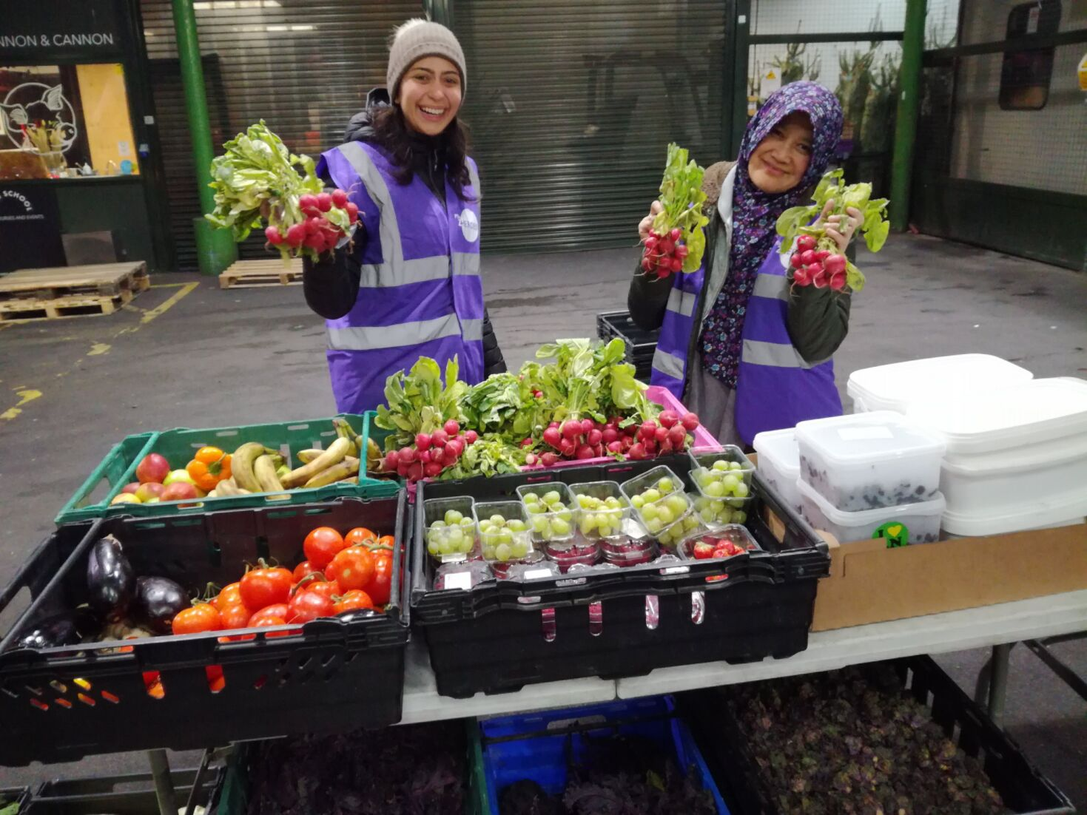
What is governance And why does it matter?
Stephen Cahill
Regional Manager for Scotland
1 February 2024

Slide 2
Cranfield Trust
We’re an independent charity that works alongside other charities to offer management advice, training and professional support
Our purpose
To empower charities with the confidence and capabilities to thrive
Our values
We care and connect
We learn and lead
We focus on impact
We meet the moment
We raise the bar
Notes:
AMANDA
Introductions from CT
Our values
We care and connect
We lead with compassion. We nurture positive relationships by listening & building trust, & collaborate with empathy, understanding & support.
We learn and lead
We value & develop knowledge, skills, & experience to help build successful charities & we aim to be at the forefront of issues & trends facing the charity sector.
We focus on impact
We strive for excellence, focus on results & achieve success for our clients, volunteers & organisation, shaping a world that offers opportunities for everyone.
We meet the moment
We face the challenges of our times head on, being creative & agile to anticipate & adapt to the changing needs of our society.
We raise the bar
We take pride in the quality of our work, always striving to exceed expectations & raise standards, while engaging a diverse range of talent, skills & perspectives from the communities we serve.

Slide 3
This is a webinar where you can see and hear the presenters but we can’t see or hear you.
There will be time at the end of the webinar for questions. Please post them in the Questions section.
We will send out recording, slides, and any other useful information after the event

Slide 4
Setting the scene What I am going to cover today
What is ‘Governance’ – A working definition
Why does it matter ( and to whom) - The $64000 question!
What GOOD governance looks like in a charity
Where to spot “The good, the bad and the ugly!” - Some brief case studies
How to create good governance in your charity - some immediate ‘takeaways’ to use
Wrap up – How well do you think your charity is governed? (Scores on the doors!)

Slide 5
What is Governance?
What do you define as governance?
Hints:
Where would I look for governance in your charity?
What would you show me/tell me?

Slide 6
Working definition of governance
‘A proportionate framework of people, policies and processes that keep your charity on track’
i.e. delivering value to its beneficiaries.
Unpacking this definition
People – Roles/duties (and separation of duties)
Policies – core principles (e.g. checks and balances, moral principles)
Processes – Ways of doing things ( legal obligations and how you do business)
Proportionality – Scaled to the size of your charity

Slide 7
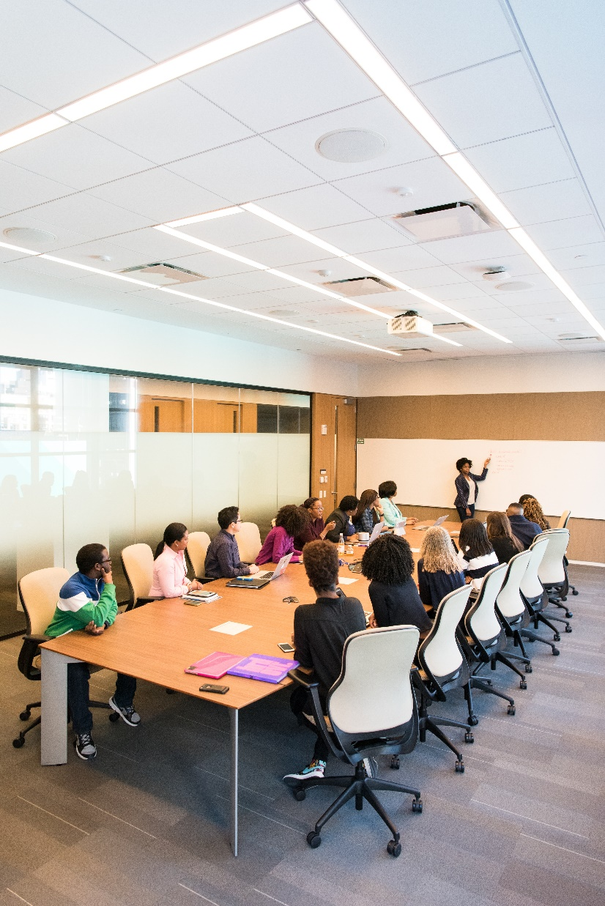
Why does governance matter?
Why does it matter?
Hint – Could you live/operate without it?

Slide 8
Why governance matters
Obligations
Natural/Moral/ethical obligation – You are doing what you are supposed to be doing
Civil/Legal obligation – Demonstration that your charity fulfils its obligations to donors and beneficiaries – as required by law
Funding
Assurance/Validation for funders/donors
Quality of governance = reflection of ‘quality of management’ of funds and purpose – What I call “ Investability”…

Slide 9
Governance as a funding ‘hot topic’
Stephen’s financial ‘crystal ball’
The “£’s pond” is shrinking and there are more fish in it!
The ‘irrational’ will be rationalised or, eliminated
Major funding landscape might be changing– from grants to social enterprise ( from ‘pay off’ towards ‘pay back’)
State centralisation Vs potential ambivalence towards 3rd sector - greater surveillance from state ( e.g. procurement rules) of 3rd sector engagement
Altruism/philanthropy won’t die – It will change and become more conditional
Changing/increasing demand will require greater agility in terms of getting funding – proactive and reactive

Slide 10
Governance model for charities Look for all five PLUS focus
Leadership (leading the charity, its strategy and separation between strategy and operations)
Accountability (Legal, Civil, and moral accountability)
Leadership & strategy
Problem solving
Transparency
Challenge
Accountability
Governance framework
Problem solving (Building board capability and strength)
Challenge (Robustness of decision making and affordance of differences)
Transparency (Mechanisms to increase openness and avoid conflict of interest)

Slide 11
Creating good governance in your charity
Immediate checkpoints
Board composition – WHO is on your board, why - what do they bring?
Skills, involvement, capacity, capability, size of your board
Board meetings – How often and what do you discuss/actions
Frequency, ‘tone’, subject matter, actions coming out of them
Leadership & strategy
Doesn’t need to be Gung Ho BUT, is there a strategy, a plan, sense of coherence? Does it resonate with your donors – would they see it?
Processes – HOW is business transacted in your charity - especially reporting
What people , do what things and why – and how do you know? Following the £’s/key decisions is usually a good start point
People
Is there some sort of ‘glue’ between everyone in the charity
Power!
Who has ‘voice’ in decision making and why? Compelling leadership Vs Dictatorship Vs poor followership. How is challenge and conflict handled?

Slide 12
Board composition
My observation – a No. 1 recurrent weakness!
Historical reasons – ‘friends of the founders’/been there for ages/”dated contribution”
Lack of understanding WHY you need a capable board – ‘making up the numbers’
The big hitters – Belief that having a big hitter on the board =success
The ‘field of eligible Vs field of available’ – It is difficult to find decent board candidates!
Remedies
Aim for balance on your board – experience, questioning ability, insights
Think about whose ‘voice’ needs to be heard on the board
Augment permanent seats with visitors if you are struggling
Build in rotation - keep it fresh

Slide 13
Board meetings
My observation – Too often ill structured and miss the point
Muddle up strategic Vs operational issues
Focus on the wrong/inappropriate topics – wrong level/wrong tone
Become a black hole of effort( 100 point agenda) …or, worse, have no agenda!
Remedies
Think WHY you are meeting as a board – what NEEDS to be aired at that level? Purpose Vs appearance
Keep your agenda living – focus moves over time( e.g. risk, opportunity)
Keep the ‘tone’ at the right level – STRATEGIC not operational
Look at the balance between internal and external matters discussed

Slide 14
Processes
My observations – vacillate between ‘a process for everything’ and ‘none at all
Historical reasons – never needed them
Over egging it – ‘world of processes’ - something for every situation
Failure to grasp why board level processes and reporting are necessary
Unable to marry the necessary processes to board and corporate functioning
Remedies
Revisit WHAT reporting/processes you need– think about what you are trying to manage – e.g. risk, transparency, accountability, performance
Look for gaps in your board processes/reporting based on WHAT comes up at the board meetings or what is missed - dynamic check on sufficiency
Scale these processes to be proportionate to your charity – sufficient and no more ( You don’t need 10 committees when 3 will do)

Slide 15
People
My observations – Board either too deeply embedded or too remote
Staff/people in the charity have a disconnect from the board – board focus too close or too far
No obvious linkage between board action and HOW this affects staff/donors/beneficiaries
Its tends to be a ‘growing pains ‘symptom – becomes bigger problem as you grow
Remedies
Focus on the ‘big stuff’ at the board – governance not minutiae
Look for connects between board action and donor/staff action – NOT to say ‘tell all’ but, have SOME form of communication between board action and the rest of the world!

Slide 16
Power
My observation – A minefield BUT, even minefields have maps
Power can be inequitably shared on boards
Where problematic – it is ALWAYS a symptom of other issues ( board composition, board meetings, people issues etc)
Failure to tackle this is a significant risk - lack of challenge/ideas/accountability
Remedies
Not an easy one to solve –revisit board composition and leadership/strategy
Tackle it using external facilitation /board development…..how to handle challenge
Be mindful of it – It doesn’t go away on its own

Slide 17
Summary - What good looks like
A board that has skills, insights and currency – Reflects strategic challenges facing charity. Has diversity in all its forms!
Board meetings – right “tone”, split between strategy and operations, balanced agenda, ‘living agenda’
The ‘Pillars’ of data/information to support the board agenda/drive discussion and decision making – e.g. risk management, financials, transparency
A ‘golden thread’ between board operations and the donors, staff and beneficiaries
A board ‘in development’ – growing in strength, sense of coherence, shared accountability – a ‘board in ascent ( not decline!)

Slide 18
The wrap up - checklist
Board composition – people, people…people
Board function! - Tie up income/strategy/risk/decisions/action/effect – Need a ‘golden thread’ going through these things
Be proportionate – Enough and no more!
Don’t be afraid to look at others and see what they are doing …and why. Peer to peer review/outside help
Don’t ignore governance!

Slide 19
Some useful links
www.cranfieldtrust.org LOADS of helpful info on governance
The governance jigsaw for trustees -https://assets.publishing.service.gov.uk/media/5a80ddf940f0b62305b8d98d/Jigsaw.pdf

Slide 20
Thank you!
We’re here to help:
TalkToUs@cranfieldtrust.org
or call us on 01794 830338

