Slide 1
Impact of US policy shifts on the global health ecosystem
CoP Health
03 April 2026

Slide 2
The US: the world's largest global health funder
$12.4B
US Global Health Funding in 2024
Stable at $10B+ since 2014 (excl. COVID surge)
 | 42% of all donor government global health assistance
 | 1 in 3 US development dollars go to global health
 | 80 Partner countries across 6 regions
 | 60% of bilateral aid to just 10 African countries
PORTFOLIO PRIORITIES
HIV/AIDS (ca.50%)
Tuberculosis
Family planning & reproductive health
Malaria
Maternal & child health
Global Health Security
Source: Just the Numbers: The Impact of US International Family Planning Assistance, 2024 | Guttmacher Institute

Slide 3
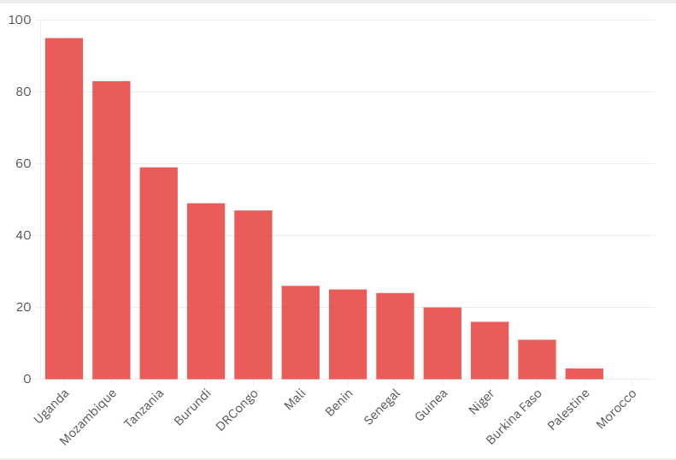
US health aid: a significant part of national health budgets
For 6 Belgium’s partner countries, the US ODA represents more than half of total bilateral health ODA. These are Burkina Faso (52%), Mali (54%), DRC (61%), Mozambique (76%), Tanzania (79%) and Uganda (83%)
All these countries (except Palestine & Morocco) have a high or moderate debt distress status
US health ODA as % of of Government Health Expenditures
2022-2023 average
Source: Health ODA Recipients - CGD Analysis.xlsx & 26 Countries Are Most Vulnerable to US Global Health Aid Cuts.
Notes:
Pas la proportion des financements US dans budgets santé nationaux mais représentativité par rapport à ces budgets

Slide 4





After turbulence, global health financing stabilizes at $9.4 billion (2026)
JAN 2025
MAY 2025
FEB 2026
AID FREEZE
CUTS REQUESTED
BUDGET ADOPTED
Dismantling of USAID
Presidential budget asks for 60% reduction
Budget & priorities largely unchanged
JAN 2025
SEP 2025
WIITHDRAWAL WHO
NEW POLICY
Official request to leave the organization (effective 2026)
Publication of the America First Global Health Strategy
Source: Just the Numbers: The Impact of US International Family Planning Assistance, 2024 | Guttmacher Institute
Notes:
Priorities unchanged: HIV/AIDS (~50% of total), maternal & child health, malaria, Global Health Security, reproductive health, TB

Slide 5



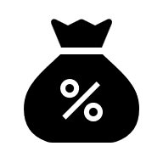
America First Global Health Strategy: a paradigm shift
Health cooperation is explicitly subordinated to geopolitical & commercial interests (e.g. Pillar 2: Leveraging Global Health leadership to compete with China)
New policy basis for the US Global Health financing
Strong focus on outbreak surveillance and response to make the US safer
Global Health as a lever for US healthcare industry
MAIN PARTNERS FOR DELIVERY
Governments Bilateral agreements to be signed by April 2026 with co-funding targets
Private sector Support American companies and innovations to expand in LMICs
Faith-based organizations Preferred implementing partner
Source: America First Global Health Strategy - United States Department of State; Protecting global health in the era of the America First Strategy - The Lancet Global Health

Slide 6
Despite the new strategy, some multilateral financing remains
US contributions to Global Health initiatives & organizations in 2026
UNFPA
Funding maintained ($32m) with conditions:
Funds to be maintained in a separate account
Amount of funds spent on programme in China to be deducted from the US conttribution ("dollar-for-dollar witholding")
UNFPA does not fund abortions
UNICEF
Funding cancelled ($142m in 2025)
WHO
Formal withdrawal in Jan 2026
Organization | Contribution (2026, million USD)
Global Fund | 1250
Gavi | 300
UNAIDS | 45
UNFPA | 32
Global TB Drug Facility | 14
Source: Just the Numbers: The Impact of US International Family Planning Assistance, 2024 | Guttmacher Institute
Notes:
Key message: malgré annonces, les USA maintiennent des budgets pour le système des NU, y compris sur SRHR et vaccins. Rôle du congrès et absence de coherence.

Slide 7
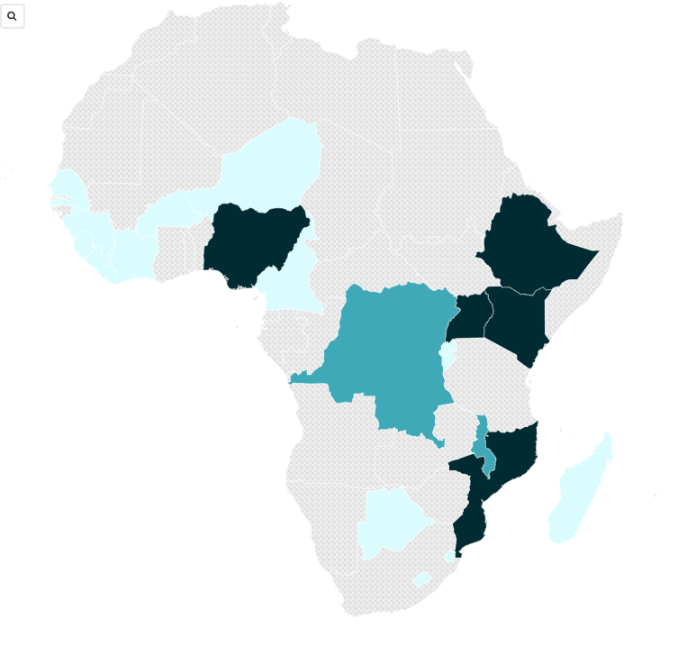
Over 20 global health MoUs signed with African countries
US Global Health Bilateral MoUs (2026-2030)
As of 13th March 2026
As of 13th March, 26 MoUs (G2G) have been signed of which:
21 with African countries
5 with Caribbean countries
Most are not publicly available
Activities are set to begin by 1st April 2026
Implementation plans due within 90 days of MoU signature
Contracts to run until 2030
Concerns about:
Conditionalities – MoUs tied to commercial agreements (especially around mining)
Data sharing provisions and sovereignty
US contribution
$0-500 million
$500-1000 million
$1 billion +
Source: KFF Tracker: America First MOU Bilateral Global Health Agreements | KFF
Notes:
USG health compacts are G2G MoUs; EGGR application likely case-by-case.
Fiscal/operational separation may protect SRHR; without it, risk of restrictive interpretation and distancing from partners

Slide 8
MoU signing process among partner countries
Country | HIV/AIDS | Tubercolosis | Malaria | Polio | Maternal & Child Health | Global Health Security
Burkina Faso | Y | N | Y | N | Y | Y
Burundi | Y | N | Y | N | N | Y
Democratic Republic of Congo | Y | Y | Y | N | Y | Y
Guinea | Y | N | Y | Y | Y | Y
Mozambique | Y | Y | Y | Y | Y | Y
Niger | N | N | Y | Y | Y | Y
Senegal | Y | N | Y | N | N | Y
Uganda | Y | Y | Y | Y | Y | Y
Narrow focus on select infectious diseases
→ Underinvestment in broader SRHR and weaker capacity of public health systems?
No support to MCH in Burundi & Senegal & HIV/AID in Niger: a risk for SRHR financing?
For other countries: is US funding an opportunity or potential Trojan horse?
Current exclusions/suspensions from the MoU process
South Africa and Tanzania
Zimbabwe withdrew from negotiations Zambia reconsidering its signature ($1b)
Kenya's deal is suspended
Source: KFF Tracker: America First MOU Bilateral Global Health Agreements | KFF ; Zambia ; South Africa; Tanzania; Zimbabwe; Kenya; Zambia2
Notes:
Norrow focus on on select number of infectious diseases may lead to underinvestment in broader SRHR services like family planning, mental health and NCDs and also HSS which could weaken the overall capacity of the public health system.
Current exclusions/suspensions from the MoU process
South Africa and Tanzania for political & commercial reasons
Zimbabwe withdrew from negotiations ($367m)
Zambia is reconsidering its signature ($1b) as it is contingent on a mining deal
Kenya's deal is suspended, pending a legal case

Slide 9
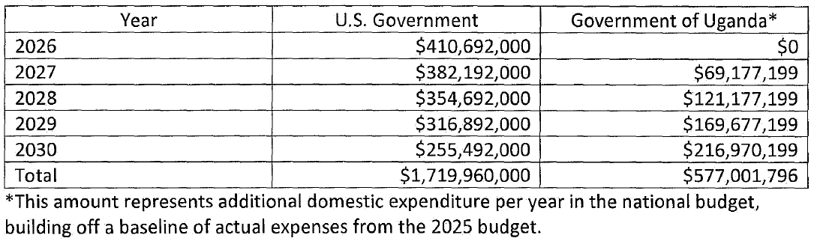
Ambitious funding targets: U.S. phase-down and rapid domestic scale-up
Planned financial support by the US and Ugandan government
(2026-2030)
The publicly available MoUs include detailed co-financing plans
The co-funding share is expected to come from the government and not from other donors or multilateral organizations
More detailed information is available here – including the links to the MoUs with Kenya, Liberia, Mozambique, Rwanda and Uganda.

Slide 10
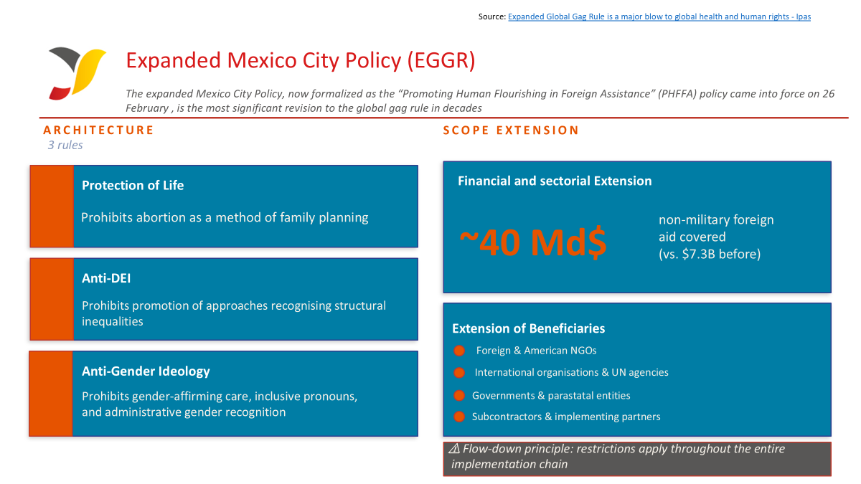
After turbulence, global health financing stabilizes at $9.4 billion (2026)
JAN 2025
MAY 2025
FEB 2026
AID FREEZE
CUTS REQUESTED
BUDGET ADOPTED
Dismantling of USAID
Presidential budget asks for 60% reduction
Budget & priorities largely unchanged
JAN 2025
SEP 2025
WIITHDRAWAL WHO
NEW POLICY
Official request to leave the organization (effective 2026)
Publication of the America First Global Health Strategy
Source: Just the Numbers: The Impact of US International Family Planning Assistance, 2024 | Guttmacher Institute
Notes:
The policy known as Promoting Human Flourishing in Foreign Assistance (PHFFA) came into effect on February 26, 2025. It represents the most substantial revision of the Global Gag Rule (GGR) since its introduction under the Reagan administration. While every Republican president has reinstated this rule since then, the current version fundamentally transforms its nature, scope, and objectives.
The PHFFA policy is based on three rules :
First, Protecting Life in Foreign Assistance — this prohibits abortion as a method of family planning, which was already part of the Global Gag Rule until now.
And then two new rules:
Combating Discriminatory Equity Ideology — this prohibits recipients from promoting, practicing, or advocating DEI approaches. The new rules also ban the promotion of what the administration calls “discriminatory equity ideology,” meaning any approach that recognizes the existence of structural inequalities between groups and seeks to address them. In practice, this could include programs aimed at improving access to healthcare for marginalized populations, inclusive hiring policies, training on discrimination, or even collecting data to identify inequalities in access to services. "This ideology, referred to in this rule as discriminatory equity ideology, treats individuals as members of preferred or disfavored groups, rather than as individuals, and minimizes agency, merit, and capability in favor of generalizations."
Third, Combating Gender Ideology — this prohibits any support to LGBTQI+ individuals, not only gender-affirming medical care, but also legal protections, psychological support, the use of inclusive pronouns, and participation in school or sports activities according to one’s gender identity, and defines sex as a binary biological classification. "Gender ideology is an ideology that replaces the biological category of sex with an ever-shifting concept of self-assessed gender identity, permitting the false claim that males can identify as and thus become females and vice versa, and requiring all institutions of society to regard this false claim as true. Gender ideology includes the idea that there is a vast spectrum of genders that are disconnected from one's sex."
In its previous versions, the GGR applied to global health assistance, representing about 7.3 billion dollars. The current version expands its scope to cover all non-military foreign aid administered by the State Department—an estimated total of nearly 40 billion dollars. In very concrete terms, this expansion now includes sectors as diverse as humanitarian aid, education, access to water and sanitation, economic development, and democratic governance.
And whereas the rule historically targeted foreign NGOs working in the field of reproductive health, it now applies to a much broader range of actors:
foreign and U.S.-based NGOs;
international organizations, including UN agencies;
foreign governments and parastatal entities;
subcontractors and implementing partners.
And so, a key mechanism of this policy is what’s known as “flow-down” — the requirement to pass these restrictions along the entire implementation chain. Any organization that receives U.S. funding indirectly must also comply with the rules.
-----
DEI policy prohibits the promotion of “discriminatory” equity and gender ideology:
“an ideology that treats individuals as members of preferred or disfavored groups, rather than as individuals, and minimizes agency, merit, and capability in favor of generalizations.”
Rules in foreign assistance: prohibits recipients from promoting DEI-related policies and activities, from providing or promoting gender affirming care, legal protections based on gender identity, sexual education teaching materials.
Adhering to such conditions is a threat to reproductive rights, health systems, gender equality and human rights.

Slide 11


Thank you for your attention!

