Slide 1
HealthProm’s approach to Safeguarding
1 December 2021
Tanya Buynovskaya, Director of Operations
HealthProm

Slide 2
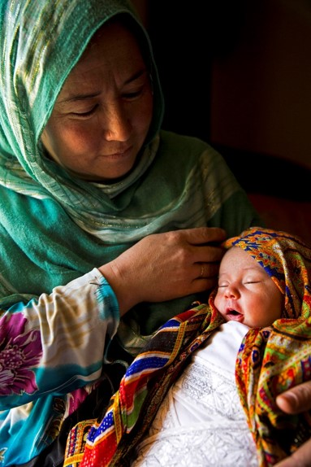
About HeathProm
HealthProm is a UK based charity supporting vulnerable children, women, and families disadvantaged by poor health, disability, and social exclusion.
We work in Eastern Europe, Central Asia and Afghanistan and with migrant communities from the region in the UK.
We work in partnership with local organisations, governments and communities to develop better local support services for children, women and families.

Slide 3
Where we work
Current projects in
Belarus
Tajikistan
Afghanistan
United Kingdom
Georgia
Recently Completed
Moldova
Russia
Ukraine

Slide 4
HealthProm’s approach to safeguarding
Recognising and responding to children and vulnerable adults in need of protection
Safer Care and Development built into all our projects and wellbeing practices with beneficiaries. We do this through providing training and support for local partners
Clear organisational policies and arrangements

Slide 5
Recognising and responding
The purpose of our child protection and vulnerable adults policies is to:
1) recognise when a child or vulnerable adult is in need of protection from violence, abuse and neglect.
2) provide a procedure for recording and reporting to protection authorities.
Local partners must have their own policies that connect with local procedures!

Slide 6
What does this mean for HealthProm?
A foundation of moral and ethical values, both personal and organisational that are compatible with HealthProm’s mission (separate Ethics Policy and Code of Conduct );
A specific role of Safeguarding Officer
A range of experienced health and social care professionals who can develop and implement safe child/family care and development programmes with local partners;
A good set of policies containing pathways for action;
All trustees, members of staff, consultants and volunteers are aware of and signed up to policies and procedures;
All trustees, members of staff, consultants and volunteers are police-checked;
Downstream due diligence with local partners;
Compliance with funders’ requirements.

Slide 7
What we do to ensure our safeguarding principles:
Review policies annually;
Conduct annual safeguarding refresher training;
All trustees, staff members, consultants and volunteers to sign up to safeguarding policies;
All trustees, staff members, consultants and volunteers to have up to date (renewed at least every 3 years) DBS checks at appropriate level.
Have a Safeguarding Officer

Slide 8
HealthProm’s safeguarding policies
Child protection policy
Vulnerable adult policy
Towards a child safe organisation;
Evaluating risks;
Recruitment;
Management and training;
Working with partner organisations;
Reporting process;
Communication guidelines;
Recognising abuse;
Report forms.
Commitment to safeguard;
Vulnerable adult rights;
Whom the policy covers;
Recruitment;
Management and training;
Working with partner organisations;
Reporting process;
Record keeping and confidentiality;
Disciplinary procedures;
Types of abuse;
Report forms.

Slide 9
HealthProm’s safeguarding policies
Ethics and Code of Conduct
Whistleblowing
Culture of openness and trust;
Compliance with laws;
Fair treatment;
Zero tolerance to fraud, bribery and bullying;
Sets out our values;
And how to report.
Duty to report wrongdoing at work;
No victimisation of reporter;
Links to disciplinary code;
Independent advocate will be appointed to support whistleblower;
3-stage procedure set out.

Slide 10
Transparency and accountability:
Our policies are posted on our web-site;
We regularly report to our donors ;
We report to our Board of Trustees;
All policies are available in our office/system.

Slide 11
THANK YOU
tanya@healthprom
www.healthprom.org
facebook.com/HealthProm · twitter: @healthprom
Registered charity number: 1100459

