Slide 1

Ralph Vaughan Williams
Schemes of work for EYFS, KS1 and KS2
Dr Rebecca Berkley
Associate Professor in Music Education Institute of Education, University of Reading
r.m.berkley@reading.ac.uk
@UniRdg_UV

Slide 2
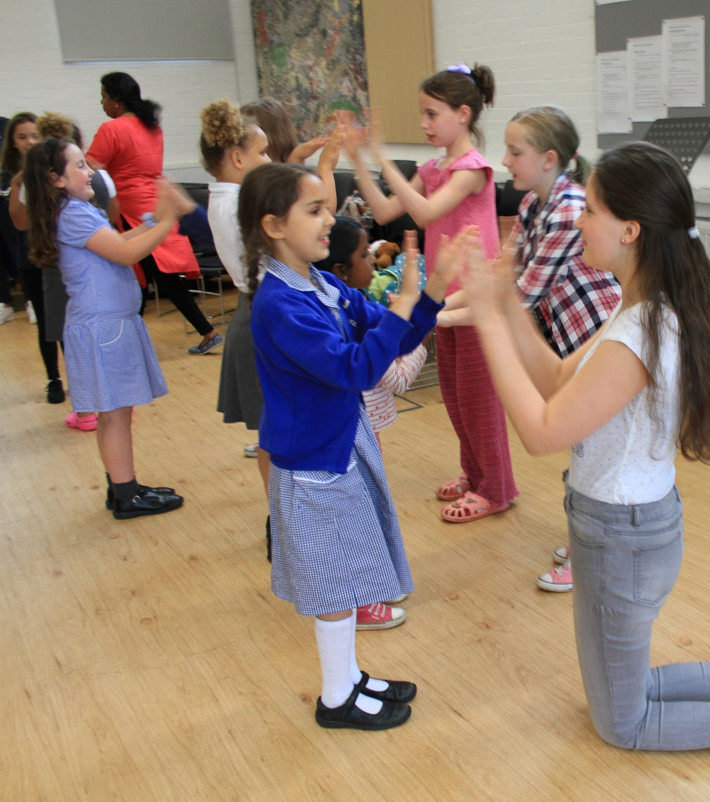
Today we will
Explore the schemes of schemes of work for EYFS, KS1 and KS2 created by the Music Teachers’ Association as part of the Vaughan Williams Foundations’ #RVW150 celebrations
Early Years Foundation Stage – Overture: The Wasps
Key stage 1 – Sinfonia Antartica
Key Stage 2 – Fantasia on a theme of Thomas Tallis
View the resource at https://www.musicteachers.org/rvw150/
Musicianship games with Universal Voices

Slide 3
 | England National Curriculum | Scotland Curriculum for Excellence | Curriculum for Wales | Northern Ireland
10-11 | KS2: Year 6 | Second level: Primary 6 | Year 6 | Year 7
9-10 | KS2: Year 5 | Second level: Primary 5 | Year 5 | Year 6
8-9 | KS2: Year 4 | Second level: Primary 4 | Year 4 | Year 5
7-8 | KS2: Year 3 | First level: Primary 3 | Year 3 | Year 4
6-7 | KS1: Year 2 | First level: Primary 2 | Year 2 | Year 3
5-6 | KS1: Year 1 | First level: Primary 1 | Year 1 | Year 2
4-5 | EYFS: Reception | Early level | Reception | Year 1
3-4 | Nursery / EYFS | Nursery / Early level | Nursery / Pre-school | Pre-school

Slide 4
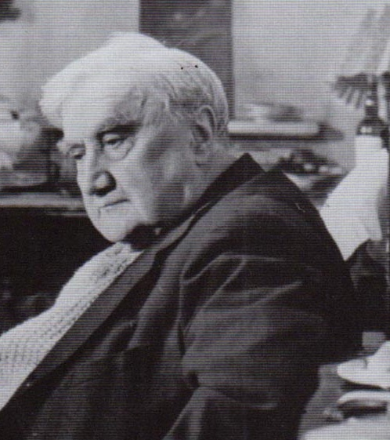
Ralph Vaughan Williams (1872 – 1958)
Ralph Vaughan Williams Society
BBC Radio 3: Discovering the music of RVW

Slide 5
Innocent ears
Innocent ears – a wide range of responses
No one *right* answer - Let the children explore how the music makes them feel so they can determine what the music inspires them to do in their own creative responses.
A child’s verbal response to music requires them to identify, discriminate and analyse in spoken language what they are hearing and their non-verbal responses to the music.
‘Articulate and justify answers, arguments and opinions; and give well-structured descriptions, explanations and narratives for different purposes, including for expressing feelings’ (English National Curriculum: Statutory guidance for spoken language).
Musical concept pairs focus on the quality of the sound and help children to analyse the effect of combinations of sounds in the musical texture.

Slide 6

Early Years Foundation Stage
Imelda Shirley
Overture: The Wasps (1909)

Slide 7
EYFS Scheme of Work
Ralph Vaughan Williams
Overture – The Wasps
Click here to watch on YouTube

Slide 8
Early Years Foundation Stage
Sitting in the garden
Wispy wasp
Little bird
Green Frog
Caterpillar

Slide 9
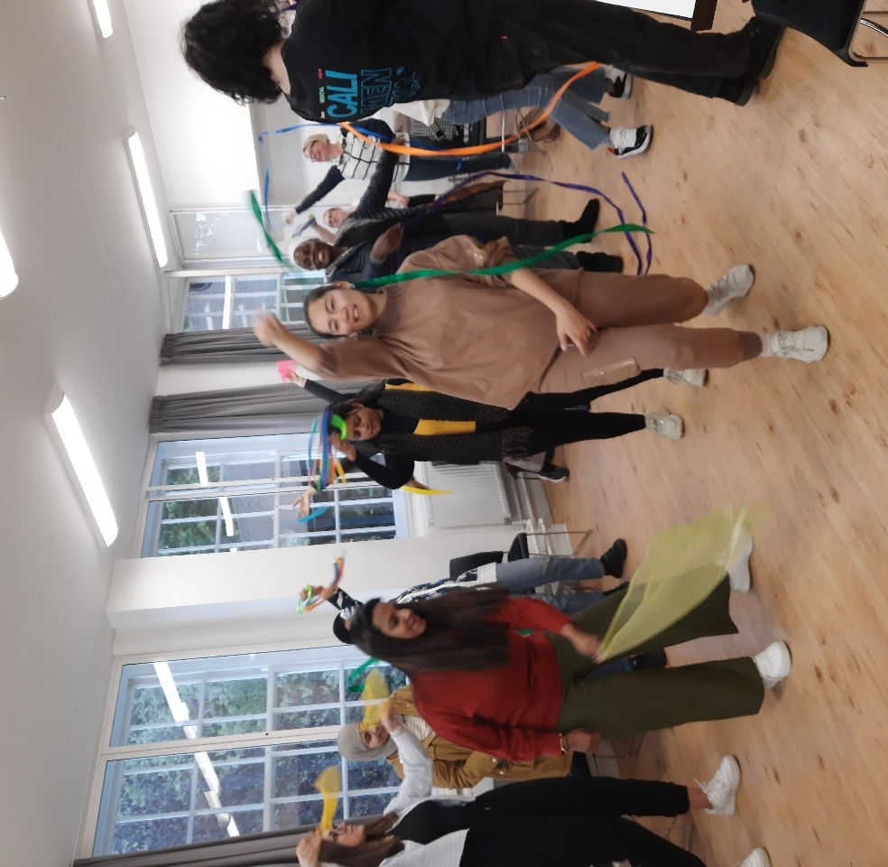
Key Stage 1
A six week creative listening unit for children in KS1 based on the Sinfonia Antartica by Ralph Vaughan Williams.
Children will explore a range of creative responses to the music through analytical talking, creative composing, movement and dance, drawing and mark making, and exploration of sounds on classroom percussion to help them understand the narratives and moods in the music.
Links to PE, Art, Geography and Science
MA Education students explore creative responses to music

Slide 10
Sinfonia Antartica
Sessions | Focus | Music focus
1 and 2 | How does music make us feel? Moving to music | Extract 1 0.00 – 2.20, opening to 5 bars after figure 5
3 and 4 | Exploring sounds on instruments: Creating soundscapes with classroom instruments | Extract 2 2.21 – 3.02, Lento (3 bars before figure 6) and poco piu mosso (13 bars after figure 8)
5 and 6 | Art in music: Making artworks in response to music | Extract 3 4.13 – 5.37, Poco animato (5 bars before figure 9) – Meno mosso (figure 12)
Timings are taken from the recording on https://rvwsociety.com/symphonies/

Slide 11

Move it! Listen to this music and draw how it sounds

Slide 12




Art in music
Listen to this music and make some art that looks like the music sounds
Try out dots, shading, lines and colours
‘I think the music sounds cold and twinkly so I have make these dots in the picture like snowflakes.’
Extract 3 - Movement 1 4.13 – 5.37, Poco animato (5 bars before figure 9) – Meno mosso (figure 12)
This Photo by Unknown Author is licensed under CC BY

Slide 13
Concept pairs
stop start
smooth spiky
loud soft
big sound small sound
up down
wood metal
near far
short long
dark light

Slide 14
Sentence strings
I can hear …… in the music
This part of the music sounds louder (or softer, faster, slower, happier, more mysterious etc.) than the other part because….
This music sounds like …. because I can hear….
I think the music is telling the story of… because I can hear…..
Questioning script for analytical listening
Is there a place in the music where we hear a loud sound? (or a soft sound, or a far away sound, or a mysterious sound etc.)
Where is the place we can hear the loud sound?
What happens in the music to make that loud sound?

Slide 15
Art in music – next lesson
The children will work together to make four mini pictures which will portray what the music sounds like in extract 3.
Mixed media resources to make a collage - stickers, glitter, paper, fabric cut outs, paints and crayons, found objects, paper cutouts.
Description | Timing | Score reference
Flying snowflakes and cold icy air | 4.12 | Poco animato, 5 bars before figure 9
Dark, cold waves rising and falling | 4.37 | Piu Mosso, 6 bars before figure 10
Flying higher and higher | 4.59 | 4 bars after figure 10
Fanfare of stars and snow | 5.07 | Meno Mosso, 4 bars after figure 11

Slide 16
How does music make us feel?
Moving to music - Children will respond to the music with free and co-ordinated movement with the body, and with manipulatives like scarves and ribbons to ‘perform dances using simple movement patterns’ (KS1 PE National Curriculum Attainment Target).
Mark making and artistic responses – creative responses to musical sound through art materials
Embodied learning – showing musical thinking through movement
Non verbal, haptic learning and doing in music
Using manipulatives to show children’s thinking
Describing music using concept pairs
Supporting analytical talking with sentence strings and a questioning script

Slide 17
Active listening
Teaching children to listen with concentration and understanding
Active listening – combining listening with other activities to focus children on creative, non-verbal responses to music
Using movement response to good effect in dance and art
Teaching focused listening
  Play classroom listening games to help children focus
  Check your audio equipment works
  Remove other distractions
  Do not talk over the music or allow children to talk
  Repeated listening of short extracts (30-90 seconds) - Play three times with minimal gap between each playing
  Allow children to complete their non-verbal response before moving to talking about this

Slide 18
Musical words
Musical activity words | listen, explore, share, respond, sing play, move, and stop
Identifying particular sounds | name groups of instruments heard, e.g. brass instruments, percussion, strings; and individual instruments, e.g. trombone, glockenspiel, solo violin
Dynamics | loud, soft, getting louder, getting softer
Musical expression words | angry, scary, cold, icy, gentle, smooth, soft, even, shiny, twinkling, detached, distant, spiky, crash, bang(ing) smooth, soft, even, shiny, twinkling, detached, soaring, flying, swirling, misty and so on
Musical style words | fanfare, dancing, procession

Slide 19
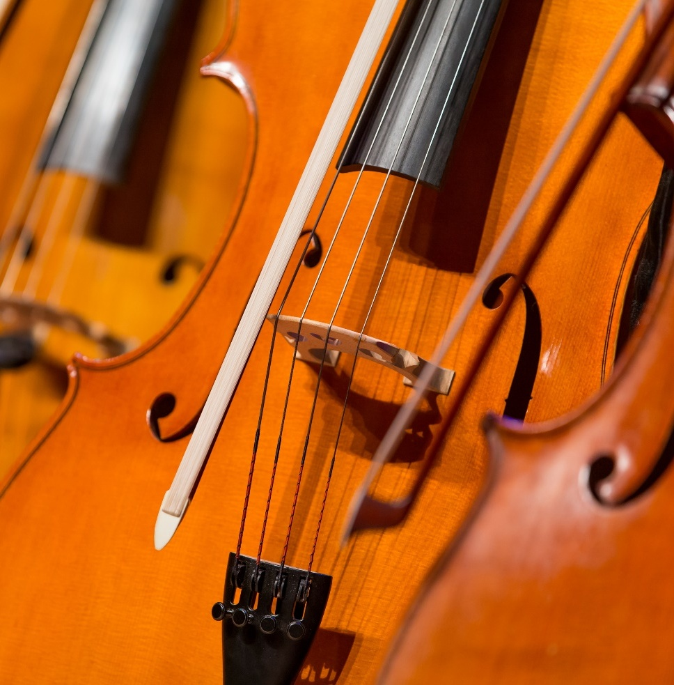
Key Stage 2
Karen Marshall
Overture: Fantasia on a Theme of Thomas Tallis

Slide 20
Ralph Vaughan Williams
Key Stage 1 Scheme of Work
Karen Marshall
Click here to watch on YouTube

Slide 21

Plenary
Three things you have learned
Two things you have found interesting
One question you have remaining

Slide 22
Ralph Vaughan Williams
Schemes of work for EYFS, KS1 and KS2
Dr Rebecca Berkley
Associate Professor in Music Education Institute of Education, University of Reading
r.m.berkley@reading.ac.uk
@UniRdg_UV

