Slide 1
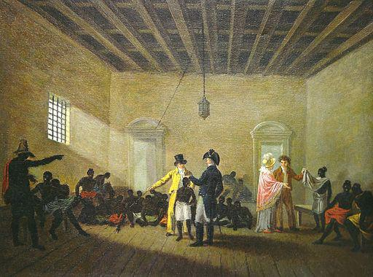
Theorising The Labour Market – Tom Staunton
iCeGS, The University of Derby
Image by audio-luci-store-it and available from Flicr

Slide 2
Theorising The Labour Market
Through this session we will explore:
How opportunity awareness and LMI have been discussed in the careers literature
How careers practice can approach the labour market using non-rationalist theories
How new understandings of career development linked to social justice can approach opportunity awareness
Provide an overview of future research

Slide 3
LMI & Careers Literature
Image by audio-luci-store-it and available from Flicr

Slide 4
Rationalistic/ Matching
Linked to work of Parsons, Holland and DOTS in particular
Focuses on quality LMI
Often described by terms such as accurate, unbiased, up-to-date, comprehensive etc.
Looks for thresholds of what people should know

Slide 5
Gatsby Benchmark 2
“All students and parents should have access to high-quality information about future study options and labour market opportunities. They will need the support of an informed adviser to make best use of available information.”

Slide 6
2018 National Careers Strategy
“It is vital, in an environment where new industries are emerging and many of the most important jobs of the future
don’t yet exist, that individuals have access to high-quality labour market information and earnings data to underpin their choices.”
“We want… everyone to get the information they need to understand the job and career opportunities available, and how their knowledge and skills can help them in considering suitable careers.”

Slide 7
AGCAS Pillar 7
Anticipating and adapting to trends and predictions in the world of work to ensure our services are relevant to current and future needs
Examples may include…
• The provision of material.. that demonstrate understanding of changing labour markets and opportunity structures
• Staff at all levels are able to demonstrate an understanding of labour market information (LMI) changes and opportunity structures...
• Evidence of active engagement and collaboration with businesses, employers, professional organisations; in order to keep information up to date...

Slide 8
Alternatives to Rationalism
Image by audio-luci-store-it and available from Flicr

Slide 9
What sort of interaction should we want between our clients and LMI?
Or
What constitutes quality learning about the world of work?

Slide 10
5 Approaches to LMI
Rationalistic/ Matching
Constructivist
Chance Based
Digital Literacy
Radical/ Social Justice

Slide 11
Constructivist
Linked to Cochran, Savickas, McMahon etc.
Individuals construct categories that are important to them in relation to work
The job of careers work is not to provide quality information so much as to support people in their own construction

Slide 12
Chance Based
Linked to Krumboltz, Bright and Pryor
Our rapidly changing world makes comprehensive understanding problematic
Focuses on attributes such as curiosity and flexibility

Slide 13
Digital Literacy
Linked to Hooley
Looks at how internet decentres knowledge
Importance of developing individual digital career literacy including Collecting, Connecting and Critiquing

Slide 14
Radical
Linked to Hooley, Thomsen and Sultana
A radical view of career guidance would argue that inequality is partly created and reproduced through LMI
Aims to raise awareness of “how the world works” and “how we could change it”
Particularly seen in what is included or excluded about the world of work.

Slide 15
LMI & Social Justice
Image by audio-luci-store-it and available from Flicr

Slide 16
Manufacturing Consent
Herman and Chomsky (1988)
Whilst Soviets coerced through power American Capitalism coerces through ideology
Controlling what is and is not possible to think e.g. Vietnam
News can be accurate but still ideologically constructed

Slide 17
Manufacturing Consent
LMI has a “system supporting” function i.e. it operates as ideology
Presents work as neutral, individual, socialising and progressive
Silences work as solidarity, environmental, nihilistic, dangerous

Slide 18
Future Research
Image by audio-luci-store-it and available from Flicr

Slide 19
Future Research
Stage 1 - Critical literature review
Stage 2 - Policy analysis
Stage 3 - Critical analysis of LMI artefacts
Stage 4 - Observational research with practitioners

Slide 20
Contact
t.staunton@derby.ac.uk
@tomstaunton84
https://runninginaforest.wordpress.com

Slide 21
References
Herman, E. S., & Chomsky, N. (1988). Manufacturing consent: A propaganda model. Manufacturing Consent.
Holland, J. L. (1959). A theory of vocational choice. Journal of counseling psychology, 6(1), 35.McMahon, M. (ed.) (2016) Career Counselling: Constructivist Approaches. Abingdon: Routledge.
Hooley, T. (2012). How the internet changed career: framing the relationship between career development and online technologies. Journal of the National Institute for Career Education and Counselling, 29(1), 3-12.
Hooley, T., Sultana, R., & Thomsen, R. (Eds.). (2017). Career guidance for social justice: Contesting neoliberalism (Vol. 16). Routledge.
Law, B. and Watts, A. G. 1997. Schools, Careers and Community, London: Church Information Office.
Mitchell, K. E., Levin, A. S., & Krumboltz, J. D. (1999). ” Planned Happenstance: Constructing Unexpected Career Opportunities,” Journal of Counseling and Development, Sept 1999, 77(2), 115-124. doi: 10.1002/j.1556-6676.1999.tb02431.x
Parsons, F. (1909). Choosing a vocation. Houghton Mifflin.
Pryor, R., & Bright, J. (2011). The chaos theory of careers: A new perspective on working in the twenty-first century. London: Taylor & Francis.
Savickas, M. L. (2015). Life Design Counselling Manual. Ohio: Mark L. Savickas.

