Slide 1
2021 Care Leavers Internship Scheme
Providing 12 month paid placements in government departments for Care Leavers

Slide 2
Why Care Leavers?
Our Care Leaver paid Internship supports the government's aim to Keep on Caring which looks at how to improve services, support and advice for care leavers.
We show our commitment to this and the Care Leaver Covenant by helping care leavers gain skills and work experience through a paid internship to support the transition from care to independence. All of this helps us move towards our ambition to be the most inclusive employer in the UK.
Executive Officer posts starting salaries: National - £21,170 London - £27,200
Administrative Officer starting salaries: National- £18,514 London- £22,638
No qualifications are required for this internship.
“If you have spent time in the care system, you will have developed valuable skills and qualities that set you apart from others who haven’t. Despite this, we know that you are less likely to get a foot in the door with a good employer. We want to attract people with a thirst for knowledge to come and work for us for a year in return for developing skills and gaining work experience. We hope that some of you will want to stay beyond 12 months and consider other Civil Service job opportunities.”​
Holly Milikouris
Head of Recruitment, Department for Education

Slide 3
Can I Apply?
To be eligible to apply for the scheme you need to meet the following criteria:
Aged between 18 and 30 (as of 31st December 2021)
Qualified for a leaving care support package when you left care.
To qualify for leaving care support, you must have been in care for a minimum of 13 weeks, some of which must have been after your 16th birthday’. Those who are invited to interview will be asked to provide a reference who can confirm their care leaver status. This could be their personal adviser, a member of their local authority or a named contact in their supporting organisation.
Satisfied the Civil Service Nationality Requirements. Nationality rules - GOV.UK (www.gov.uk)
No qualifications required

Slide 4
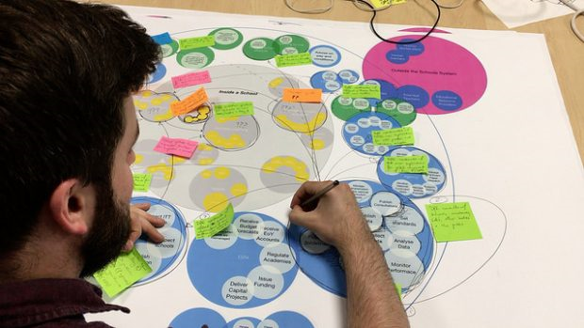
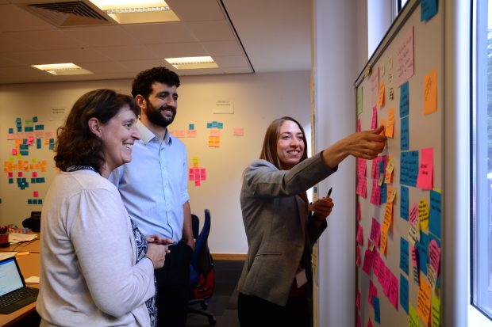
What is the role?
You will provide administrative support to your assigned department, helping them to achieve their objectives.
Tasks will vary depending on the placement, but you will be involved in problem solving, business planning and policymaking, at the very highest levels of government. You’ll usually work within a supportive team structure, under the direction of relevant team leaders. You may also hold individual responsibility for pieces of work within a programme or project
Good communication and organisational skills will be used in your everyday work. You may be asked to take your own initiative with minimal supervision, knowing when to seek help. You will take ownership identifying priorities, resolving issues and able to operate with tact and diplomacy to secure the most effective outcome.

Slide 5
Application form guidance
You will complete an online application form, which will ask you to provide a personal statement telling us how you have demonstrated the following skills (500 words max):
•Using computer packages. E.g., Microsoft Word, PowerPoint and Excel. • Communicating with people. Speaking to them over the telephone, face to face and using written communication. •Showcasing good organisational skills. •Ability to prioritise workloads.
You could think about occasions when you have previously demonstrated these skills. This might be at work or somewhere like work experience, volunteering or in connection with a hobby. Do not assume we will know or understand the situation you were facing, you need to make sure it is clear how your example meets these skills.
We will provide you feedback on your application and interview.

Slide 6
Interview guidance
If you are successful at application stage, you will be invited to a video interview. The purpose of the interview is to assess your suitability for the role. It will usually last about 30 minutes.
Interview Questions
We will ask questions to give you the opportunity to talk us through occasions when you have used some of these skills and to assess your experience.
We will provide you feedback on your application and interview.

Slide 7
Hear from some of our Care Leaver Interns
“I have been in my internship in the Foreign, Commonwealth and Development Office (FCDO) for nearly a year. My experience in the FCDO has been absolutely life changing! I have such a lovely team and an amazing line manager and a mentor who have always been there for me from my first day. I have gained so much experience and have made great strides in improving my written and communication skills. I have also been given the opportunity to do job shadowing in other departments, which I am looking forward to. I have learned to believe in myself, stop doubting myself and be happy. I am proud to be part of the FCDO and look forward to hopefully being made permanent in the future. I would encourage other care leavers to take up this life changing opportunity. Most importantly, I would like to thank the Care Leavers Team for making it possible. I have grown from a person who felt not good enough to even make friends, to someone who is happy and always looking forward to the future. Thank you from the bottom of my heart." Suad - Foreign, Commonwealth and Development Office (FCDO)
“I work within the Secretariat at Border Force Heathrow; my time here so far has been nothing short of exceptional. I partake in a wide variety of work from handling public complaints, MPs/Lord’s correspondence, media enquiries, as well as producing and cascading global communications. I am also the primary Officer responsible for Rewards & Recognition at Border Force Heathrow, and I am now training to be a Designated Signatory to escort visitor's airside at the airport as well as upskilling with cameras & media equipment to produce videos and photography for the business. I have met so many amazing individuals and get to work very closely with Assistant Directors, Deputy Directors and the Regional Director. Working so well within this team has even enabled me to receive a permanent offer of employment to stay with my team!” Joseph - Border Force Officer- Home office

Slide 8
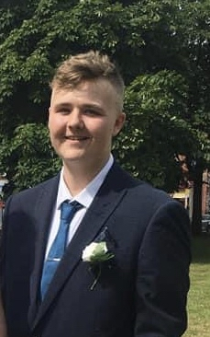
Hear from some of our Care Leaver Interns
It's officially been 6 months since I joined the Civil Service as a Policy Advisor for the department of Business, Energy, Industrial Strategy. The last six months have been one of the most influential, life changing experiences; From learning how government internally operates and delivers to adopting new methods of working whilst developing my understanding and approach on tackling pressing, societal challenges & Government priorities. This position has given me the opportunity to continue learning (Level 4, Policy Implementation - apprenticeship.) alongside my work. I joined at a crucial time within my team's Strategy development and have enjoyed seeing everyone's amazing efforts come to fruition but to also be a part of something that will ultimately, implement change for the better! Jayden – Department for Business, Energy & Industrial Strategy (BEIS)
I joined HMRC during the first lockdown, my first few weeks my area of work had just launched the Help out to Eat out scheme. I have been involved in bringing the Tax apprenticeship process for tax academy into the 21st century, as well as supporting senior management with the Ofsted inspection for HMRC apprentice offering. During this entire process, my manager/mentor continued to ask me, what I wanted to do in the short and longer term and aligned me with teams and work to meet the short-term goals with the internships but with a longer-term view with my career either internally with HMRC or with wider Government. Overall, I recommend the care leaver programme. Jordan HMRC
Since being successful in my application for the Care Leavers internship I have had the distinct pleasure of working in the Planning Infrastructure Division of Ministry of Housing Communities and Local Government (MHCLG). I have since had the opportunity to develop my knowledge of the policy area and planning infrastructure. I have also had plenty of exposure with certain civil service processes from Surveying and consultation analysis to engaging with Key stakeholders whether it be Local councils or Industry. Overall, this has been an amazing experience that has helped me to better map a plan for my future. My biggest concern when I started was the risk, I took on a new challenge that was different from anything I had ever done. By the end of the experience, I felt minimal anxiety in my place with the civil service because of the help that my team put into honing my core skills. Jon - MHCLG

Slide 9
Civil Service Overview
The Civil Service delivers public services and supports the government of the day to develop and implement its policies. The work civil servants do reaches all aspects of life in the UK, from education and the environment, to transport and defence. Civil servants are politically impartial. Together, we ensure the effective running of government and provide the best possible services to the public.
The scale, complexity and impact of the work civil servants do is unrivalled. We employ 420,000 people across the country and overseas. Our work is everything from advising ministers on policy, to delivering front line services to the public.
Civil Servants work as vets, customer service advisers, weapons engineers, marine biologists and web developers (to name only a handful of jobs available). Joining the Civil Service will give you access to exceptional learning and development opportunities, a variety of career paths, career development support, and flexible working.
Visit the Civil Service Careers website for further information about working in the Civil Service.

Slide 10
Locations
With departments and agencies based across the country we can offer positions
in below offices:
Ashford,
Bangor,
Barnsley,
Barry,
Bath,
Bedford,
Belfast,
Birkenhead,
Birmingham,
Blackburn,
Blackpool,
Bootle,
Brecon,
Bristol,
Bury St Edmunds,
Cambridge,
Cardiff,
Chester,
Hull,
Huntingdon,
Kingswood (Bristol)
Leeds,
Leicester,
Liverpool,
Llandindrod Wells,
Llanelli
London,
London (Heathrow Airport),
London (Luton Airport)
London (Stansted Airport)
Loughborough,
Lymington,
Macclesfield,
Manchester,
Merseyside,
Merthyr,
Middlesbrough
Neath,
Newcastle,
Newport,
Northwood (Middlesex)
Nottingham,
Pembroke Dock,
Peterlee,
Plymouth,
Preston,
Rugby,
Scunthorpe,
Sheffield,
Solihull,
South Shields.
Stockport,
Stockton-on-Tees,
Stoke,
St. Albans,
St. Austell,
St. Leonards-on-Sea,
Sunderland
Titchfield,
Torquay,
Warrington,
West Bromwich,
Weston-Super-Mare,
Weymouth,
Wolverhampton,
Wrexham,
Yate (Bristol),
York
Colchester,
Coventry,
Crewe,
Croydon,
Daventry
Derbyshire
Dundee,
Durham,
East Kilbride,
Edinburgh,
Folkestone,
Gateshead,
Glasgow,
Greenock,
Grimsby,
Halifax,
Hartlepool,
Haverfordwest,
You can state your preferred location on the application form.

Slide 11
Where are placements available?* (1 of 3)
We have 26 government departments and agencies that are looking for Care Leaver interns to join them:
Department/agency | Overview and link to further information
Department for Education (DfE) | We are responsible for children's services and education. We work to create a highly educated society, in which opportunity is equal for children and adults from all backgrounds - Working for DfE
Department for Digital, Culture, Media and Sports (DCMS) | We work to create a world-leading digital economy, to protect and promote the UK’s cultural, sporting and artistic heritage and to build a bigger and stronger civil society - Working for DCMS
Department for Environment, Food and Rural Affairs (Defra) | We are responsible for creating a great place for people to live, from the food they eat, to the air they breathe - Working for Defra
Cabinet Office | We are at the centre of government and the corporate headquarters of the Civil Service. We support the Prime Minister and ensure the effective running of the Civil Service - Working for Cabinet Office
Ministry of Housing, Communities and Local Government (MHCLG) | We create great places to live and work, and to give more power to local people to shape what happens in their area - Working for MHCLG
Department for Transport (DfT) | We work to support the transport network that helps UK businesses, our people and goods travelling around the country. We plan and invest in transport infrastructure to keep the UK moving. - Working for DfT
Ministry of Justice (MOJ) | We're at the heart of the justice system, working together to bring the principles of justice to life for everyone in society - Working for MOJ
* Successful applicants may be offered Civil Service roles based in other government departments if further vacancies arise

Slide 12
Where are placements available?* (2 of 3)
We have 26 government departments and agencies that are looking for Care Leaver interns to join them:
 | Name of department/agency | Overview and link to further information
 | Foreign, Commonwealth and Development Office (FCDO) | We are here to build a more secure and prosperous world, promote the UK's interests overseas, and support our citizens and businesses around the globe - Foreign, Commonwealth & Development Office - GOV.UK
 | Ministry of Defence (MOD) | We protect the security, independence and interests of our country at home and abroad. Our aim is to ensure that the armed forces have the training, equipment and support necessary for their work. - Working for MOD
 | Office for National Statistics | We work to ensure that as the UK's largest producer of official statistics, our outputs are trusted to inform government and guide policy makers. - Working for the Office for National Statistics
 | Scottish Government | We are responsible for most of the issues of day-to-day concern to the people of Scotland, including health, education, justice, rural affairs, and transport. The Scottish Government - gov.scot
 | Government Legal Department | We are the government’s principal legal advisers. Our core purpose is to help the government to govern well, within the rule of law. - Working for GLD
 | Crown Prosecution Service (CPS) | We prosecute criminal cases that have been investigated by the police and other investigative organisations in England and Wales. The CPS is independent, and we make our decisions independently of the police and government - Working for CPS
 | Department of Health and Social Care (DHSC) | We're responsible for the nation's health and social care. Together, we help people live more independent, healthier lives for longer - Working for DHSC
* Successful applicants may be offered Civil Service roles based in other government departments if further vacancies arise

Slide 13
Where are placements available?* (3 of 3)
We have 26 government departments and agencies that are looking for Care Leaver interns to join them:
 | Name of department/agency | Overview and link to further information
 | Home Office (HO) | We are responsible for keeping the country safe, secure and prosperous - Working for HO
 | National Crime Agency (NCA) | We are a crime-fighting, law enforcement agency responsible for leading the UK’s fight to cut serious and organised crime - Working for NCA
 | Department for Business, Energy and Industrial Strategy (BEIS) | We are responsible for building an economy that works for everyone, so that there are great places in every part of the UK for people to work and for businesses to invest, innovate and grow. - Working for BEIS
 | Her Majesty’s Revenue and Customs (HMRC) | We collect the money that pays for the UK's public services and help families and individuals with targeted financial support. - Working for HMRC
 | Department for Work and Pensions (DWP) | We're responsible for welfare, pensions and child maintenance policy. We deliver the State Pension and a range of disability and ill health benefits to around 20 million people. - Working for DWP
 | Attorney General's Office | We provide legal advice and support to the Attorney General and the Solicitor General (the Law Officers) who give legal advice to government. - Attorney General's Office -
 | Office of the public Guardian | We help people in England and Wales to stay in control of decisions about their health and finance and make important decisions for others who cannot decide for themselves. Office of the Public Guardian - GOV.UK
* Successful applicants may be offered Civil Service roles based in other government departments if further vacancies arise

Slide 14
Application Process and Timeline
Submit Application Form
Complete the online application form via the ‘Apply Now’ link on Civil Service Jobs
Shortlisting
Applications will be assessed and scored by a panel of recruiters. Successful candidates will be invited to interview.
Interviews
Interviews will start week commencing 27th October 2021 and will be conducted virtually.
Completed application forms must be submitted by 23:55 on Friday 24th September 2021
All applicants will receive notification of the outcome and feedback.
Expected to last 30 minutes
All applicants will receive notification of the outcome and feedback
For successful applicants, pre-employment checks and security checks will be need to be conducted by the department they are allocated to prior to starting the roles.
Some departments require different checks so this process may take longer.
All applicants will receive regular updates on the progress of the checks.
Pre-employment checks

Slide 15
Hints and Tips for applying
H
The Civil Service Care Leaver Internship Programme is open to all care leavers who meet the eligibility requirements for the role,
Ensure that you have checked that you meet all the eligibility criteria for the Programme.
Ensure you read carefully the details of the vacancy, the responsibilities and the skills required for the roles.
You have 500 words to show that you meet the essential criteria and skills. Use that word count fully to explain How you have demonstrated those skills .
Successful applicants will be subject to successful completion of pre-employment checks, which will include a Disclosure & Barring Service (DBS) check. Decisions to appoint will be made by the allocated department in-line with their policy. Some departments require more security checks which will take longer to complete.
If you have any questions please contact Leavers.care@education.gov.uk

Slide 16
Complaints
The Department for Education’s recruitment processes are underpinned by the Civil Service Commissioner’s Recruitment Principles. This outlines that the selection process for appointment is on merit based through fair and open competition.
If you feel your application is not processed in accordance with the values in the Civil Service Code or that the recruitment has been conducted in such a way that conflicts with the Civil Service Commissioner’s Recruitment Principles, you may make a complaint. You can do so by contacting the Central Recruitment Team at the following address: Leavers.care@education.gov.uk

