Slide 1
Shazia Shah
Bradford NEU Officer

Slide 2
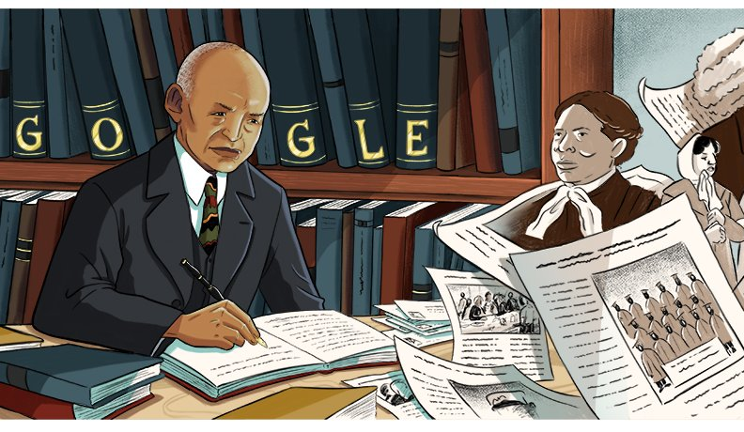
What is Black History Month?
Black History Month was created in the United States by historian Carter G. Woodson. He founded The Association for the Study of Negro Life and History in 1915 as he wanted to challenge society’s ideas that ‘the negro has no history’. He encouraged scholars to study and preserve black history.
Woodson later founded Black History Week in 1926. After the civil rights movement and The Black Power movement, this week became a month in 1969 (many didn’t believe a week was long enough to celebrate black history).
The UK adopted Black History Month in 1987 after Akyaaba Addai, a project officer for The Greater London Council, visited America in the 1970s.

Slide 3
Why can Black History Month cause controversy?
“It should be BAME history month”
“It’s divisive”
“All lives matter”
“There’s no White History Month”
“Promotes victim narrative that is harmful to British society”

Slide 4
Q: What does Black History Month look like in your school?

Slide 5
Why is Black History Month necessary?
People from African and Caribbean backgrounds have been a fundamental part of British history for centuries. However, campaigners believe their value and contribution to society is often overlooked, ignored or distorted.
Most schools still teach a history curriculum which focuses on traditional events and the achievements of white figures. Black History Month gives everyone the opportunity to share, celebrate and understand the impact of black heritage and culture.
More recently, greater attention has been paid to the importance of the Windrush generation and the Black Lives Matter movement, especially since the death of George Floyd in May 2020.

Slide 6
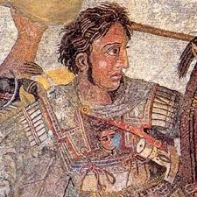
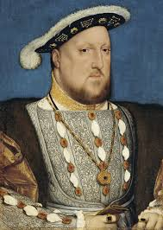
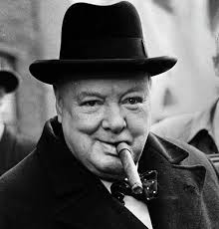
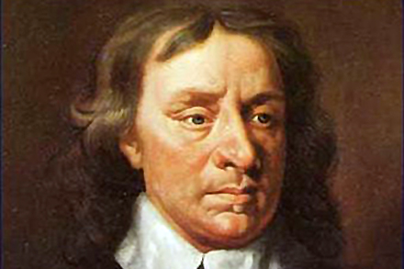
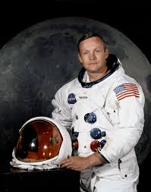
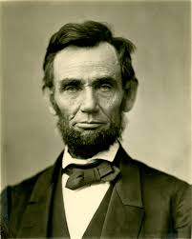
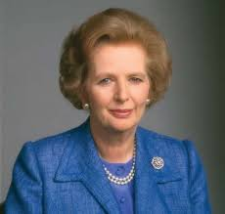
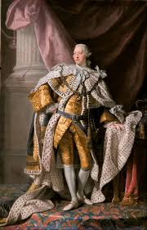
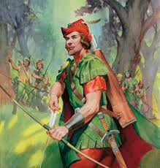
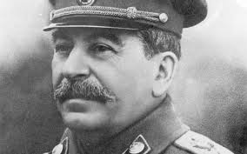
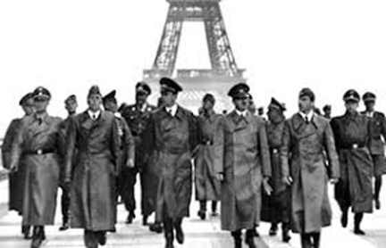
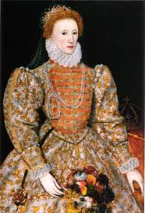
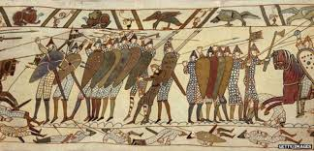
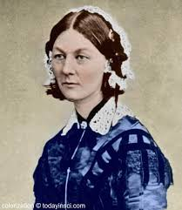
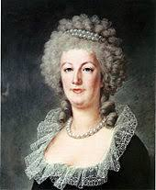
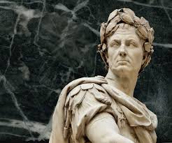
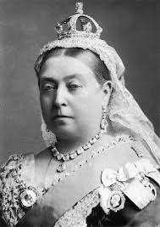
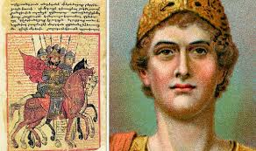
Imagine if you tried to learn about all the white history you had heard of in one month?
Just one month…….. And there is as much black history as white history.

Slide 7
Is Black history taught in schools?
Education is a devolved issue in the UK, so there are marked differences in the curriculum in England, Wales, Scotland and Northern Ireland.
Over the years there have been growing calls from campaigners for black history to be included in the curriculum in England - and not just celebrated in October.
Criticisms of the Eurocentric and Ethnocentric curriculum.

Slide 8
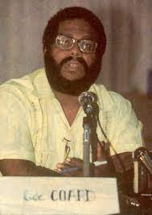
Example of ethnocentric curriculum?
For example, the history curriculum tries to recreate a 'mythical age of empire and past glories', while ignoring the history of black and Asian people. ... Bernard Coard (2005) explains how the ethnocentric curriculum may produce under-achievement.

Slide 9
Why is black history important to learn about?
Notes:
There has been black presence in Britain since at least the 3rd century but their stories are often untold because of those who write, record and control history. Andrew Hann, a historian at English Heritage states, “History tends to be written by the powerful…it tends to be written by the people in charge…It’s predominately male, it’s predominately white, it’s predominately middle or ruling class…While this can be a challenging story to tell, tell it we must, as it teaches us important lessons about the present as well as the past.” History has erased the presence of non-white individuals in Britain and America.

Slide 10
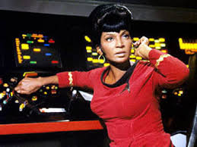
Up until Nichols’ character appeared on popular American series Star Trek in 1966, every black female on TV had been portrayed as a maid or a menial worker.
Every single one.
Imagine what that does for your aspirations as a young black girl growing up.
Now imagine seeing Lieutenant Uhura for the first time – a successful translator and communications officer who specialises in linguistics, cryptography, and philology. IN SPACE!
Quite a bit of a difference there.
Lieutenant Nyota Uhura
Originally played by
Nichelle Nichols in the
Star Trek series.

Slide 11
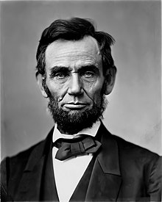
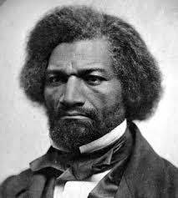
Have you heard of the following figures in history?
Frederick Douglass was a prominent activist and a leader of the abolitionist movement to end slavery.
He was one of the most famous intellectuals of his time, advising presidents Abraham Lincoln and Andrew Johnson. Douglass became the first African American nominated for vice president of the United States. He also gave lectures about important issues and wrote numerous books.
Throughout his life, Douglass fought for equality and was an advocate for women’s rights and for women to be able to vote.
Abraham Lincoln
Frederick Douglass
Notes:
These slides are to highlight how students are likely to be aware of white historical figures and less likely to hear about black historical figures who also impacted society/that field.
Although he supported President Abraham Lincoln in the early years of the Civil War, Douglass would fall into disagreement with the politician after the Emancipation Proclamation of 1863, which effectively ended the practice of slavery. Douglass was disappointed that Lincoln didn’t use the proclamation to grant ex-slaves the right to vote, particularly after they had fought bravely alongside soldiers for the Union army.

Slide 12
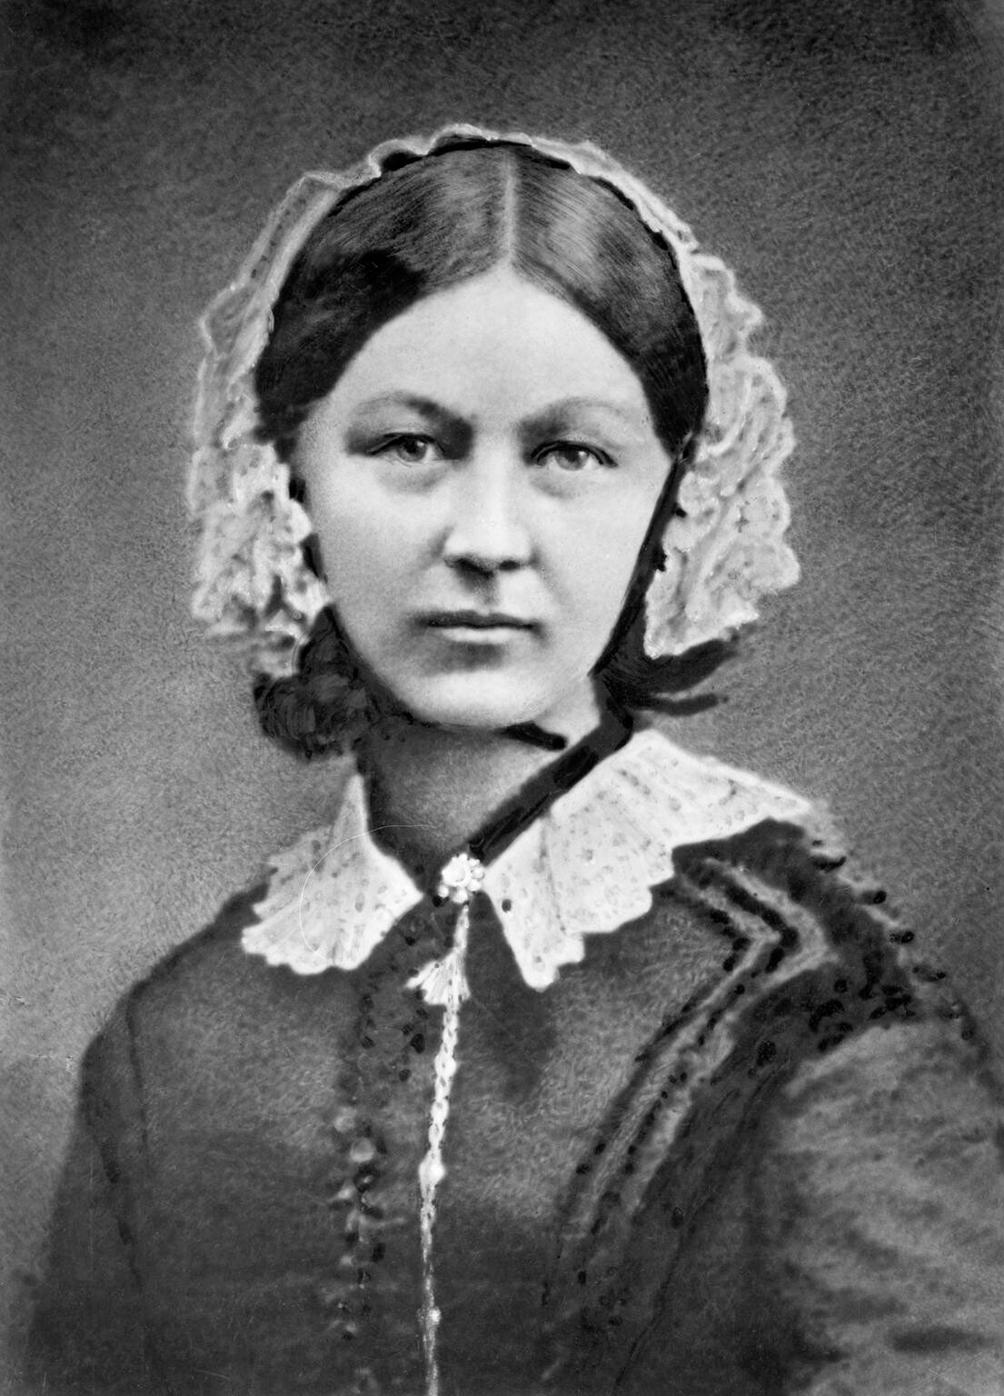
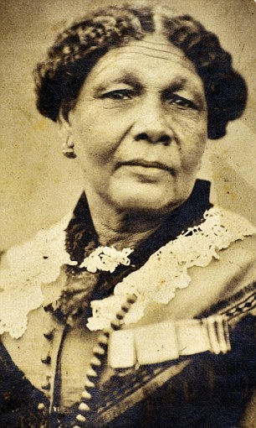
Have you heard of the following figures in history?
Mary Seacole was born in Kingston, Jamaica. She was a pioneering nurse and heroine of the Crimean War. She learned her nursing skills from her mother who ran a house for sick soldiers.
In 1854, Seacole travelled to England to ask the War Office if she could be sent to Crimea as an army nurse. They refused because she was mixed race. She paid for her trip to the Crimea to help. She set up her own British hotel for wounded soldiers and visited the battlefield to help.
She became known as ‘Mother Seacole’
Florence Nightingale
Mary Seacole
Notes:
Florence Nightingale (1820-1910), known as “The Lady With the Lamp,” was a British nurse, social reformer and statistician best known as the founder of modern nursing. Her experiences as a nurse during the Crimean War were foundational in her views about sanitation.

Slide 13
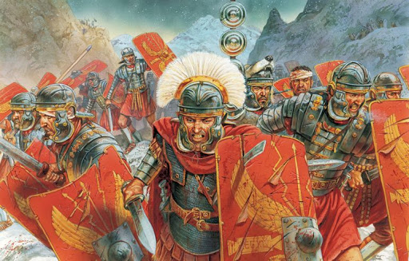
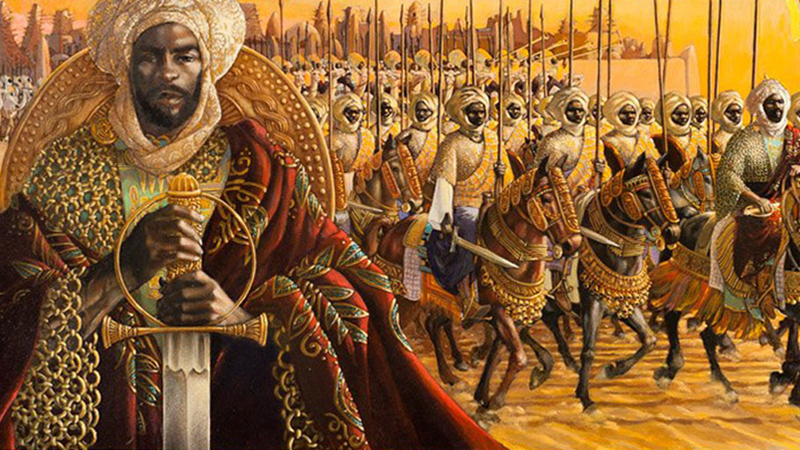
Do you recognise the following figures in history?
Moors was the term given to pre-Arab inhabitants of North Africa. ‘Moor’ came to mean anyone who was Muslim or had dark skin.
Moors, led by the general Tariq ibn-Ziyad, seized the Iberian Peninsula (Spain and Portugal). Education, the arts and science flourished in this area. Moors introduced this region to paper, Arabic numerals, cotton, silk, street lamps, universities and many crops (oranges, lemons, ginger and more)
Romans
Moors

Slide 14
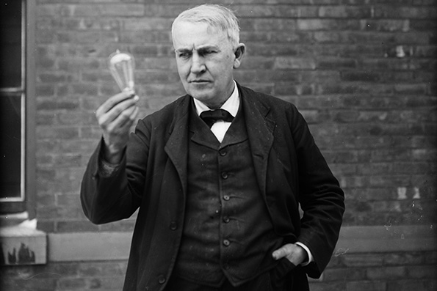
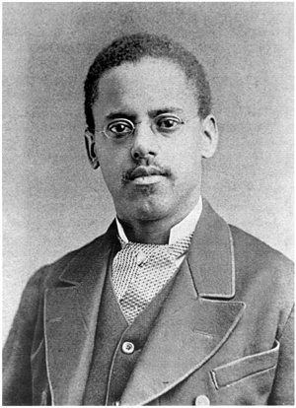
Do you recognise the following figures in history?
Lewis Howard Latimer was an inventor and draftsman. He helped to improve on Thomas Edison’s invention of the lightbulb by patenting a carbon filament, allowing electric lighting to be more efficient and affordable for households. He also helped draft the patent for Alexander Graham Bell’s design of the telephone.
Latimer invented the toilet for railroad cars and an early air conditioning unit.
Thomas Edison
Lewis Latimer

Slide 15
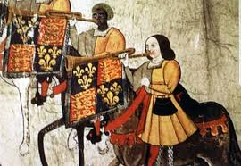
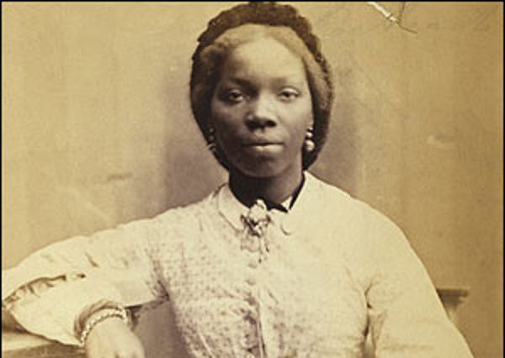
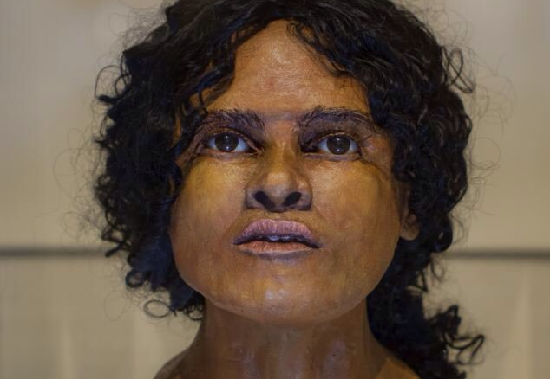
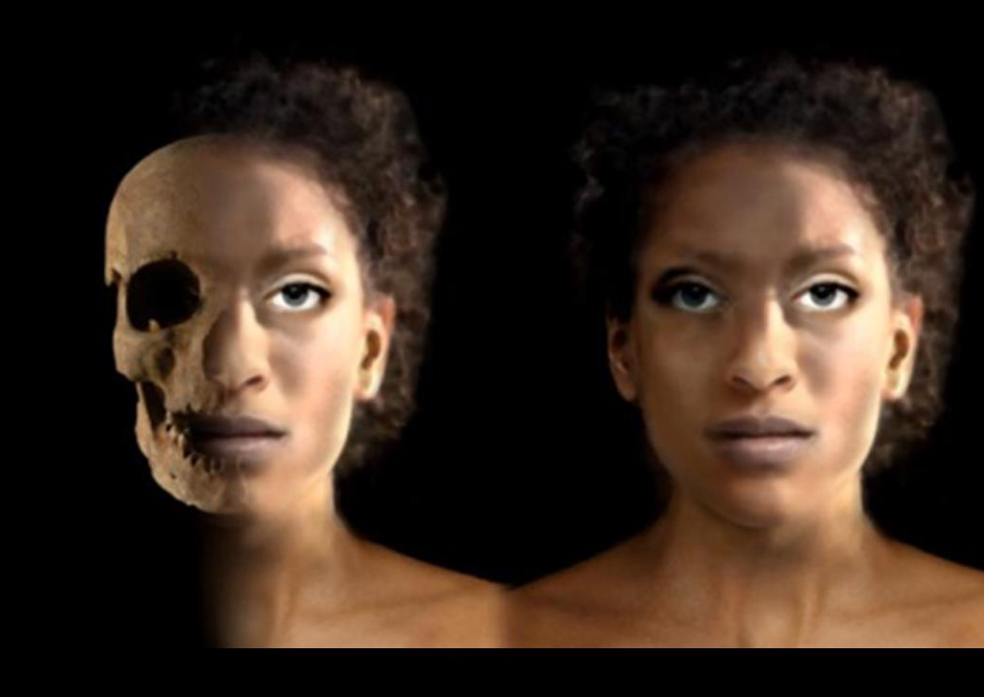
Black History is British History
John Blanke
Sarah Forbes Bonetta
“History isn’t a solid set of facts…It’s very much about what questions you ask of the past. If you ask different questions, you get different answers. People weren’t asking questions about diversity. Now they are.”
– Miranda Kaufmann
2. Ivory Bangle Lady
Beachy Head Lady
Notes:
Slavery was not the beginning of the presence of African people in Britain.
John Blanke- “May well have arrived in England in 1501, as part of the entourage of Catherine of Aragon…John Blanke made his first appearance in the records in 1509 when a note records wages being paid to him by the court of Henry VIII…[The image] came about because Blanke performed at the celebrations that were staged in January 1511 to mark the birth of Prince Henry, the son born to Henry VIII and Catherine of Aragon…The festivities of 1511 are recorded in the Westminster Tournament Roll. John Blanke appears twice on the Roll, shown on both occasions within the procession riding a grey horse and wearing an identical liveried uniform to his five fellow royal trumpeters. - – Black and British, David Olusoga
Sarah Forbes Bonetta- Born in West Africa of Yoruba descent, Sarah Forbes Bonetta was captured in 1848, at the age of five, during the Okeadon War. While her family were killed in the war, as the daughter of an African chief, Sarah was kept in captivity as a state prisoner, either to be presented to an important visitor, or to be sacrificed at the death of a minister or official to become his attendant in the next world. In June 1850 Captain Forbes, on board the Bonetta, arrived in Dahomey on a mission to negotiate the suppression of the slave trade. While there, he asked the King for the little girl as a present, whether for himself or on behalf of the Queen is not clear. The request was granted and the child was brought to England, being given the names of Forbes Bonetta, after the Captain and the ship.
She lived at first with Captain Forbes's family, then, on 9 November, she was taken to Windsor Castle and received by Queen Victoria and Prince Albert. The Queen paid for Sarah to be educated and saw her several times in the space of a few years. Sarah, a highly intelligent girl, developed a particular talent for music. She married in 1862 and later had a daughter, Victoria, to whom the Queen acted as godmother. -https://www.rct.uk/collection/themes/trails/black-and-asian-history-and-victorian-britain/sarah-forbes-bonetta-and-family
The Beachy Head Lady- Ïn 2012, local archaeologist in Eastbourne began to work their way through a collection of skeletons that had been locally excavated from the late 19th century up until the 1990s. One skeleton- almost complete- was stored in a box labelled ‘Beachy Head’…The Beachy Head lady was therefore a second- or third- century Afro-Roman who had been brought up in the south of England and had either been born in that region or was brought there very young, possibly from Africa. ..The facts that those teeth were in good condition, that she enjoyed a healthy diet and was discovered laid out carefully in her grave go to suggest that in life she had not served in a lowly position, or lived as a slave….the Beachy Head Lady-the first black Briton known to us-had lived and died in rural East Sussex.” – Black and British, David Olusoga
Ivory Bangle Lady- “She was discovered in 1901 in a stone sarcophagus in a site near to Sycamore Terrace, an everyday street in the city [York]…In her sarcophagus were a number of luxury grave goods: some blue glass, beads, fragments of five bone bracelets, silver and bronze lockets, two yellow glass earrings, two marbled glass beads, a small round glass mirror and a blue glass perfume bottle. The presence of these items suggests she was a woman of high social status, from the upper strata of Roman York…this high status citizen of Roman York is likely to have been a mixed-raced woman of North African descent, and that either she, or her parents or grandparents, had come from Mediterranean North Africa. “– Black and British, David Olusoga

Slide 16
https://neu.org.uk/black-history-month

Slide 17
https://www.bbc.co.uk/teach/black-history-month-primary-and-secondary-resources/zjwf8xs?scrlybrkr=42fd708e

Slide 18
https://www.anewdirection.org.uk/blog/7-creative-ways-to-mark-black-history-month-in-your-school

Slide 19
https://www.blackhistorymonth.org.uk/section/bhm-for-schools/

