Slide 1
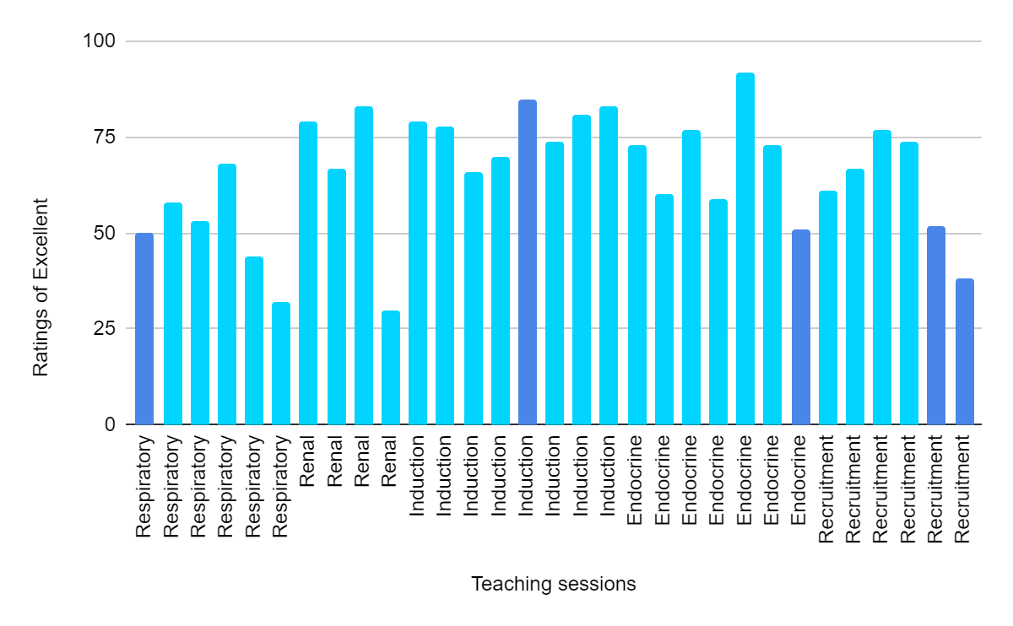
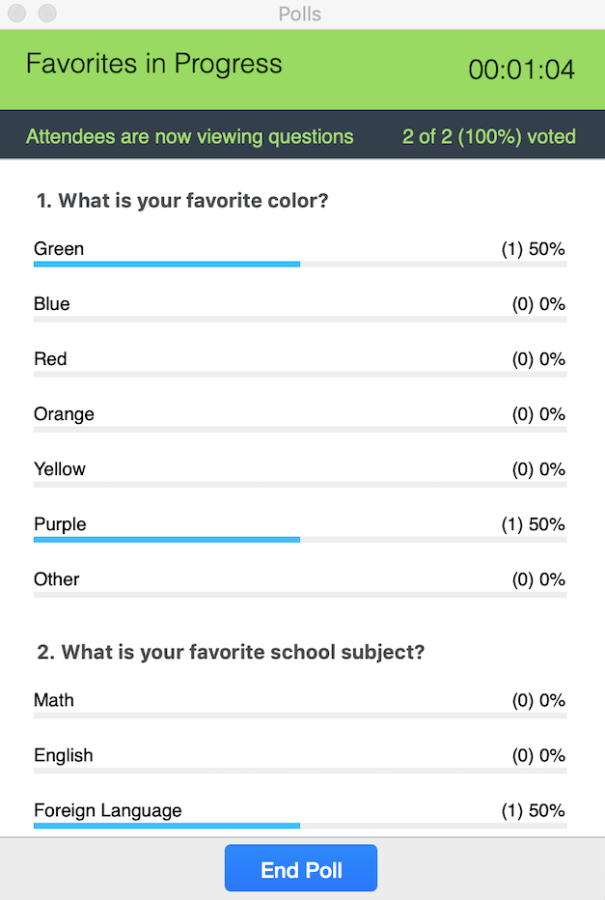
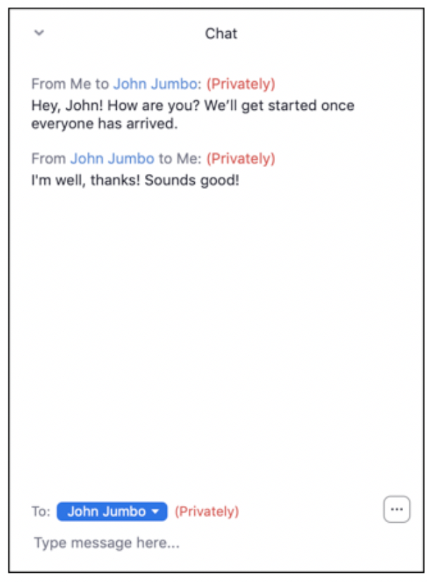
A review of the different tools used to engage a "locked down" audience during virtual teaching
Authors: ST1-3 Deanery Teaching Committee:
Dr Emily Williams, Dr Spandana Madabushi, Dr Thomas Hixson, Dr Roisin O'Dea,
Dr Gemma Wilson and Dr Sandra Fernandes​
Introduction
Results
Technology has given many the opportunity to continue learning virtually in light of COVID-19 restrictions. However, this poses a risk of poor engagement which reduces the benefits of these opportunities. New methods to maintain interactivity have arisen in response to this challenge.
The median percentage of participants who rated talks using interactive tools as Excellent was 71.5. Whereas, the median percentage of participants that rated talks that were recorded or did not use tools to encourage interactivity were rated Excellent was 50.5.
Graph 1: The percentage of participants who rated each talk as Excellent
Aim
Interactive
Non-
interactive
To review the interactive tools used for audience participation during virtual teaching sessions and evaluate participant feedback.
Method
Virtual teaching sessions for junior doctors (predominantly paediatric trainees) began in June and ran through to October 2020. Speakers used Zoom polls, the Zoom chat box for question and answer sessions and Mentimeter. Questionnaires were sent to participants following the sessions regarding the quality and interactivity of the session. The quality of each session was rated as Excellent, Good, Fair or Poor. Following a short lecture series, the audience were asked about their preference of interactivity tool.
Image 1: Mentimeter
Feedback from a short lecture series on renal problems in Paediatrics was analysed in further detail. 3 talks used the Zoom chat box and 1 used Mentimeter. The interactivity of the talk using Mentimeter was rated Excellent by 67% of participants whereas the interactivity of the others was rated Excellent by an average of 50%. Participants were also asked about a preference of tool used to encourage interactivity. The highest proportion (33%) had no preference.
Table 1: Data showing the preference of interactive tools over short lecture series, n=42
Interactive tool | Percentage of participants
Zoom poll | 26
Zoom chat box | 22
Mentimeter | 7
All | 12
No preference | 33
Image 2: zoom polls Image 3: zoom chat box
Conclusion
In conclusion, there was a higher rate of Excellent ratings from talks that employed interactive tools to help keep their audience engaged. There was no clear evidence to support which interactive tool would be superior to others. However, this is likely related to the speaker, as there is a tendency to use something they are familiar or comfortable with. As virtual teaching continues for the forseable future, we may see the introduction of new ideas or more advanced technology which we will quickly have to adapt to.
References: Image 1: Zoom Help Center. 2021. Polling For Webinars. [online] Available at: <https://support.zoom.us/hc/en-us/articles/203749865-Polling-for-webinars?mobile_site=true > [Accessed 16 January 2021]. Image 2: It.tufts.edu. 2021. Meeting Room Basics. [online] Available at: <https://it.tufts.edu/book/export/html/1762> [Accessed 16 January 2021]. Image 3: Mentimeter. 2021. Interactive Presentation Software. [online] Available at: <https://www.mentimeter.com/enterprise> [Accessed 16 January 2021].
Notes:
Zoom poll: https://support.zoom.us/hc/en-us/articles/203749865-Polling-for-webinars?mobile_site=true
Zoom chat: https://it.tufts.edu/book/export/html/1762
Mentimetre: https://www.mentimeter.com/enterprise

