Slide 1
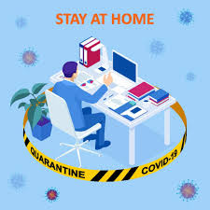
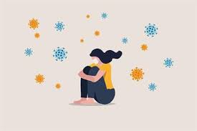
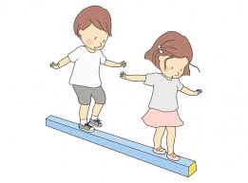
Evelina London Community Child Health- training in the time of Covid 19
Dr Claire Wicks
Community Paediatrician, Evelina Community, Evelina London
Introduction: On the 23rd March 2020 Britain went into lockdown, with it a large part of Evelina London community workforce was redeployed into the acute hospital. It quickly became apparent that the needs of our vulnerable children and families was great and as community paediatrician returned, there was a realisation that shielding / vulnerable trainees needed to continue their training.
Aim: To evaluate the quality of training received by community paediatric trainees in Evelina London Community Child health after a 4 month period of virtual training (May - August 2020)
Methods: end of post structured interview between trainees and their educational supervisor and a trainee presentation ‘Reflections on training in a post Covid world’ .
Results:
Challenges:
Home office Set- up
Lack of social contact
Integrating into a new
team virtually
Maintaining physical &
mental Health
Not seeing and interacting
with children
Positive Aspects
Virtual teaching sessions-
able to access wide range
Time for e-learning (e-learning for health and Mind Ed)
Easy to access supervision
(MS Teams / Skype)
Weekly Chat and Catch-up session
Monthly Wellbeing sessions
Conclusion: Shielding trainees valued the ability to return to training. Virtual developmental & Look After Children’s clinics, child protection on-call and case conferences as well as online learning and teaching sessions enabled trainees to complete many of their level 2 community competencies.
Correspondence to: Claire.wicks@gstt.nhs.uk

