Slide 1


Copyright © Spinnaker 2026

Slide 2
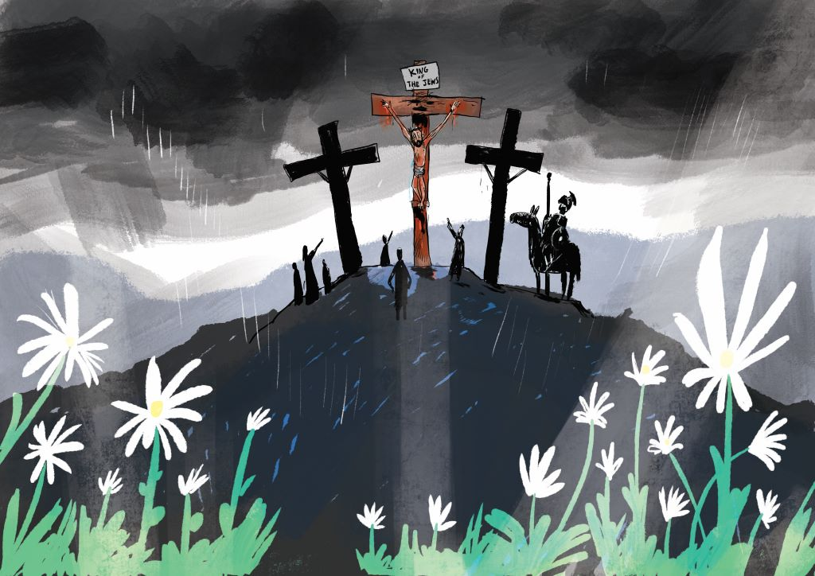

Easter Forgiveness
Copyright © 2026 Spinnaker Trust Ltd

Slide 3

Intro Object

Slide 4
Copyright © 2022/23 Spinnaker Trust Ltd

