Slide 1


Copyright © Spinnaker 2022

Slide 2
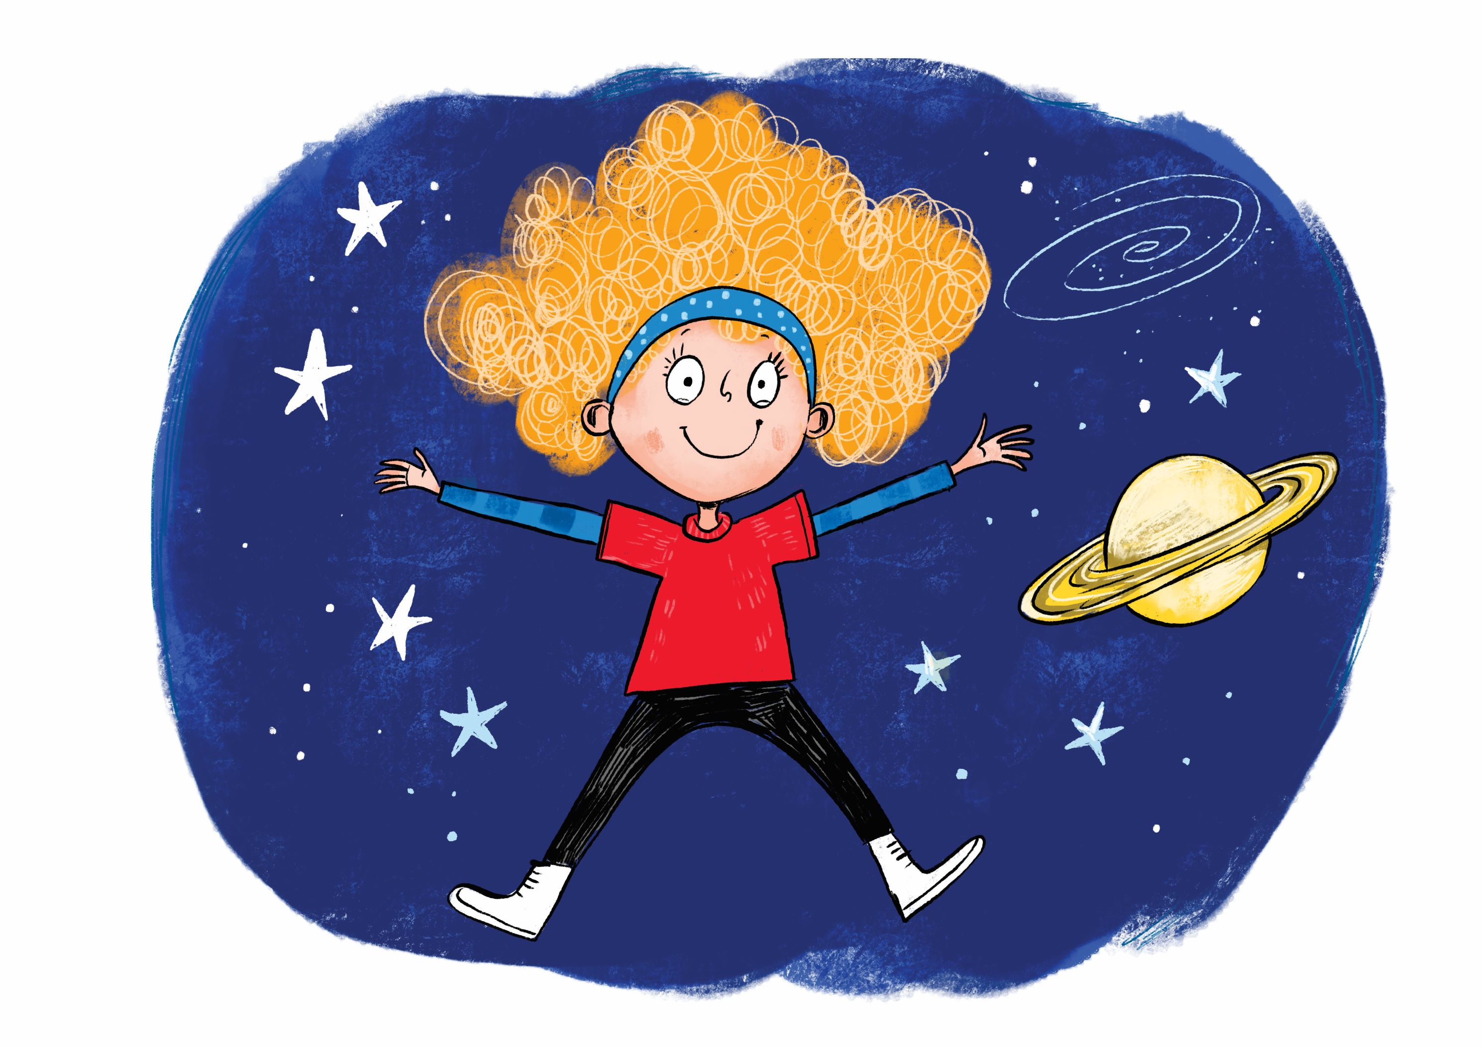
BB3
SELF-WORTH

Slide 3

Intro Object

Slide 5
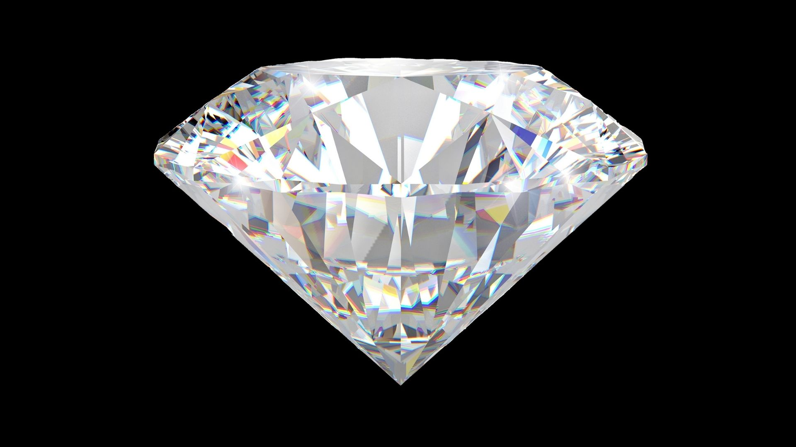
As D??? as a Diamond
Notes:
Suggestions: Dazling, Diligent, Delightful, Dear, Dood!

Slide 6

As R??? as a Ruby
Notes:
Suggestions: Resilient, Radical, Resourceful, Respectable, Resplendent!

Slide 7
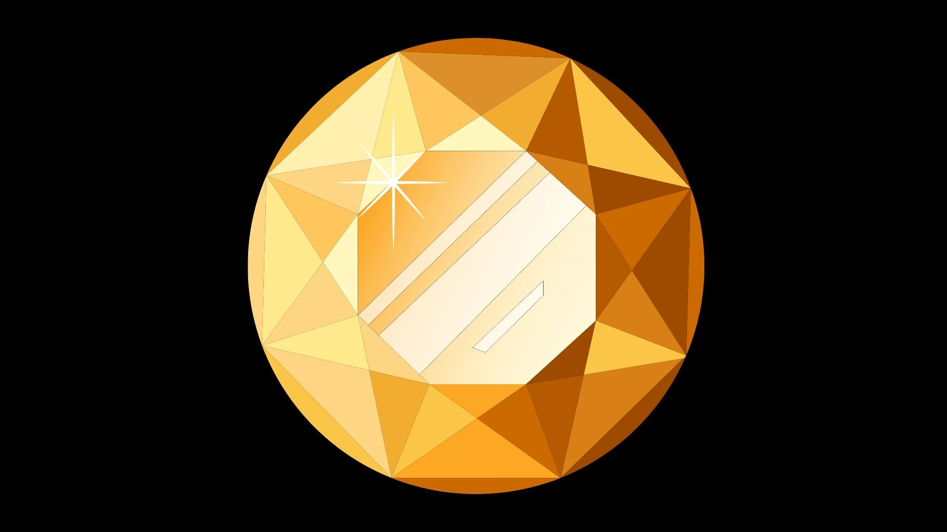
As G??? as Gold (golden beryl)
Notes:
Suggestions: Good, Great, Generous, Gorgeous, Glorious!

Slide 8
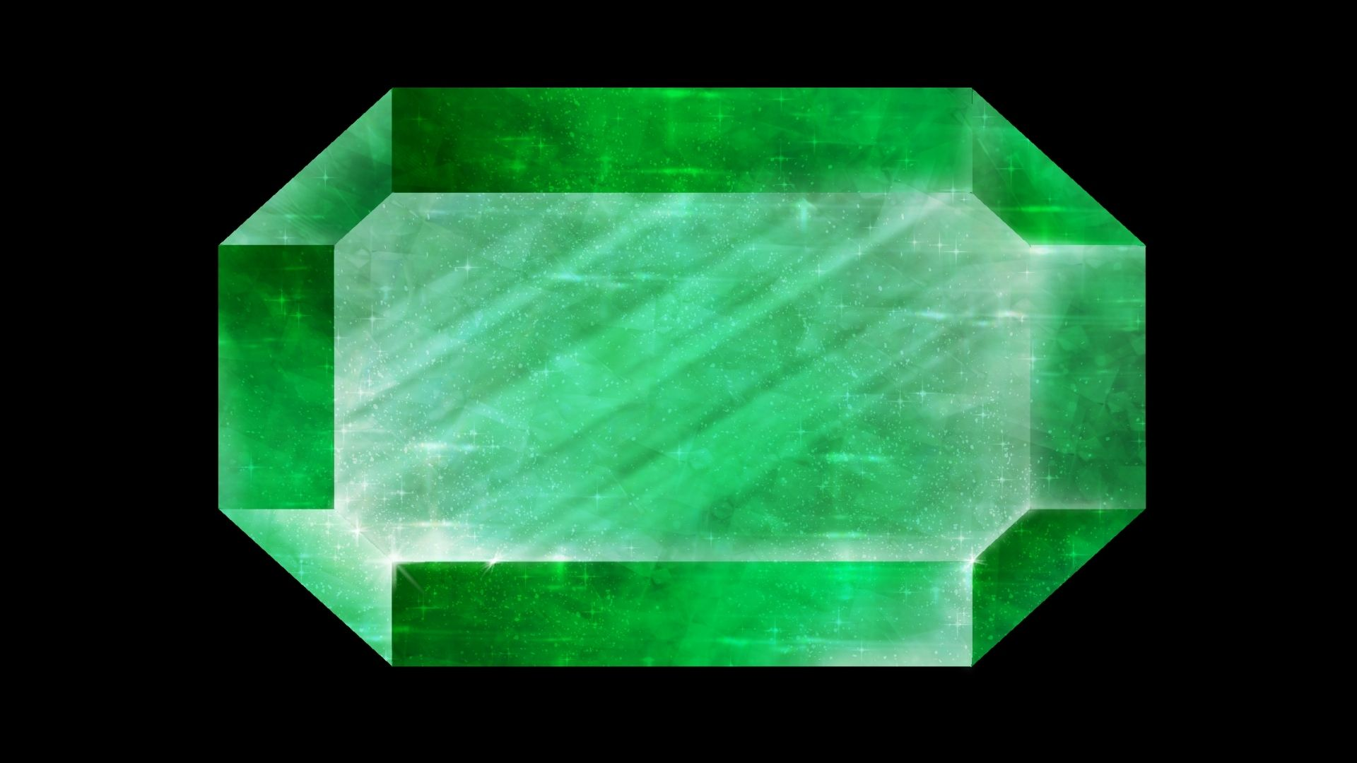
As E??? as an Emerald
Notes:
Suggestions: Enthusiastic, Energetic, Excellent, Empathetic, Exciting

Slide 9
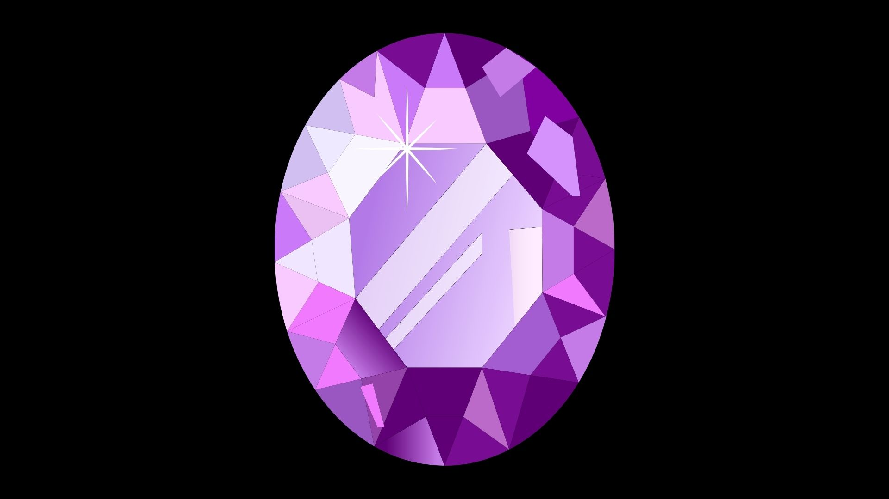
As A??? as an Amethyst
Notes:
Suggestions: Dazling, Diligent, Delightful, Dear, Dood!

Slide 10

As S??? as a Sapphire
Notes:
Suggestions: Sparkly, Super, Special!

