Slide 1


Copyright © Spinnaker 2022

Slide 2
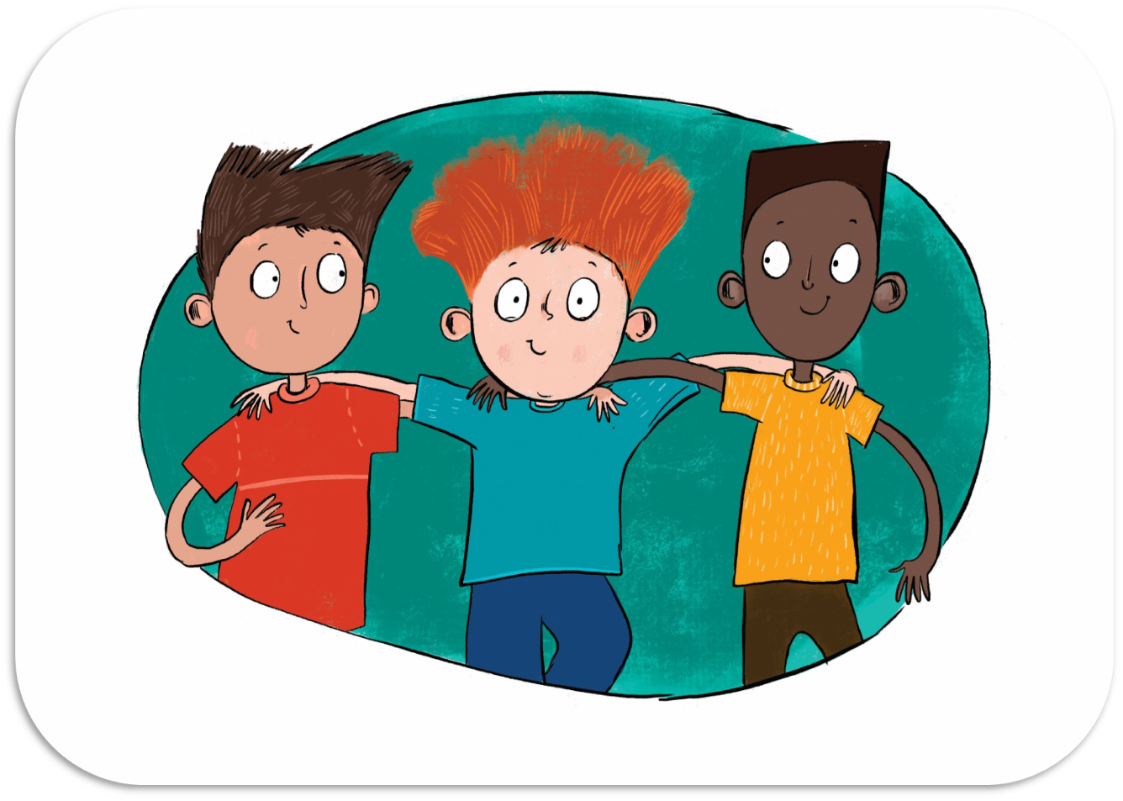
BB4
Friendship

Slide 3

Intro Object

Slide 4
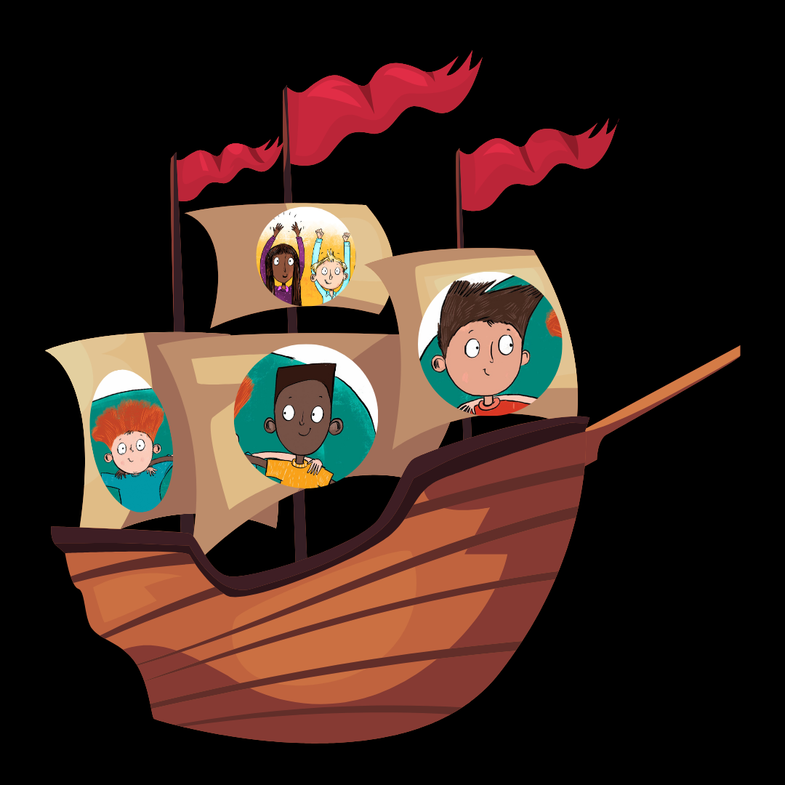
T _ _
F _ _ _ _ D
_ _ I _
Fill in the letters, guess the name of the ship

