Slide 1


Copyright © Spinnaker 2022

Slide 2
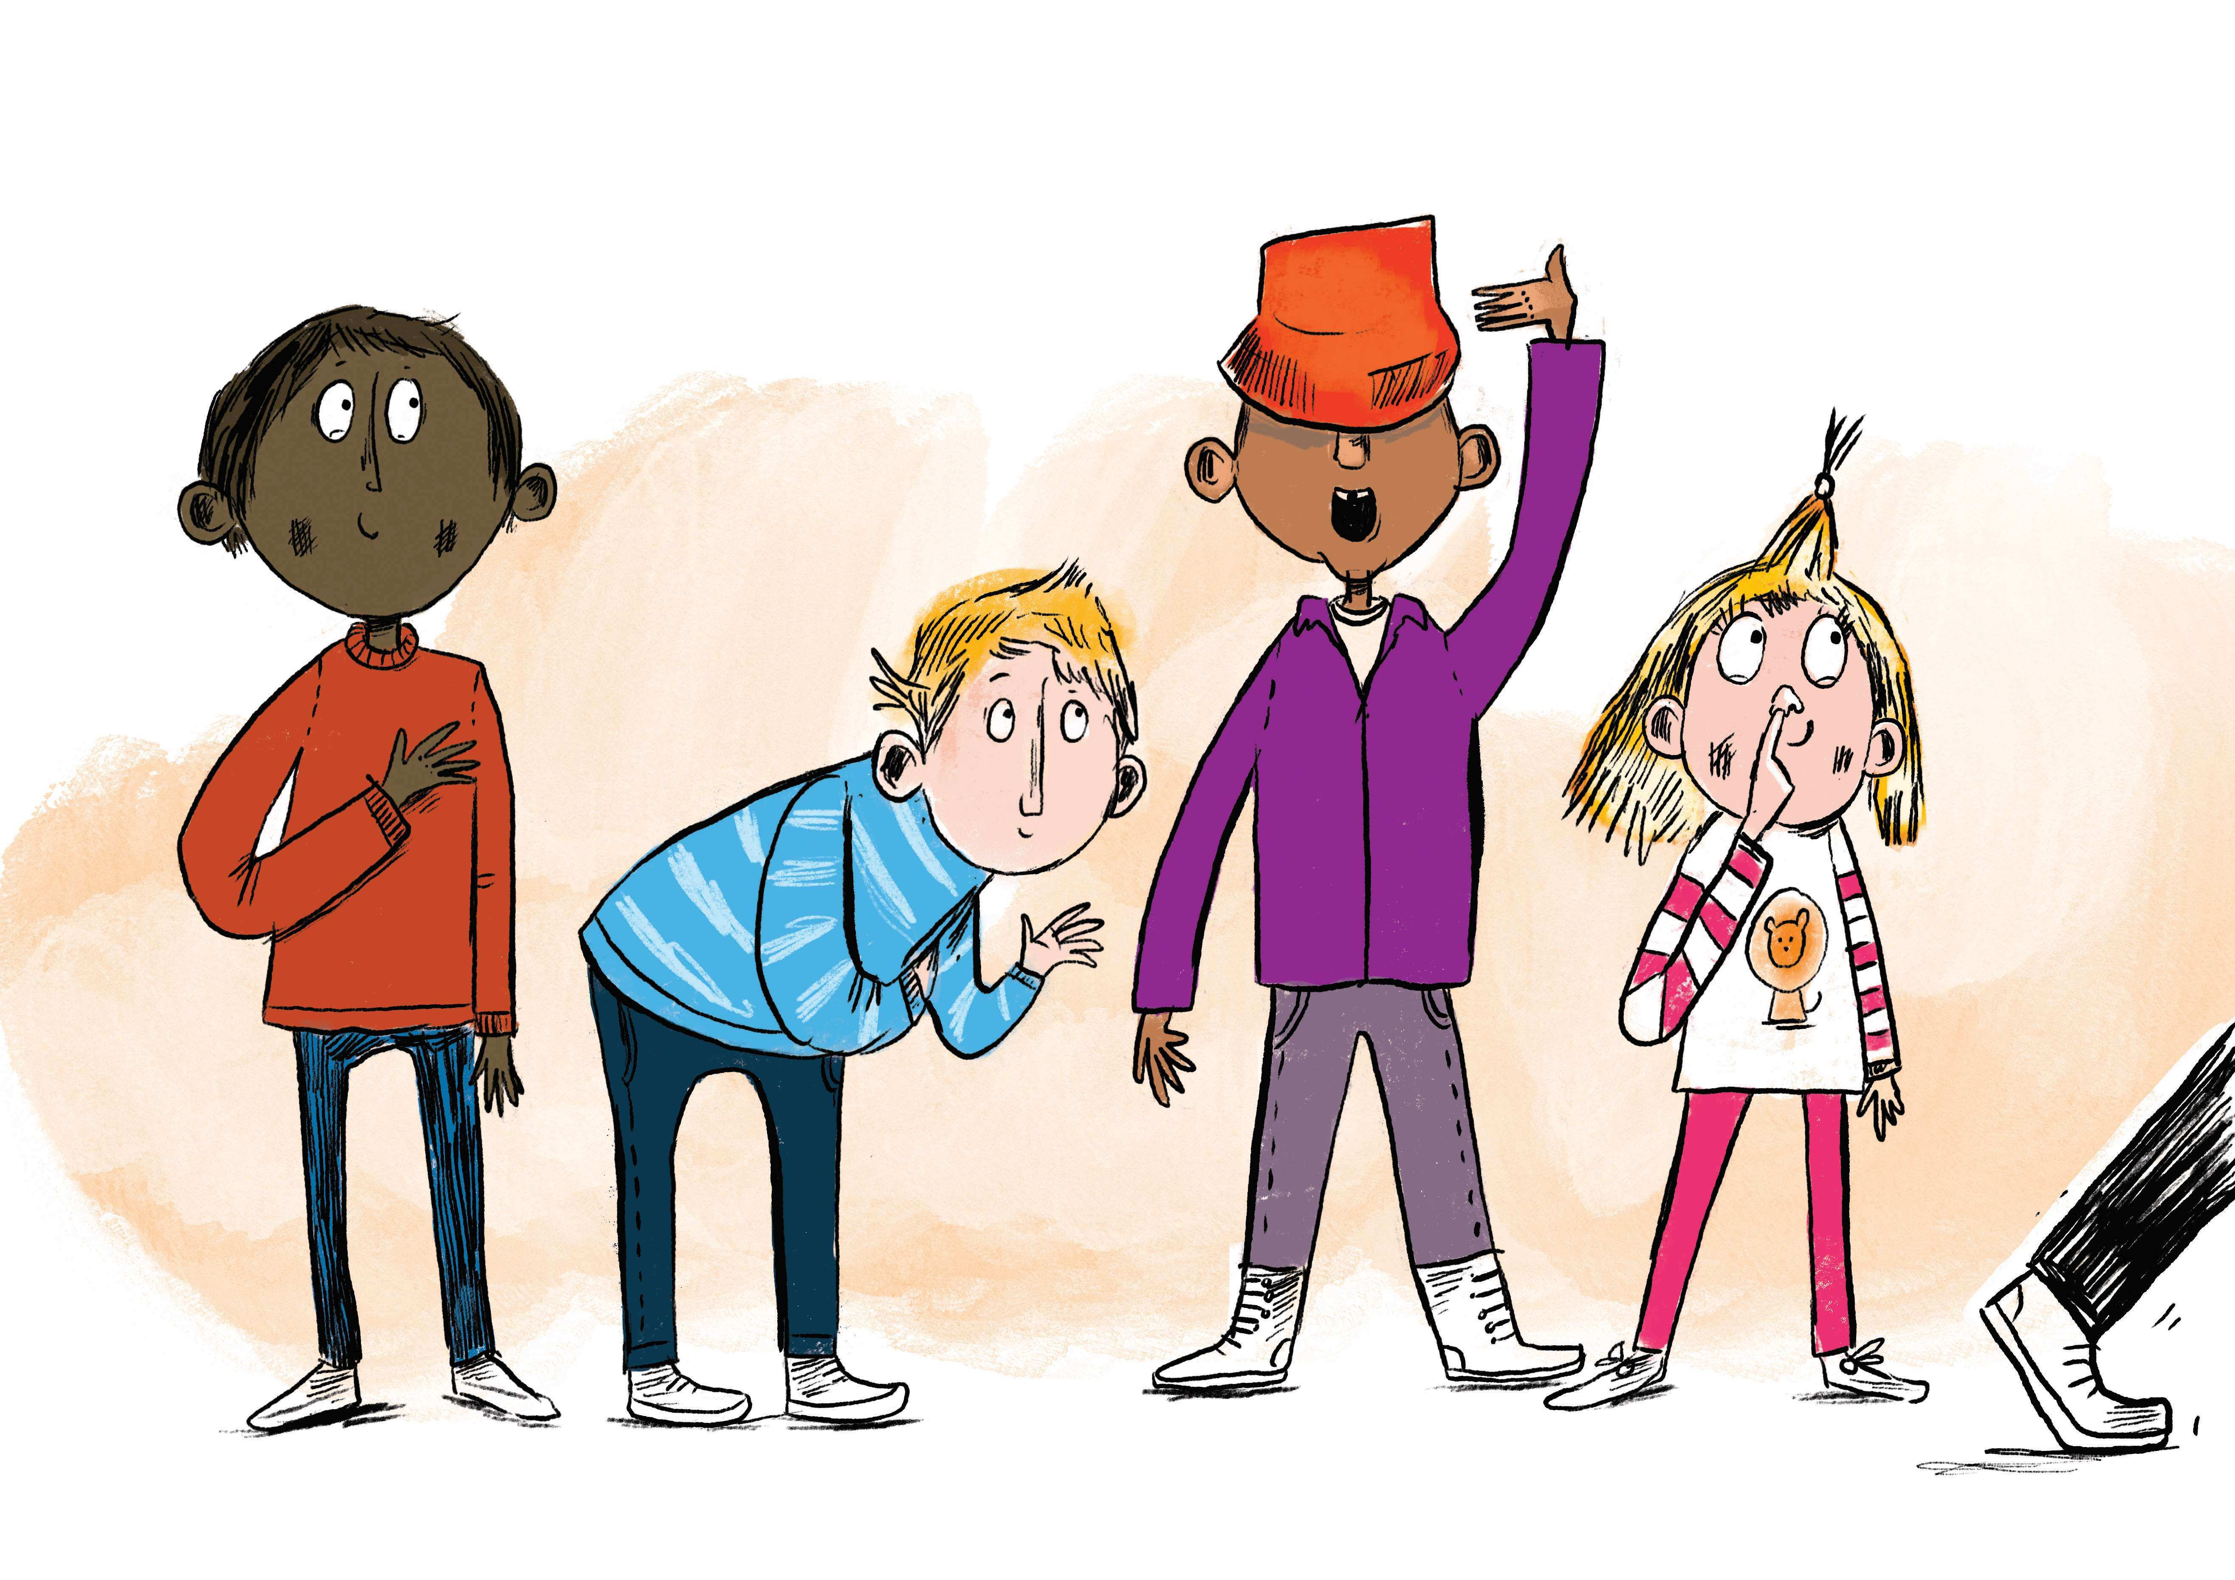
BB5
Respect

Slide 3

Intro Object

