Slide 1


Copyright © Spinnaker 2026

Slide 2
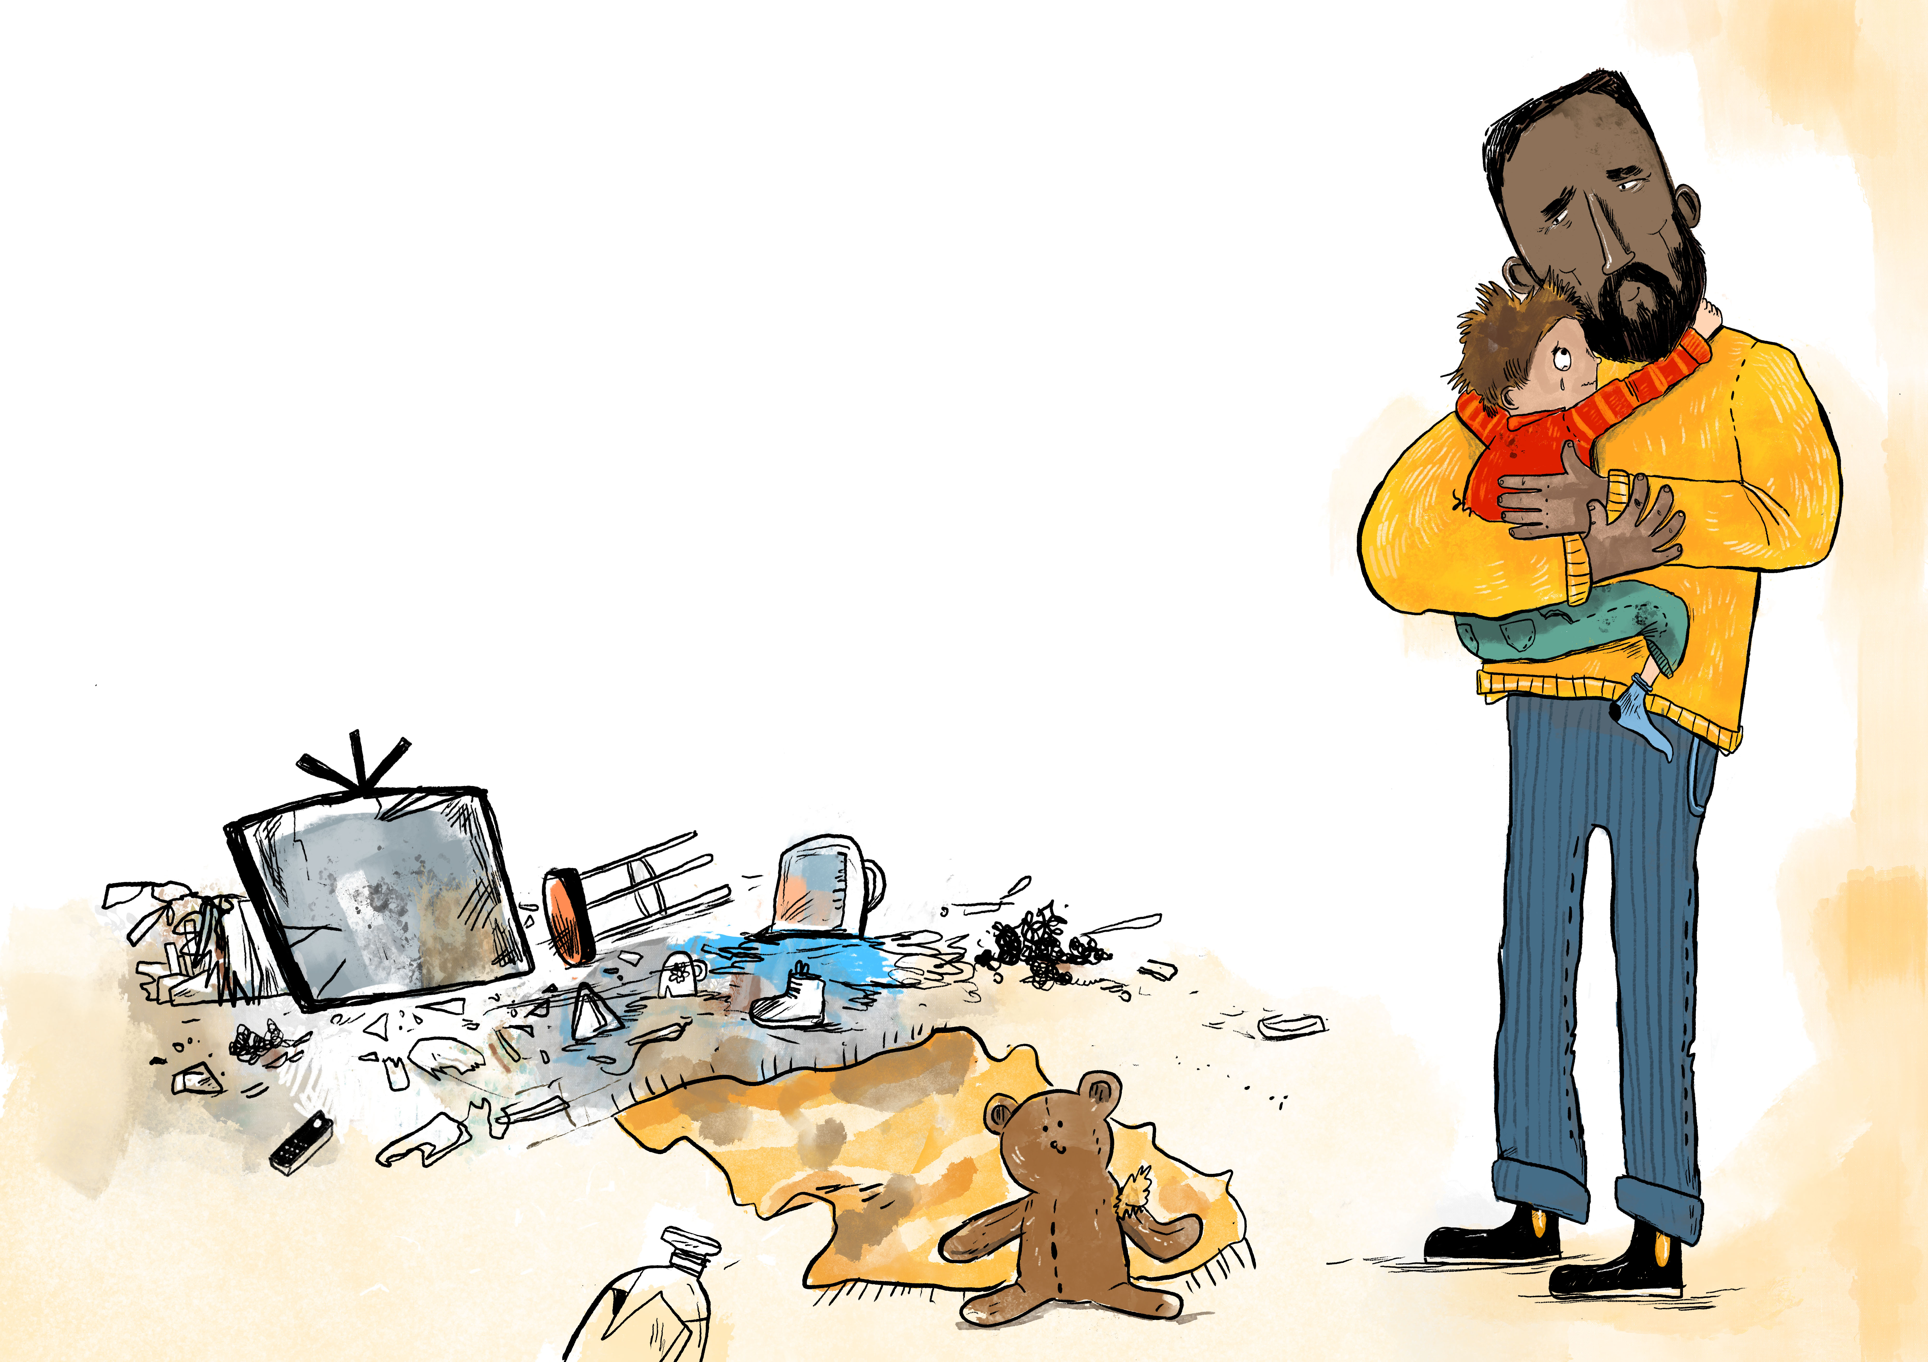
BB00
Grace

Slide 3

Intro

