Slide 1
Mar 6:30-44 The apostles gathered around Jesus and reported to him all they had done and taught. (31) Then, because so many people were coming and going that they did not even have a chance to eat, he said to them, "Come with me by yourselves to a quiet place and get some rest." (32) So they went away by themselves in a boat to a solitary place. (33) But many who saw them leaving recognized them and ran on foot from all the towns and got there ahead of them. (34) When Jesus landed and saw a large crowd, he had compassion on them, because they were like sheep without a shepherd. So he began teaching them many things.
(35) By this time it was late in the day, so his disciples came to him. "This is a remote place," they said, "and it's already very late. (36) Send the people away so that they can go to the surrounding countryside and villages and buy themselves something to eat.”
Bible Reflections
Part 1

Slide 2
(37) But he answered, "You give them something to eat." They said to him, "That would take more than half a year's wages! Are we to go and spend that much on bread and give it to them to eat?" (38) "How many loaves do you have?" he asked. "Go and see." When they found out, they said, "Five--and two fish." (39) Then Jesus directed them to have all the people sit down in groups on the green grass. (40) So they sat down in groups of hundreds and fifties. (41) Taking the five loaves and the two fish and looking up to heaven, he gave thanks and broke the loaves. Then he gave them to his disciples to distribute to the people. He also divided the two fish among them all. (42) They all ate and were satisfied, (43) and the disciples picked up twelve basketfuls of broken pieces of bread and fish. (44) The number of the men who had eaten was five thousand.

Slide 3
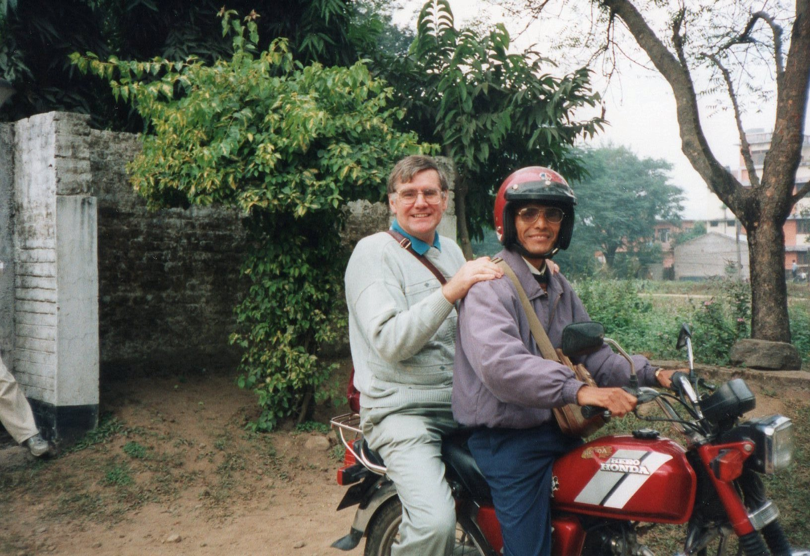
“My answer to poverty starts with what the poor have, not with what they don’t have”

Slide 4
Identifying with the disciples in their:
Personal call and
commitment.
Personal commission

Slide 5
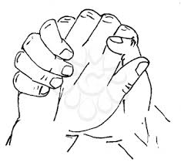
Compassion:
Spiritual poverty
– Given biblical truth
Physical poverty (hunger)
– Given something to eat
Compassion has to be linked with action
Challenge to the church is to be wholistic in addressing both spiritual and physical needs

Slide 6
Jesus challenging and changing mindsets.
“You give them something to eat.”
Problem or Opportunity?
The disciples:
Only saw what they didn’t
have.
Only thought what they
couldn’t do.

Slide 7
What about us?
Do we only see what we don’t
have?
Do we only think what we
can’t do?
Jesus replied - “How many loaves do you have? Go and see.” When they found out, they said, "Five—and two fish."
The answer to the problem starts with what we have!

Slide 8
For Reflection and Discussion
Share your testimony of
coming into a personal relationship
with Jesus.
What does your commitment to
follow Jesus look like today?
Jn 12:24, Rom 12:1, 2 Cor 4:10-12
How does this story challenge
your thinking, your mindset?
Prov 23:7. [KJV], Rom 12:2,
1 Peter 1:13

