Slide 1
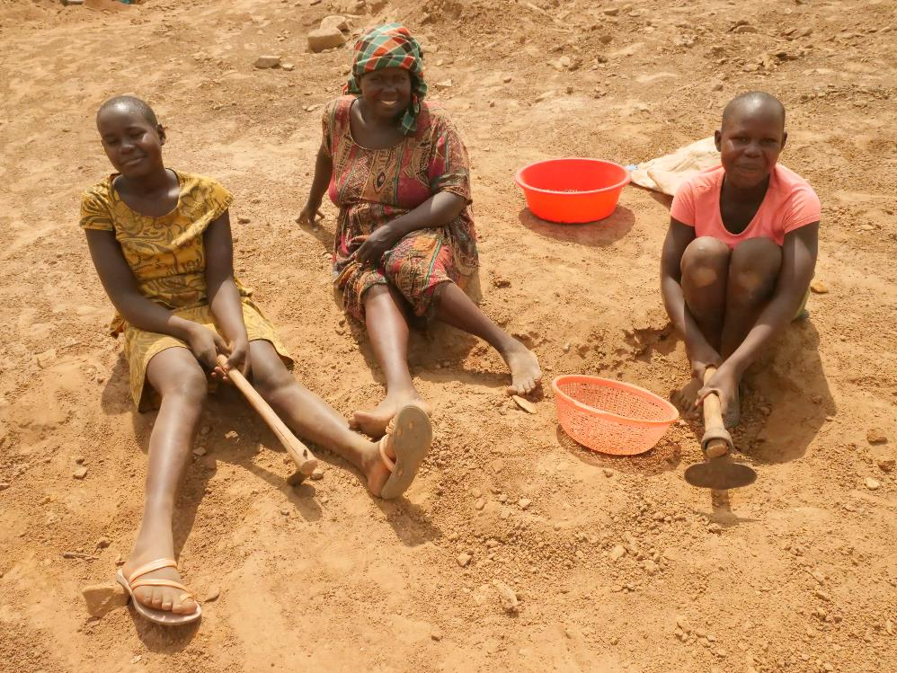
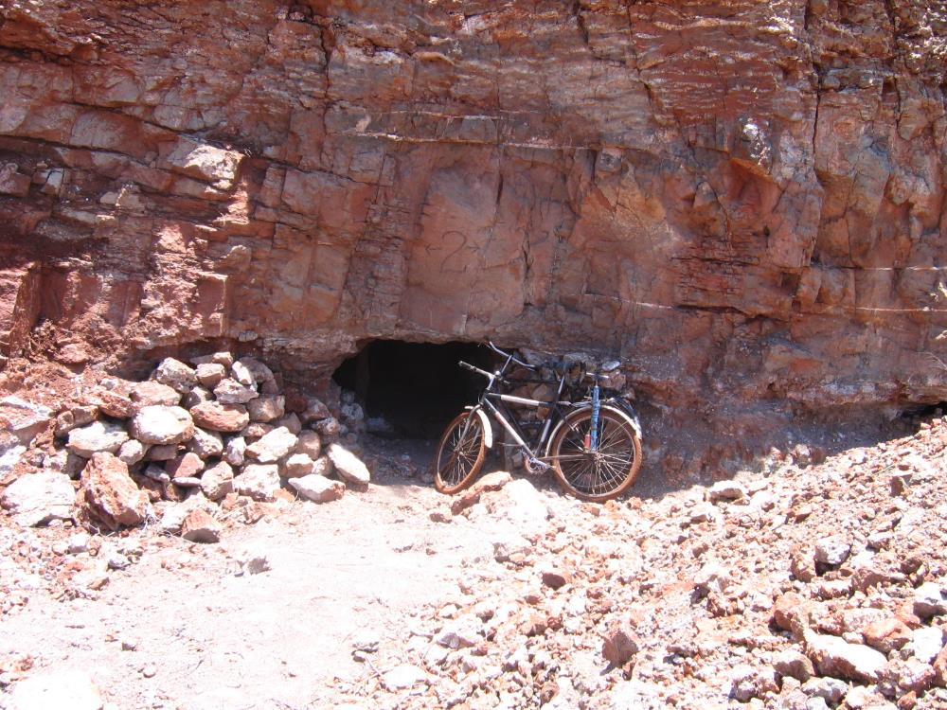
Fruit & Gold
Mining God’s Way Programme

Slide 2
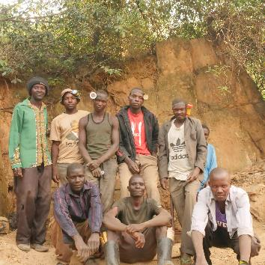
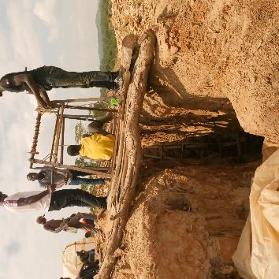
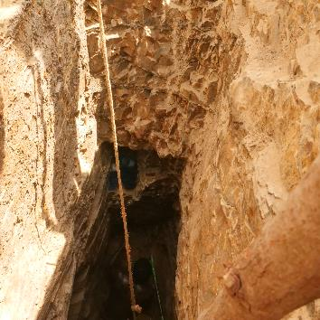
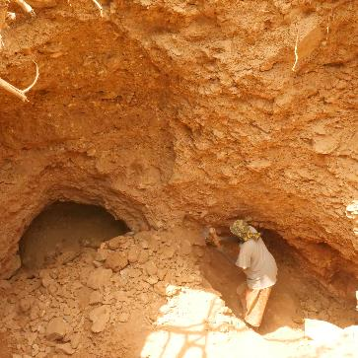
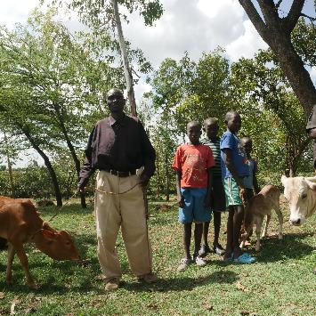
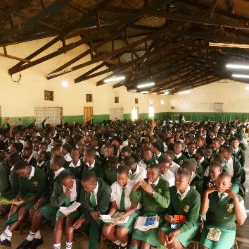
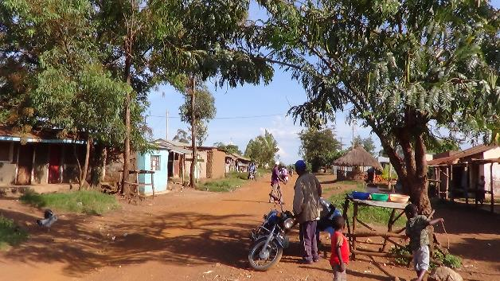
Masara Community
A GOLD MINING AND FARMING COMMUNITY IN WESTERN KENYA
80% of mining is illegal or semi-legal

Slide 3
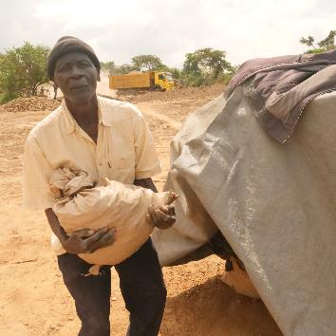
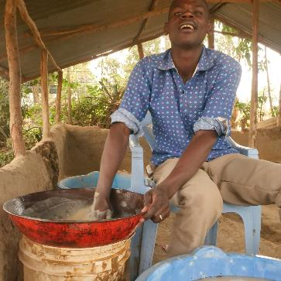
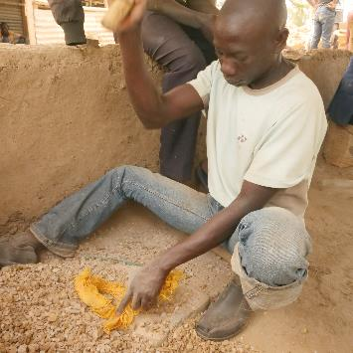
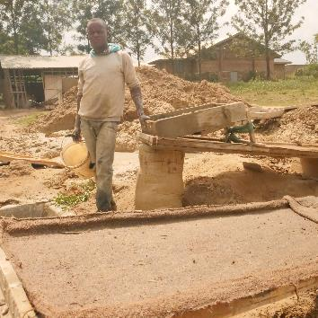
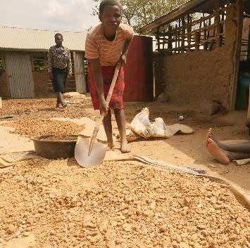
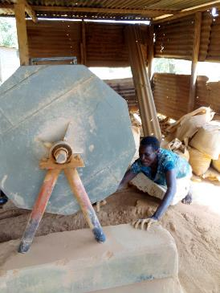
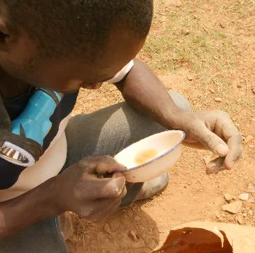
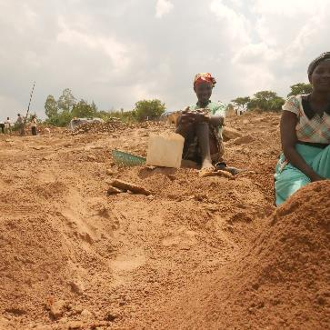
Masara Community

Slide 4
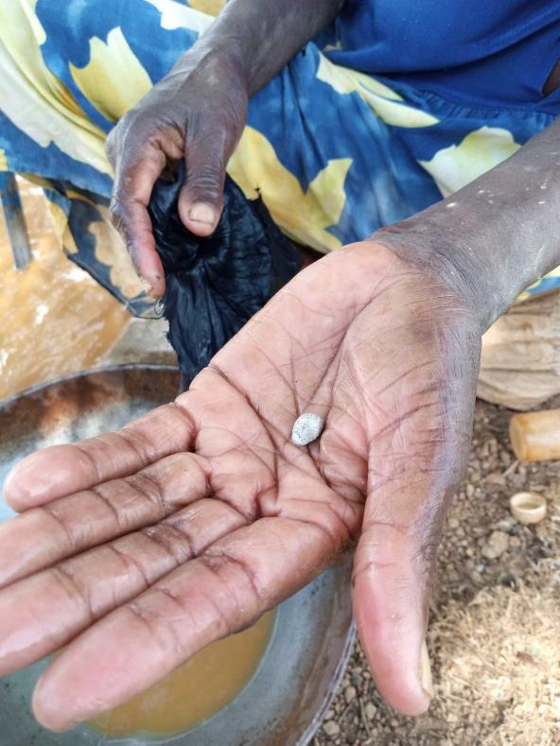
The point of it all: A few grams of gold

Slide 5
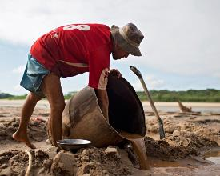
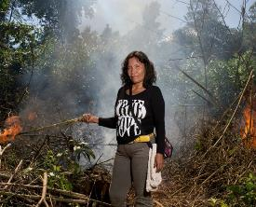
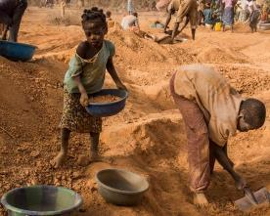
Poverty Driven Mining
A CYCLE OF POVERTY TRAPS MANY MININING COMMUNITIES
30% of global mercury emissions
7% of global deforestation
1,000,000 children in hazardous work
Economic
Poverty Cycle
Environmental
Social
Spiritual
80% of mining is illegal or semi-legal
High rate of fatality, drug use, domestic abuse, violence and prostitution

Slide 6
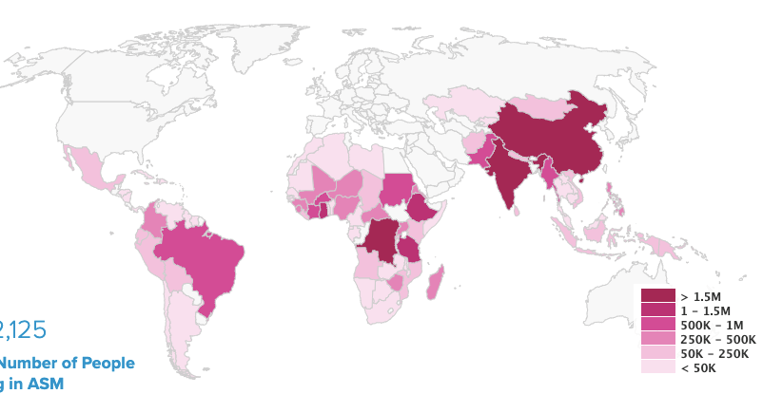
Scale of the Opportunity
OPPORTUNITY TO SCALE THE FIGHT AGAINST POVERTY TO REACH SOME OF THE WORLD’S MOST VUNERABLE COMMUNITIES
41,500,000 people working in poverty driven mining
Poverty driven mining is concentrated in developing nations
Poverty driven mining can be found in:
  10-20% world’s gold
  90% world’s colored gems
  90% of the minerals in your phone

Slide 7

It’s about livelihoods…
Easily accessible minerals, easily processed, easily sold.
Quicker returns and more reliable than farming.
Minimum tools, self trained.
£10 to £50 per day ( 2 to 10 points i.e. 1/5 to 1 gram of gold).
Puts food on the table, school fees paid, better houses…
Tax free, no profit, no savings, gold there tomorrow.

Slide 8
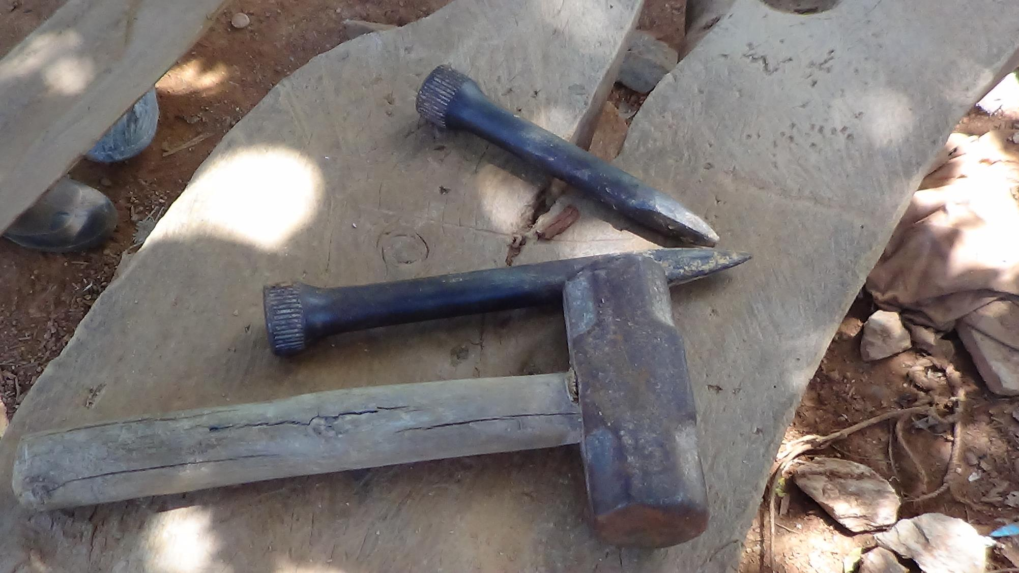

Slide 9
Production first…
Livelihood (the course of our economic life) means money. Minimum outlay means minimum income and minimum ESG.
Improved production means more money, however little.
Production equipment requires capital which is risky.
To go from a few grams a day sold locally, towards an exportable quantity of gold (e.g. 500 grams) requires working capital of say £25000, which is unimaginable.
All this before creation care (stewardship), fair trade, social justice and governance…

Slide 10
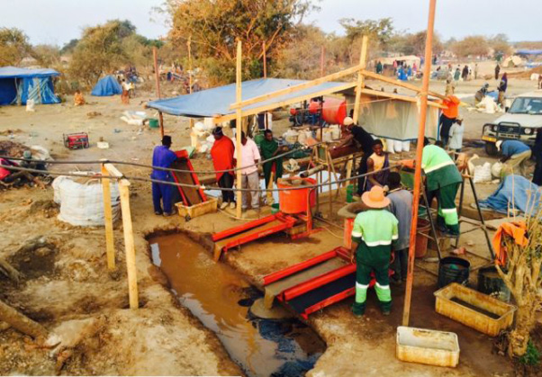
Miners are expected to bring their ore to a central processing plant:

Slide 11
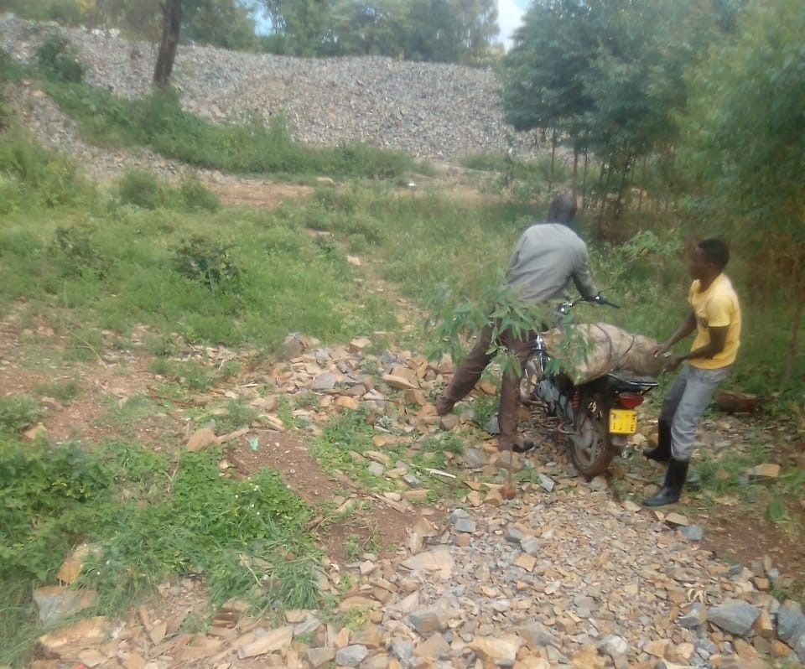
Sacks are between 20 and 50kgs:

Slide 12
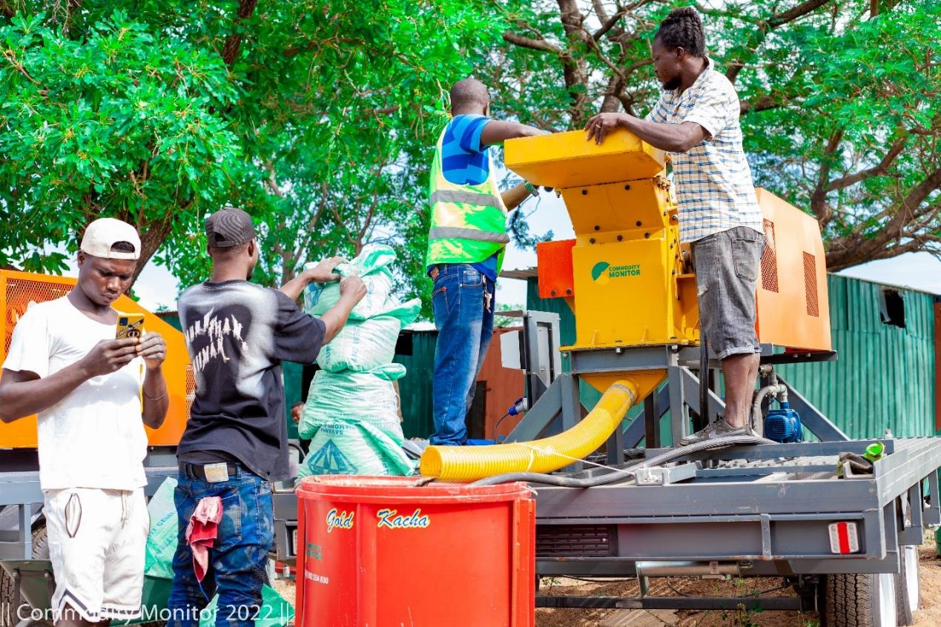
Why not take the equipment to the miners?

Slide 13
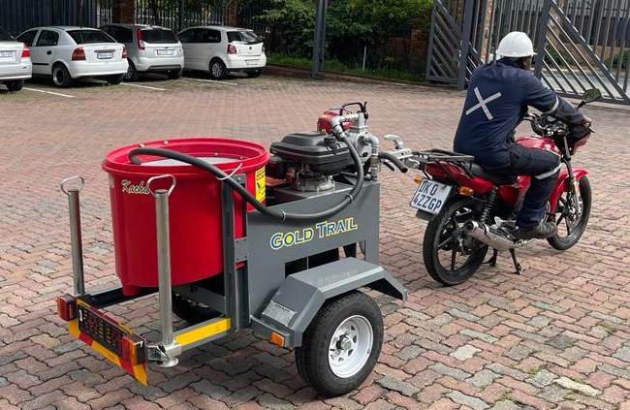
Mobile Equipment to serve the community
Gold Ore Concentrator:

Slide 14

2 Stages of Enterprise
Equip recommended local entrepreneurs with appropriate mobile equipment as their business i.e. local ownership for hiring on a pay per use basis (juokali). Equipment is kept overnight in business centres and its use accounted for.
Their operators can begin to buy small amounts of gold daily and return to town for aggregating into larger amounts through remelting and sold.
Once 500g or more are accumulated on a regular basis, we can export and auction to jewellers overseas for their use.

Slide 15




Breaking The Cycle of Poverty
THE UNDERLYING DRIVERS OF CHANGE ARE:
COMMUNITY ENTERPRISE
Community relationships provide the platform for mutual social and business support
Community enterprises enables a community to capture economic benefit of the resource extraction
Working practices safeguard workers, the environment and resource sustainability for ongoing livelihoods
Pastoral support has the power to transform the social, environmental and economic behavior of a community as it gains God’s perspective
Economic
Environmental
Social
COMMUNITY RELATIONSHIPS
Spiritual
WORKING PRACTICES
PASTORAL SUPPORT
Notes:
?

Slide 16
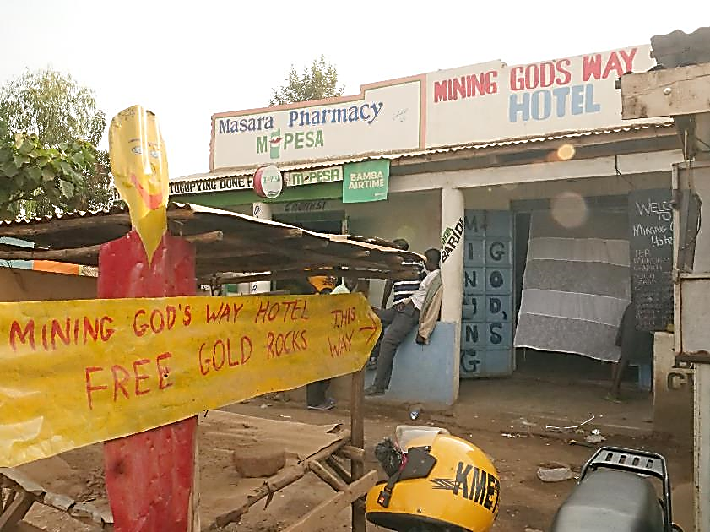
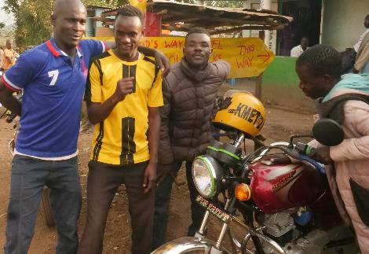
Community Transforming Services
WHOLESOME SOCIAL AMENITIES
Social spaces to encourage community cohesion and offer alternatives to bars and brothels
1.

Slide 17
Community Transforming Services
ENTERPRISE SUPPORT
Accountancy, legal and other technical assistance to strengthen small community enterprises
2.

Slide 18
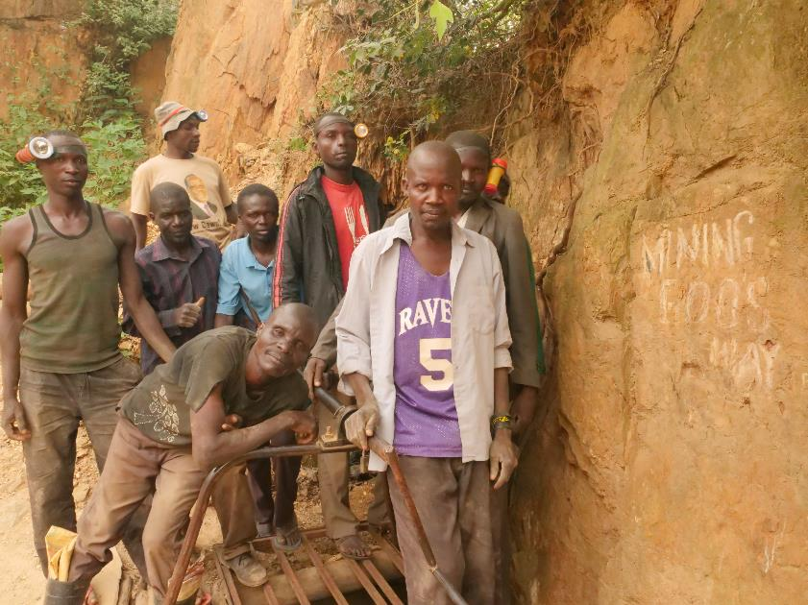
Community Transforming Services
APPLICATION OF BIBLE TO OPERATIONAL BEST PRACTICE
Training for community miners and farmers in environmentally sensitive, safe and profitable methods of operating using biblical principles as the framework for communicating the purpose of doing so
3.

Slide 19
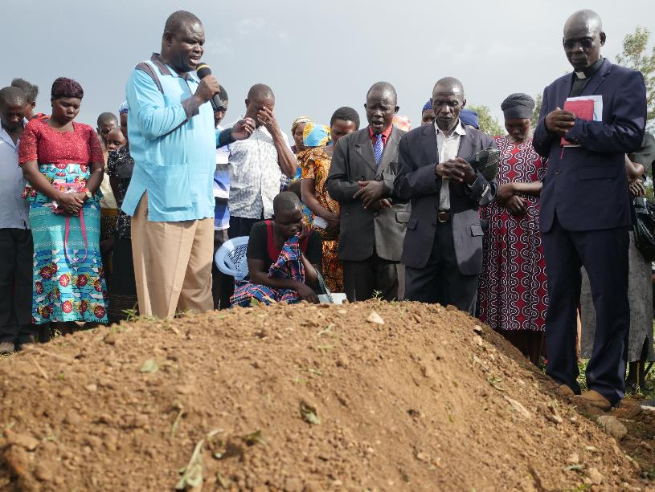
Community Transforming Services
CHURCH IN THE COMMUNITY
Pastoral care delivered in the community, to rural mines and farms and social spaces to improve access and increase engagement
4.

Slide 20
Measuring Success
WE WILL USE IMPACT METRICS TO PROVIDE AN INDICATION OF SUCCESS
1
Economic Resilience
1
Stronger Enterprises # of enterprises with improved business skills and a higher level of formalisation
Access to Social Amenities # people accessing wholesome social amenities
Improved Operational Practices # operations (a mine pit or field) using more environmentally sensitive, safer and more profitable methods
Engagement with Pastoral Services # people regularly interacting with pastoral support services
2
Breaking the Poverty Cycle
3
Environmental Safeguard
Social Cohesion
2
3
Spiritual Support
4
4

Slide 21
Where am I at this time?
Trying to go from vision to practice
I have a (very) draft Prospectus
I have the beginnings of cash flow spreadsheets
Seeking good people/ partners with experience
Needing help with preparing pitches
Needing help with a network of possible investors

Slide 22
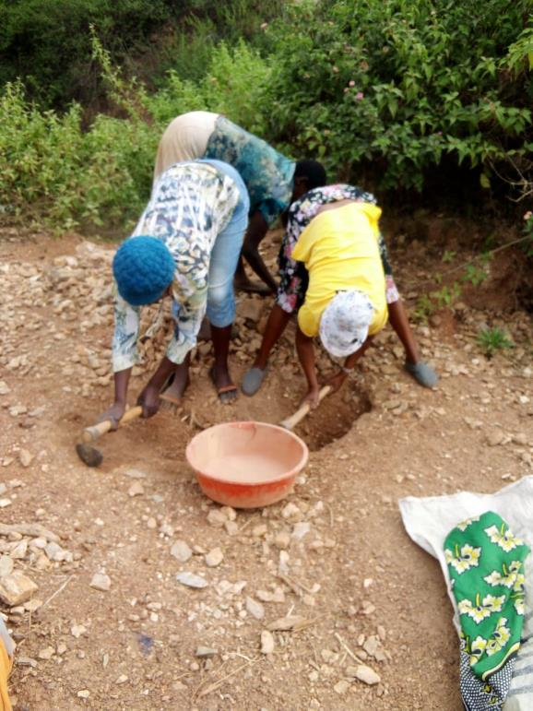
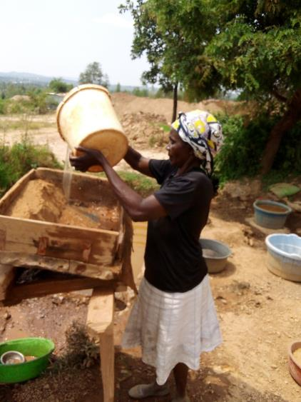
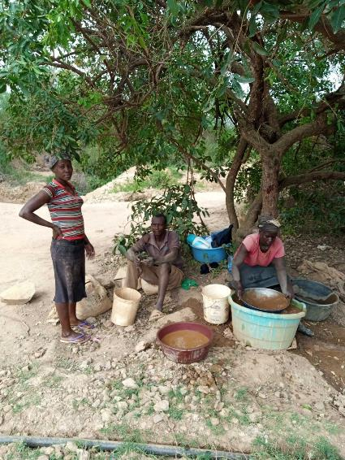
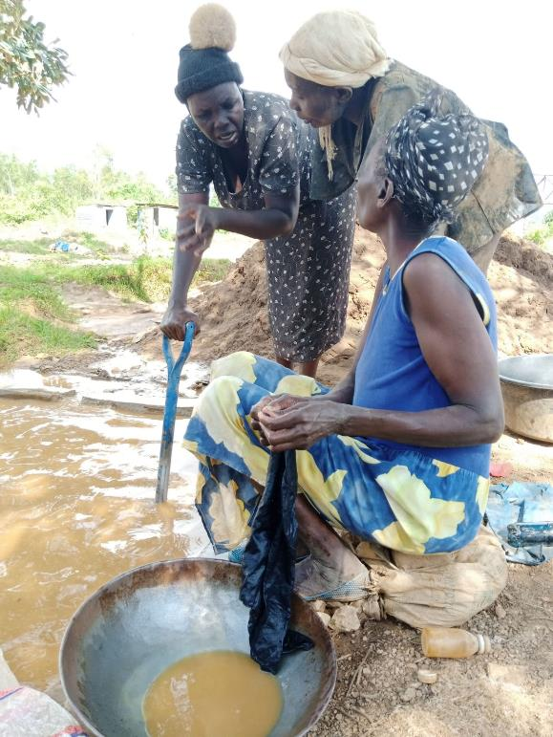
THANK YOU FOR YOUR TIME & INTEREST.
Any questions or comments?
CONTACT:
Terry Garde – terry.garde@gmail.com
LinkedIn, Facebook

