Slide 1
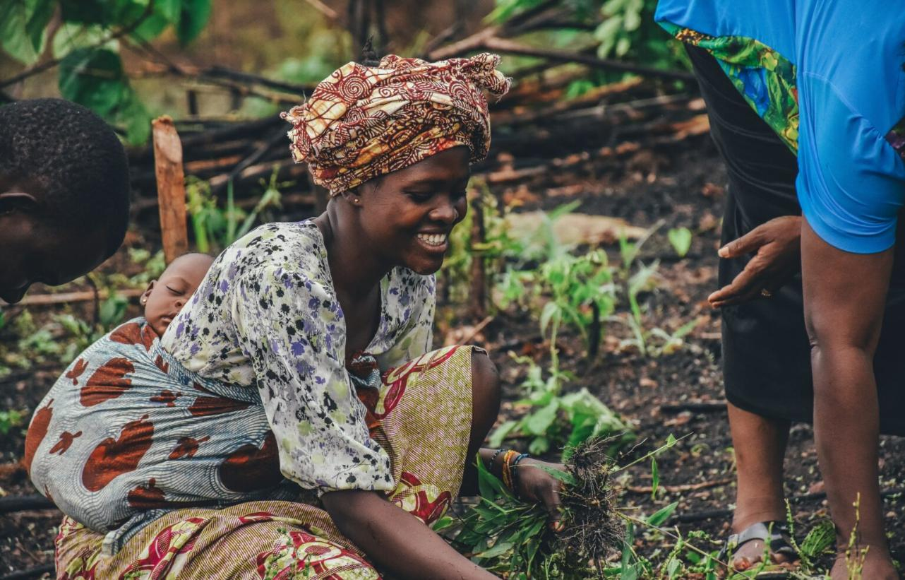

Notes:
The Problem The climate crisis is no longer a distant threat; it is disrupting lives and livelihoods today. Communities that contributed the least to global emissions are paying the highest price. To adapt, they need practical, locally-driven solutions; from climate-smart agriculture and clean energy to flood defences and drought-resistant crops. But there is a huge funding gap. Small and medium-sized enterprises (SMEs) that can deliver these solutions often fall into the “missing middle” of finance as they are too big for microloans, too small or risky for commercial banks. Without affordable capital, these businesses cannot scale, and communities remain exposed to the next climate shock.
The Solution The Resilient Futures Fund (CARFF) is Christian Aid’s innovative answer to this challenge. Instead of traditional one-off grants, CARFF will provide affordable loans and technical support to climate-focused enterprises in sub-Saharan Africa. These loans are repayable, and as they are repaid, the capital is reinvested into new projects, creating a revolving pool of funds that delivers impact again and again.
Our ambition is to target up to £20million by 2030 through public and private investments, and grants.

Slide 2

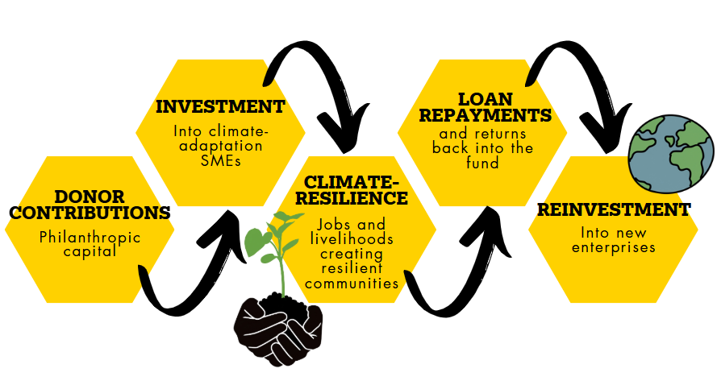
How does the
Resilient Futures Fund work?
Notes:
How does the Resilient Futures Fund work?
Donations are matched by Christian Aid and deployed into climate-resilient enterprises. As loans are repaid, capital returns to the fund and is reinvested again. This creates a permanent pool of catalytic capital supporting communities for years to come.
CARFF is (at this stage) a Philanthropically funded impact-first climate investment fund. Operating in phases, our ambition is to become a fully regulated investment fund raising both philanthropy and returnable capital.
By providing affordable loans and accompanying support to enterprises, The Resilient Futures Fund will support climate focused enterprises scale up, create jobs and build community resilience to climate shocks; boosting and stabilising the wider economy, and delivering climate focused goods and services.

Slide 3
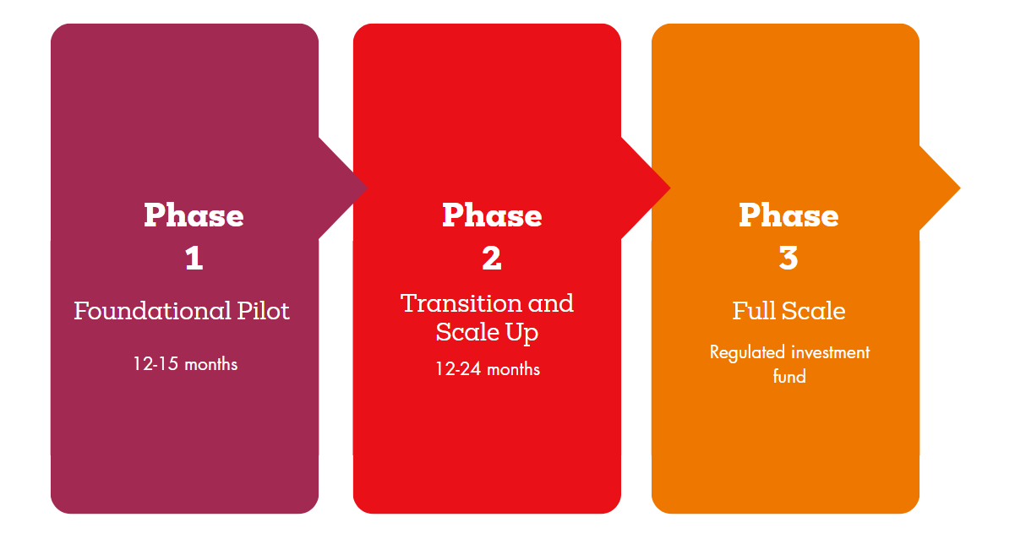
Notes:
We are starting with a phased approach.
Phase 1: is about proof of concept, demonstrating that the Fund can combine the heart of philanthropy with the discipline of investment to deliver measurable results. We will track both financial and social returns, reporting transparently on jobs created, women empowered, emissions reduced, and communities protected.
Phase 2: based on the success of the pilot, we will expand the Fund’s size and reach, raising additional philanthropic capital and potentially preparing for regulated investment.
Phase 3: our ambition is to grow the Fund into a £20+ million blended finance vehicle, attracting institutional and concessionary investment alongside philanthropy. This will enable us to back hundreds of enterprises, strengthen thousands of livelihoods, and create systemic change in climate resilience.
This approach spreads risk, taps into professional expertise, and ensures immediate deployment into high-impact projects. Every £1 donated is matched by Christian Aid’s commitment, invested, and recycled, multiplying its value over time.

Slide 4
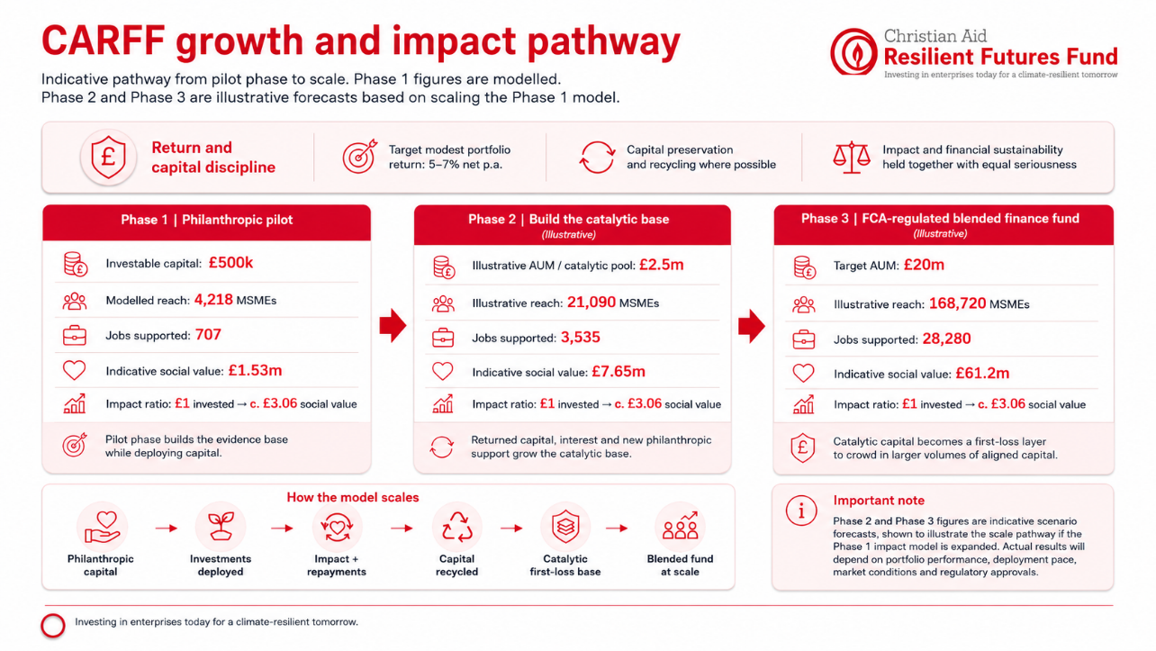
Phase 1 Funding
Notes:
Lots of figures, pulling out £500k to £1.53m

Slide 5
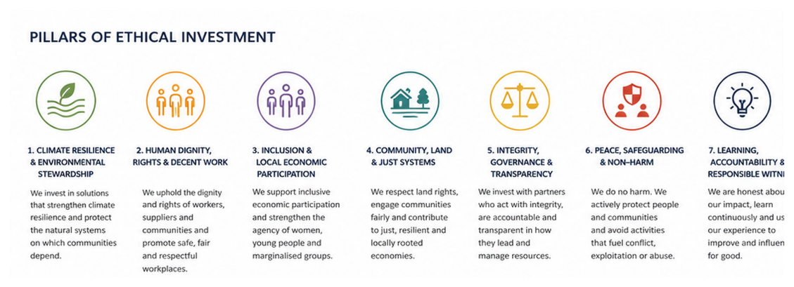
Ethical investment pillars
Christian Aid Resilient Futures Fund
Seven pillars of ethical investment
Ethics is central to our investment approach. It is part of the underlying logic and mission: who benefits, who bears risk, how power is exercised, and whether capital serves justice.
05
Ethical, Impact and Investment Framework

Slide 6
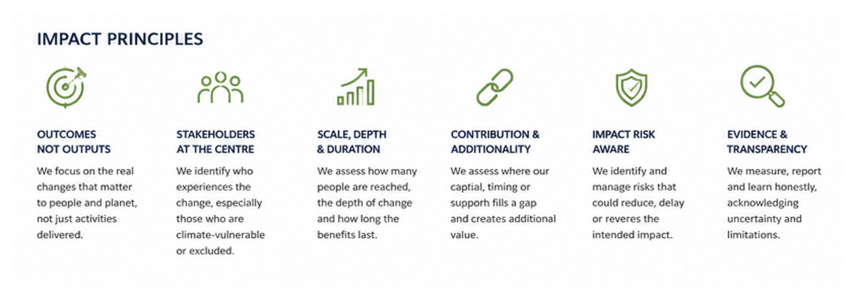
Impact measurement
Christian Aid Resilient Futures Fund
How we measure impact
CARFF measures impact as material change in social, economic or environmental conditions, not as activity delivered or capital deployed.
The discipline is simple: outcomes, stakeholders, scale and depth, contribution, impact risk, evidence and transparency.
08
Ethical, Impact and Investment Framework

Slide 7






Measurement discipline
Christian Aid Resilient Futures Fund
Impact reporting without overclaiming
Every material investment should pass through the same measurement spine, with assumptions and uncertainty made visible.
1. Define the outcome
4. Test contribution
State the material change expected, not the activity delivered.
Use capital, timing, capability and market-access gap analysis.
2. Identify who benefits
5. Apply confidence bands
Segment by role, income, gender, age and climate exposure where relevant.
Assess evidence, execution, external, endurance and harm risks.
3. Assess how much
6. Report honestly
Measure scale, depth and expected duration of change.
Separate outputs from outcomes, projected from realised, and contribution from attribution.
SROI supports donor reporting, but is not a standalone decision rule.
09
Ethical, Impact and Investment Framework

Slide 8
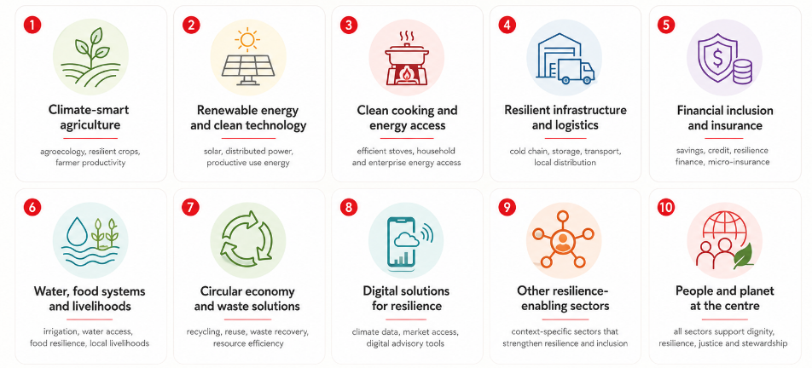
Sectors of focus
Christian Aid Resilient Futures Fund
Where the mandate meets markets
CARFF should prioritise sectors where resilience, inclusion and investability overlap.
Sector eligibility should always return to the question: does this investment materially improve climate resilience or inclusive economic participation?
11
Ethical, Impact and Investment Framework

Slide 9
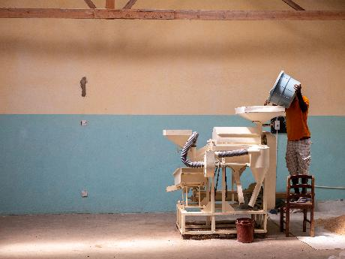
Investment selection
Christian Aid Resilient Futures Fund
Selecting enterprises
For direct investments, CARFF looks for enterprises that combine climate relevance, credible operations, investability and willingness to improve governance and reporting.
Indicative enterprise criteria
Criteria
Selection guide
Trading history
Usually 18–24 months+ operating history
Employees
Typically 5–100, with sector flexibility
Revenue
Visible recurring or contracted revenue
Growth ambition
Clear capacity to scale without mission drift
Leadership
Management willing to engage consistently
Financial visibility
Basic records and willingness to improve reporting
Investment potential
Ability to absorb repayable finance responsibly
10
Ethical, Impact and Investment Framework

Slide 10

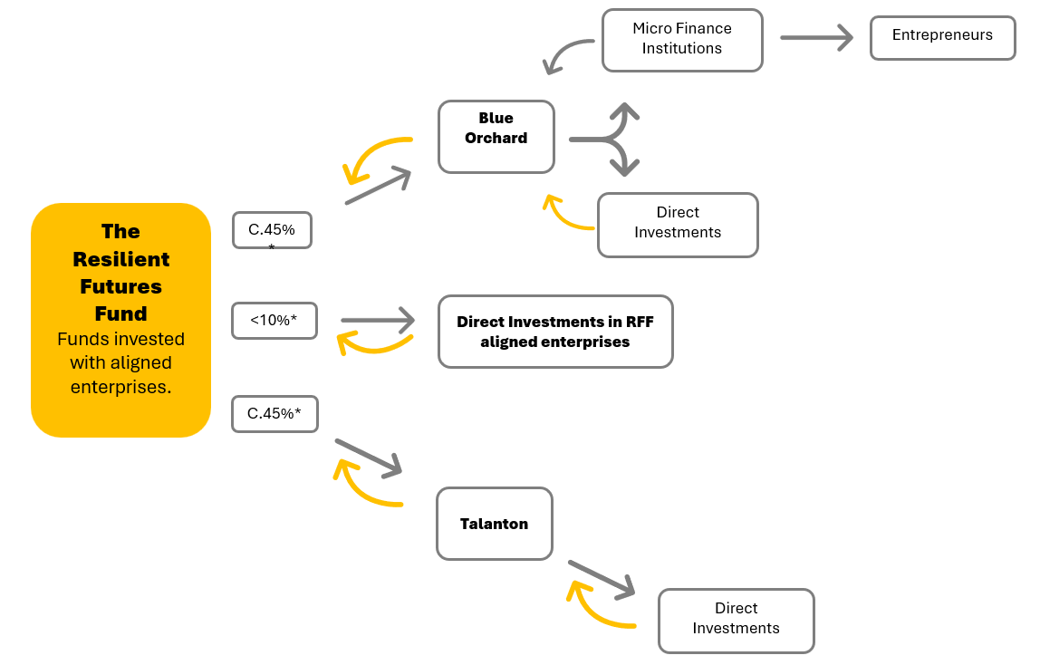
Fund management and direct investment
Notes:
The Resilient Futures Fund is partnering with two proven fund managers, each with a complementary focus, to build a diversified, resilient portfolio of projects:
Blue Orchard - A pioneering global impact investor with over 20 years of experience. BlueOrchard specialises in climate resilience finance meeting the highest level of sustainability regulation.
Talanton invests in growth-stage, values-driven businesses that uplift communities and especially women.
Whilst over 90% of the funds will be deployed in partnership with our fund managers, The Resilient Futures Fund investment committee may make some additional small investments directly into enterprises which are tried and tested local enterprises established by, or known to Christian Aid, with capacity for growth.

Slide 11

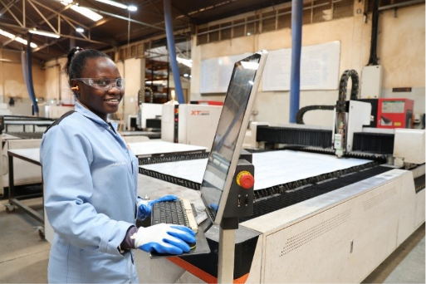
Burn Enterprise - Kenya
Notes:
Adlight works for BURN, an enterprise in Kenya supported by our fund manager Talanton. BURN is now the only vertically integrated modern cookstove company in sub-Saharan Africa. The solar-powered facility currently employs over 2,500 people, half of whom are women.
Among her proudest moments is one she remembers with a smile, being recognised as “Employee of the Month”. With stable income came stability at home. Adlight is now able to pay school fees for her 16-year-old niece, who she helped raise. She saves consistently every month with dreams in mind to build her mother a proper home and to start a small cosmetics business.

Slide 12
Questions?
Notes:
Adlight works for BURN, an enterprise in Kenya supported by our fund manager Talanton. BURN is now the only vertically integrated modern cookstove company in sub-Saharan Africa. The solar-powered facility currently employs over 2,500 people, half of whom are women.
Among her proudest moments is one she remembers with a smile, being recognised as “Employee of the Month”. With stable income came stability at home. Adlight is now able to pay school fees for her 16-year-old niece, who she helped raise. She saves consistently every month with dreams in mind to build her mother a proper home and to start a small cosmetics business.

