Slide 1
Supporting youth entrepreneurship in low- and middle-income contexts
Susy Ndaruhutse
Talk and discussion for TEN community
June 2022

Slide 2
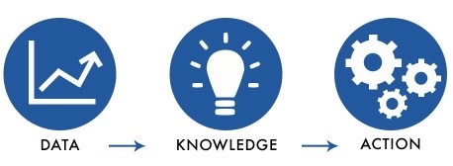
Situation as COVID-19 hit
1.8 billion young people aged 10 to 24 = 1/4 of the world’s population
One third are currently NEET – neither in employment, education or training
Of the one billion more youth that will enter the job market in the next decade, only 40% are expected to be able to get jobs that currently exist
Nearly 97% of all young workers in LICs and MICs are in the informal economy
Relatively few formal sector jobs mostly in public sector; little regulation and job security; often poorly/irregularly paid
Young entrepreneurs are often moving in and out of wage and self-employment, mixing their livelihoods portfolio
Source: UN’s World Youth Report: Social Entrepreneurship and the 2030 Agenda https://www.un.org/development/desa/youth/wp-content/uploads/sites/21/2020/07/2020-World-Youth-Report-FULL-FINAL.pdf

Slide 3
Livelihoods v growth entrepreneurs
Livelihoods entrepreneurs – driven by necessity, not choice
Subsisting not thriving
Tend to be low productivity, low earnings, underemployed with poor working conditions and often unable to move out of poverty
Often in agriculture or household goods (buying and selling)
Growth entrepreneurs – people who innovate and create jobs
Only a small minority of youth entrepreneurs

Slide 4
Opportunities for young entrepreneurs
Youth-led micro and small enterprises offer potential for job creation
Youth-led start-ups account for 50% of newly created jobs with founders often employing peers
Need an enabling business environment including:
Access to financial capital
Good business mentoring support
An understanding of the basics of business planning
Ensuring that business ideas are matched and linked to a country’s economic growth areas
Biblical financial stewardship principles – e.g. a culture/mindset of saving for future investment and stewardship; honesty and integrity in financial management

Slide 5
Challenges for young entrepreneurs
Lack of knowledge, skills and attitudes needed for success
Not completed secondary education or had the opportunity to go to university
Limited or no training in business
Limited access to social protection, networks, markets, physical assets and financing capital
No collateral making it difficult to borrow from commercial banks
High interest rates – average 34% in Africa, 28% in MENA and 22% in Asia for microcredit over period 2003-2015 compared to 8-20% range for commercial bank lending*
Limited social networks especially for the poorest
Youth businesses tend to fail at a higher rate than other businesses
*Source: A Survey of Microfinance Institutions and Informal Finance in Africa. https://www.sciencedirect.com/topics/economics-econometrics-and-finance/lending-interest-rate

Slide 6
Global trends and movements
COVID-19
Reset the paradigm of global business and of ways of working
Travel, climate, value for money, greater dependence on local partners
Black Lives Matter
Greater focus on diversity, equality and inclusion
Decolonisation (UK term)
“Localization” (US term)
Ukraine conflict and global food security
GLOBAL INTERCONNECTENDESS
Notes:
2014 no black executives in any of top 3 roles UK’s biggest companies and future pipeline was not likely to change this
https://www.theguardian.com/business/2021/feb/03/ftse-100-firms-have-no-black-executives-in-top-three-roles
2.4% of US businesses have Black owners while 12.8% of the US population are Black
https://www.lendingtree.com/business/small/black-owned-businesses-study/
Alone and together: Entrepreneurship and diversity in the UK
https://www.british-business-bank.co.uk/research-alone-together/

Slide 7
I Corinthians 12:12-31
Unity and diversity in the body
¹² Just as a body, though one, has many parts, but all its many parts form one body, so it is with Christ. ¹³ For we were all baptized by one Spirit so as to form one body—whether Jews or Gentiles, slave or free—and we were all given the one Spirit to drink. ¹⁴ Even so the body is not made up of one part but of many.¹⁵ Now if the foot should say, “Because I am not a hand, I do not belong to the body,” it would not for that reason stop being part of the body. ¹⁶ And if the ear should say, “Because I am not an eye, I do not belong to the body,” it would not for that reason stop being part of the body. ¹⁷ If the whole body were an eye, where would the sense of hearing be? If the whole body were an ear, where would the sense of smell be? ¹⁸ But in fact God has placed the parts in the body, every one of them, just as he wanted them to be.¹⁹ If they were all one part, where would the body be? ²⁰ As it is, there are many parts, but one body.²¹ The eye cannot say to the hand, “I don’t need you!” And the head cannot say to the feet, “I don’t need you!” ²² On the contrary, those parts of the body that seem to be weaker are indispensable, ²³ and the parts that we think are less honorable we treat with special honor. And the parts that are unpresentable are treated with special modesty,²⁴ while our presentable parts need no special treatment. But God has put the body together, giving greater honor to the parts that lacked it, ²⁵ so that there should be no division in the body, but that its parts should have equal concern for each other. ²⁶ If one part suffers, every part suffers with it; if one part is honored, every part rejoices with it. ²⁷ Now you are the body of Christ, and each one of you is a part of it.

Slide 8
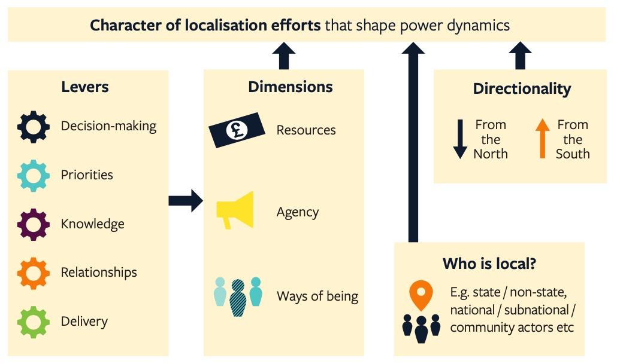
ODI’s framework for localisation
Source: Are we there yet? Localisation as a journey towards locally led practice: Models, approaches and challenges. https://cdn.odi.org/media/documents/ODI-SH-Localisation-Report-Oct21-Proof06.pdf

Slide 9
Discussion questions
Where can we add most value with our strengths, gifts and experience?
In what ways can we help young people move from being livelihoods to growth entrepreneurs?
Given we are likely to have relatively more power and resources, how can we ensure that we place mutual value on what we bring and what those we are working with bring? (Recognise unconscious bias and blind spots)
How can we build shared “one body” partnerships with the right “ways of being” and “ways of doing”?
How can we make our community, boards, etc. more diverse, representative and inclusive? (Intersectionality)

