Slide 1
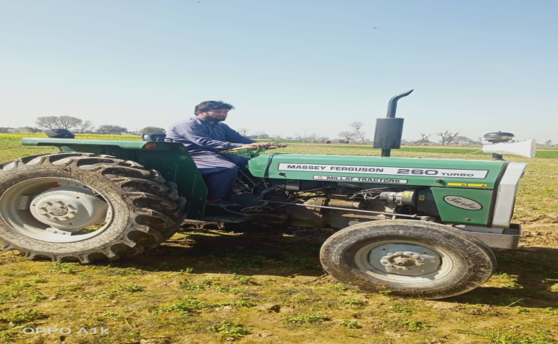
COOPERATIVES’ MEMBERSHIP AND WELLBEING OF FARMERS: AN EMPIRICAL EVIDENCE, BASED ON INTEREST-FREE TRACTOR SCHEME FOR BARANI AREAS, FROM DISTRICT NAROWAL. PAKISTAN
Presented By:
Munib-ur-Rehman
Cooperatives Department of Punjab. Pakistan.
For UKSC 2020 – 03rd Oct 2020

Slide 2
Table of Contents
Introduction
Cooperative Profile Of The Study Site.
The Interest-Free Tractor Scheme
The Impact – Wellbeing of Members
Findings & Recommendations

Slide 3
Introduction
Cooperatives- A proven initiative of
Self help and mutual aid aiming at uplifting of its followers
Ensuring Food Security
Empowering Women
Providing Affordable Finance to its members
Creating Decent Jobs
Social Strength and Decision Making
Efficaciously addressing the common economic, social, and cultural needs and aspirations of the members

Slide 4
Cooperative Profile of Study Site
District Narowal (Punjab, Pakistan)
All Cooperatives are agricultural Cooperatives
Name of Tehsils | Total No. of Villages | Villages with Coop: Socs: | Villages without coop Socs:
Narowal | 419 | 141 | 278
Shakargarh | 788 | 209 | 579
Total:- | 1207 | 350 | 857
Name of AR | No. of Agri: Socs: Ltd: & Un-Ltd: | Membership | Share Capital | Working Capital
Narowal | 164 | 4153 | 0.495 | 10.372
Shakargarh | 250 | 10930 | 1.174 | 12.865
Total:- | 414 | 15083 | 1.669 | 13.237

Slide 5
Crop loaning as on 1/1/2020 ( in Millions)
Name of Tehsil | Total Amount Advanced | No of Societies | No of Borrowers
Narowal | 63.85 | 42 | 165
Shakargarh | 55.09 | 34 | 134
Total | 118.94 | 76 | 299

Slide 6
The Project – Govt intervention
Initiated in 1979. Revived in 2017-18 with allocation of funds of Rs 70 Millions
Main objective of govt. intervention: Strengthening the Cooperative Institutions of Baarani Areas
Baarani Areas. 13 notified District of Province of Punjab irrigated through rain water
District Narowal, the Study site, is one of the Baarani Area District.
Applicants’ contribution is 20% of the cost of tractor. Remaining 80% amount to be provided under the project without any markup.
In the first phase 98 tractors were provided in all 13 Districts. 15 were allocated in our study site.

Slide 7
Conti…
11 out of 15 tractors were delivered and 04 applicants were disqualified during scrutiny.
The initiative is contributory towards revival of cooperative movement, resource creation & uplifting of the beneficiary members.
The tractor provided under the project are being used in cultivation and carriage transportation.
The project is significant in revival of Cooperatives. Most of Cooperatives were stagnant and engaged in getting agri credit from Cooperative bank. This project led them to act out of box.

Slide 8
The Study
First ever initiative, aimed at mapping the impact on economic betterment of members and strengthening of cooperative institutions.
Qualitative epistemologically.
FGT was used for investigation
Two FGs (FG1- 09X field staff of Cooperatives at study site, and , FG2 – 09x members of Cooperative societies, five out which were the beneficiary of interest free tractor scheme from District Narowal) were conducted
Study frame was adapted from the work of Musa Hasen Ahmed and Hiwot Mekonnen Mesfin (2017) with Cooperative membership as Independent Variable and Wellbeing as Dependant Variable.
The study particularly addresses role of govt intervention for cooperative movement strengthening, presents the following propositions :-

Slide 9
Cont…..
Cooperatives have the potential to address the economic issues at individual as well as collective level.
Cooperatives are still far behind from self sufficiency and require external intervention to sustain and invite attention of the masses.
Governmental /external interventions motivate the adherence of members to the cooperatives.
Lack of understanding of Cooperative System is leading towards its dormancy. External interventions surely create awareness on Cooperatives.
Cooperatives may bring prosperity, wellbeing in alternative words, to individual members through collective action. Individual wellbeing will bring collective wellbeing.
Inefficiency of Cooperative Field Staff, lack of coordination between societies and field staff and improper government policies with indifferent priorities are some major causes of failure of the Cooperative societies in meeting their objectives, thus remain deficient in getting desired results of members’ wellbeing.

Slide 10
Wellbeing
AIHW’s framework on Welfare and Wellbeing (2019)

Slide 11
Determinants of Wellbeing
Determinants of Wellbeing, based on AIHW’s framework

Slide 12
Emerging Themes
Themes from FG1 | Themes from FG2
(1). Sustainability of the Coop Sub-themes: (a).Triggers of stagnation leading to failures (b). Possible solutions. (c) Developing members’ interest. (d) attraction of general public | (1). Problems and hurdles in smooth running of the Coops Members are resource-poor Least participatory members Lack of coordination between societies and the department
(2). Dynamics of Coops Sub-themes: (a).Composition (b). Benefits/Advantages (c). Disadvantages (d). Leadership/administration | (2). Significance of Coops government interventions are necessary Motivation to join the coops Financial Security

Slide 13
Findings
The study was challenging and helpful in framing of policy for cooperative movement.
Cooperative enable the people to be self reliant
The project in hand energized the cooperatives by implementing operational activities like holding of AGMs, conducing of financial audits, accountability of managing committees etc. inducing trust on the organization resultantly. Also did capacity building of regulatory regime and cooperative societies.
cooperative membership is guaranteed solution to many of the problems faced by farmers community through a collective action, as is evident from implementation of interest free tractor scheme which provided financial security, employment, enrichment in income, enhancement in productivity
Another aspect which transpired out of group talks was that members are not limited to availing benefits out of such schemes, they keenly take part in other organizational activities and contribute to strengthen their cooperatives.
The implementation of the project caused better agriculture, resulting in better income which eventually leads to better living i.e wellbeing to the members.
This intervention brings resilience in Cooperative Institutions

Slide 14
Recommendations
Subsidiary schemes like the one studied through this investigation bring financial and social health at institutional and individual levels
The government interventions like the one studied here help achieving self-reliance. Therefore it is recommended that Cooperatives must be organized as per modern day needs and interventions be kept on introduced on participatory basis to ensure food security, institutional strengthening and economic betterment through cooperatives besides strict monitoring and evaluation for proper implementation of such interventions.

Slide 15
Thank You

