Slide 1
Marketing organic farmers’ cooperatives in Russia: cases and policy recommendations
Artur Rykalin (RUS)
Eurasian Centre for food security
Moscow State University,
Consumer cooperative «National Health»
E-mail: artrykalin@yandex.ru

Slide 2
Research problem
Organic
High certification costs
Cooperatives
20 mln. SME’s in rural areas with weak market power
Lack of technologies and training
Low physical and economic accessibility
Too long food supply chain with price disparity
Young institutional framework
Demand constraints
Bad historical reputation
Legal limitations of form
Deficit of sound business models
Grant not result orientation

Slide 3
Cooperative tool for organic farmers
Combination of individual efficiency and cooperative economy of scale
Complementary not competing sector to dominant agriholdings
Reduced costs and price within shorter supply chain
Policy measures for the accelerated and sustainable development of organic farmers’ cooperatives

Slide 4
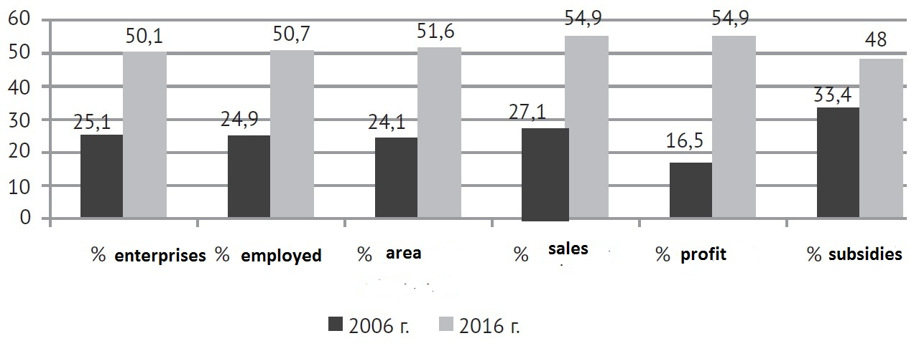
Share of one founder agrarian enterprises to all
№ 33 among 90
Decollectivization, capital concentration, inequality. 1990 – 500 shareholders in average; 2016 – 1,5% of enterprises with more than 100 founders, 2-5 founders are in 30% of enterprises.

Slide 5
Agricoop’s bottleneck?
Coping with democratic governance
For grants or for farmers?
Advantages or tax and regulation burden?
Pro and contra of subsidies
Compliance with all cooperative procedures
Deficit of specialists and management models

Slide 6
Case study: induction
Firm level: marketing cooperative
Industry level: other Russian and foreign cases
Country level: policy recommendations
Eurasia level: Armenia and other countries

Slide 7
Case study: marketing cooperative
Market not grant orientation, demand and sales focus, 10 years
Urban, long-life organic products, 40 active suppliers monthly, 24 workers
Wholesale, retail, offline, online, 165 buyers per day
Multifunctional: sales, marketing, investments
Learning and training by doing, rural-urban cooperation, Solawi and CSA
Small business incubator

Slide 8
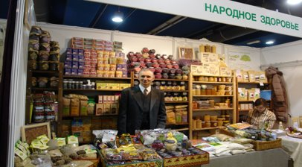
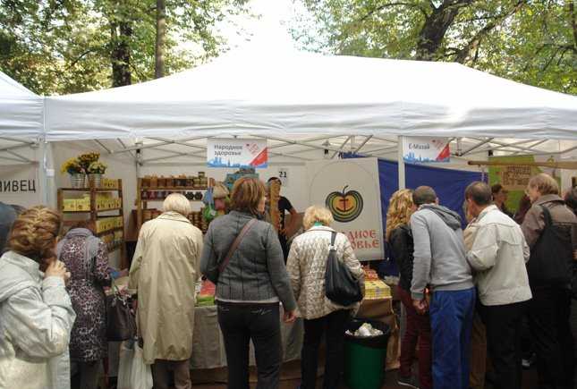
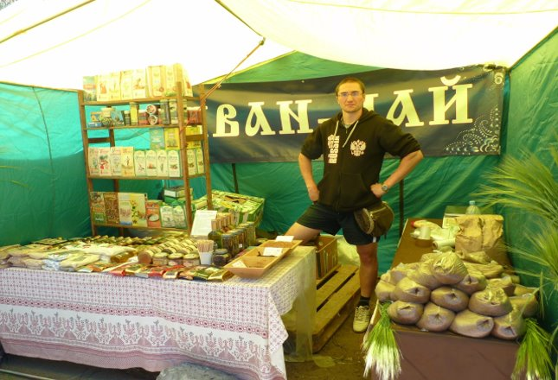
Case study: marketing cooperative

Slide 9
Policy options
Legislative simplification
Tax preferences
Network of advisory services and training
Trade infrastructure
Demonstrative network
Internships
From support to stimulating

Slide 10
Policy recommendations: managing cooperatives is easy and profitable
Institutions: limit the subsidiary liability; simplify registration, managing and reporting; eliminate double taxation; protection from excess regulation; legal form for solawi.
Economy: tax deduction for organic farmers selling their produce through cooperatives; retail infrastructure; social tax free for employee-members; state institutions purchases.
Education: refresh training on the basis of the Russian University of Cooperation; best world practices; internships in advanced organic farms and coops; demonstration network.

Slide 11
Stakeholders
Consumers: lower prices for organic quality, sharing risks and finance
Rural MSME’s: competing with giants via community models
Supply chain participants: more supply and growing fashion
Government and NGO’s: grants optimization, defense from large competitors and regulation
Agriholdings: contract production, integration, different segments, raiding

